Slide 1
Primary hemophagocytic Lymphohistiocytosis – A Review of Management
Christopher L. Cornett II, Pharmd
Baptist Health Louisville – Hematology/oncology pharmacy specialist

Slide 2
Disclosure of relevant financial relationships
Dr. Christopher Cornett II has no relevant financial relationship(s) with ineligible companies to disclose.

Slide 3



Objectives
Recognize pathophysiology and key clinical diagnostics of hemophagocytic lymphohistiocytosis (HLH)
Identify primary and refractory management strategies in primary HLH
Interpret clinical trials associated with refractory management of primary HLH

Slide 4
Prevalence
Prevalence varies widely. In Sweden, incidence of primary HLH in children is estimated to be approximately 1 case per 50,000 births
  In 2018, England estimated the incidence of all forms of HLH in adults to be 4.2 cases per 1 million
National Inpatient Sample reported 16,136 adult HLH admissions between 2006-2019
  Annual percent change (APC) over the study period of 25.3% (APC 25.3%, CI 20.1-30.7%, p < 0.0001)
  Reported mortality of 18.4% (n=2966) during hospitalization
Based on CDC WONDER, 2,724 HLH-related deaths occurred from 1999 to 2020, with an overall age-adjusted mortality rate (AAMR) of 0.0295 per 100,000
eClinicalMedicine, 2023; 62.
The New England Journal of Medicine, 392(6), 584–598.

Slide 5
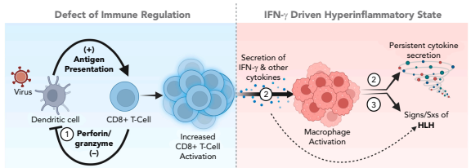
Pathophysiology
Deficient perforin/granzyme function impairs regulatory functions between dendritic cells and CD8+ cells
Dysregulated T-cell activation leads to hypersecretion of cytokines, including IFN-γ
Abundant secretion of cytokines leads to widespread macrophage activation and further persistent cytokine secretion
Blood 2026; 147 (10): 1019–1036.

Slide 6
Genetic Influences
Granule Mediated Cytotoxicity
PRF1
UNC13D
T-Cell Signaling
SH2D1A
MAGT1
Macrophage Function/Signaling
HMOX1
SLC7A7
Inflammasome Function
STX11
STXBP2
LYST
CD70
CD27
ITK
XIAP
NLRC4
CDC42
Blood 2026; 147 (10): 1019–1036.

Slide 7
Historical nomenclature
Primary HLH (pHLH)
Secondary HLH (sHLH)
Familial HLH (fHLH)
Genetic immunodeficiencies with HLH as the primary manifestation, typically outside of the granule-mediated pathway
Genetic immunodeficiency within the granule-mediated cytotoxic pathway (e.g. PRF1, UNC13D, STX11, STXBP2)
Driven by trigger and varying etiologies without identifiable genetic defects
Oncologic, rheumatologic, and infectious etiologies
Blood 2026; 147 (10): 1019–1036.

Slide 8
Paradigm shift
Primary HLH
Secondary HLH
Historically considered a dichotomous disease state
Advancements in genetic sequencing revealed genetic alterations that may predispose patients to secondary HLH
  Cetica et al observed 43 patients with secondary HLH with monoallelic mutations suggestive of reduced perforin function
HLH Spectrum
Multifaceted nature supports threshold theory for HLH etiology
Blood 2026; 147 (10): 1019–1036.
Blood 2026; 147 (10): 1037–1047.
The Journal of Rheumatology, 40(6), 761–767.
The Journal of allergy and clinical immunology, 137(1), 188–196.e4.

Slide 9
Threshold Theory
HLH
Genetic defect
Inflammation
Infection
Threshold
Primary HLH
Infectious Secondary HLH
Inflammatory Secondary HLH
The Journal of Rheumatology, 40(6), 761–767.

Slide 10
clinical manifestations
Unexplained Fevers
Cytopenias
Organomegaly
Hypertriglyceridemia
Hyperferritinemia
Hypofibrinogenemia
Blood 2026; 147 (10): 1019–1036.
Blood 2026; 147 (10): 1037–1047.

Slide 11
Hlh-2024 criteria
Clinical Criteria
Fever
Laboratory Criteria
Cytopenia in ≥2 of 3 cell lines:
Histopathologic Criteria
Hemophagocytosis on biopsy from:
Inflammatory Criteria
Ferritin ≥ 500 µg/L
Splenomegaly
Hgb <90 g/L
PLT <100 x 10⁹/L
ANC <1.0 x 10⁹/L
Hypertriglyceridemia and/or hypofibrinogenemia
TG ≥ 3 mmol/L
Fibrinogen ≤ 1.5 g/L
Soluble CD25 ≥ 2400 U/mL
Spleen
Bone marrow
LN
5 out of 7 criteria must be met for HLH diagnosis
Blood 2026; 147 (10): 1019–1036.
Blood 2026; 147 (10): 1037–1047.
Notes:
Highlight the use of sCD25 in HLH

Slide 12
Role of the hscore
Characteristics | Presence/Severity | Points
Underlying Immunosuppression | Yes/No | 0-18
Temperature (°F) | <101.1 -- >102.9 | 0-49
Organomegaly | Hepatomegaly and/or splenomegaly | 0-38
Number of Cytopenias | 1-3 lineages | 0-34
Ferritin (ng/mL or µg/L) | <2,000 -- >6000 | 0-50
Triglycerides (mg/dL) | <132.7 -- >354 | 0-64
Fibrinogen (mg/dL) | ≤250 -- >250 | 0-30
AST (U/L) | <30 -- ≥30 | 0-19
Hemophagocytosis on bone marrow aspirate | Yes/No | 0-35
HScore of 169 points
  Sensitivity of 93%
  Specificity of 86%
HScore of 168 points and 4/7 HLH-2024 criteria
  Sensitivity of 100%
  Specificity of 94%
Blood 2026; 147 (10): 1019–1036.
Blood 2026; 147 (10): 1037–1047.
Arthritis & Rheumatology (Hoboken, N.J.), 66(9), 2613–2620.
Notes:
Hscore – not validated in pediatrics but has shown positive predictive value in fHLH
Allude to other predictive scoring models such as H-HLH – hindered by small cohorts and not validated for widespread HLH cohorts

Slide 13
Treatment overview
Primary Management
Etoposide/Dexamethasone Backbone
Targeted Therapies?
Continuation/HSCT
Pulse VP-16/Dexamethasone
AlloSCT
Relapsed/Refractory HLH
Targeted Therapies
Blood 2026; 147 (10): 1019–1036.
Blood 2026; 147 (10): 1037–1047.
The New England Journal of Medicine, 392(6), 584–598

Slide 14
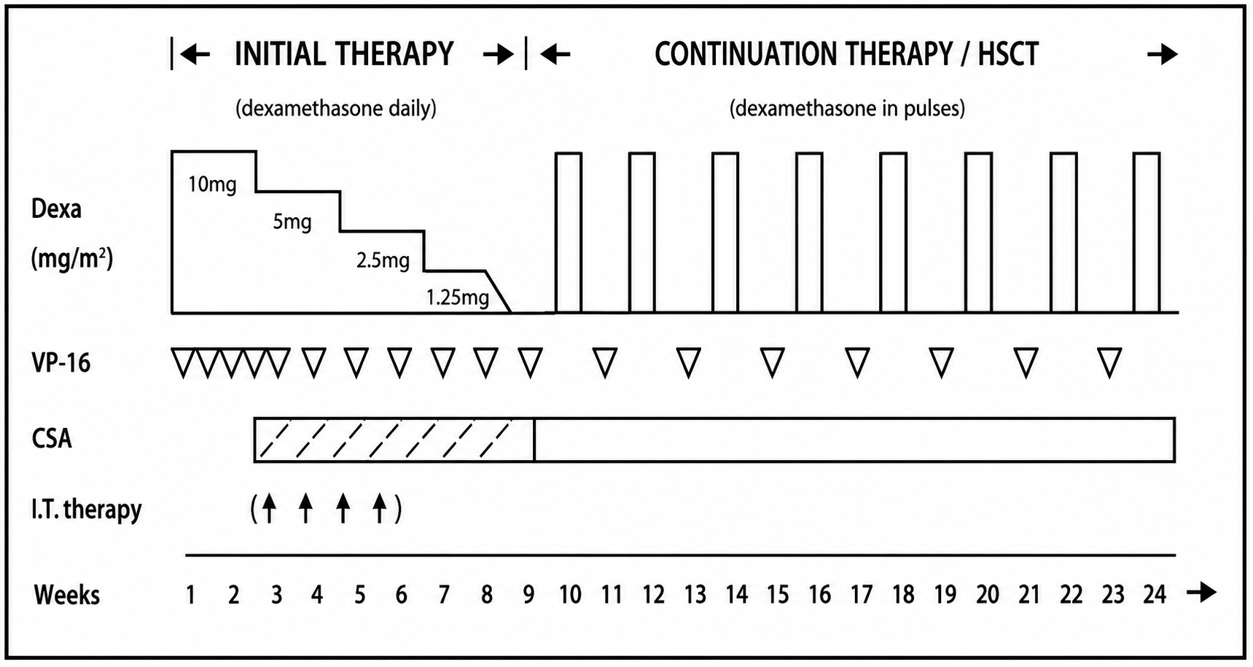
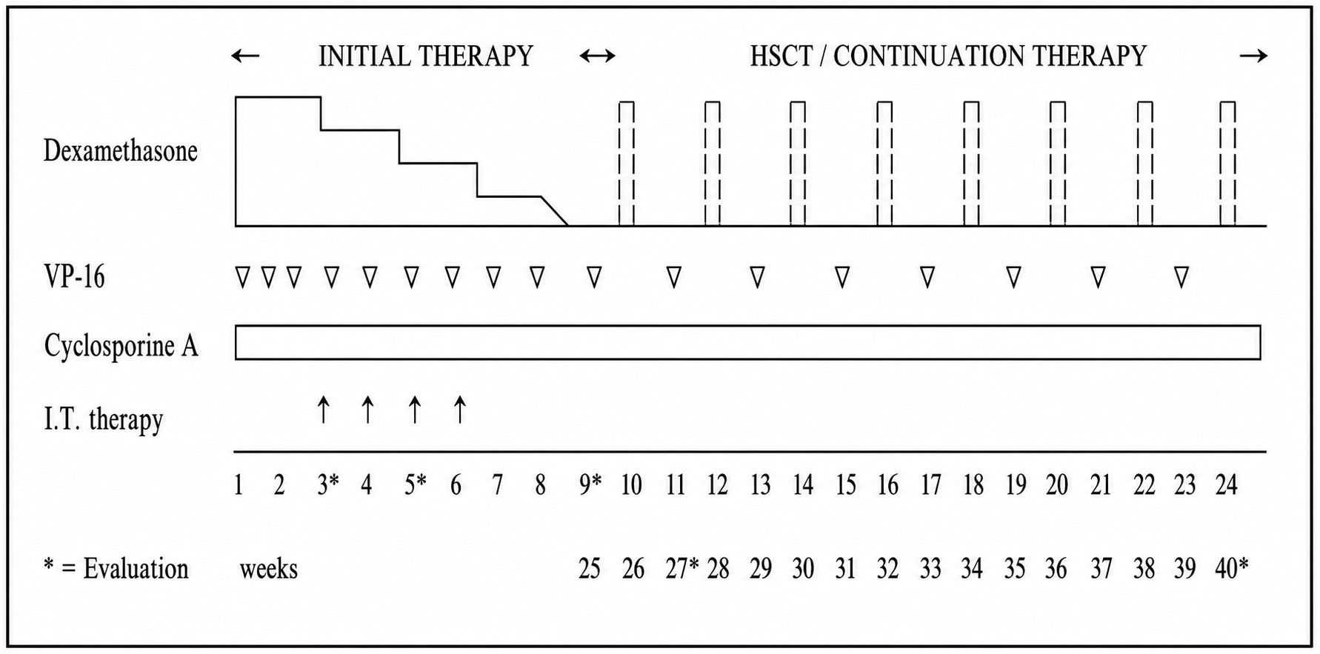
HLH-94 vs HLH-2004
HLH-94
HLH-2004
Blood, 130(25), 2728–2738.
Blood, 118(17), 4577–4584.
The New England Journal of Medicine, 392(6), 584–598
Notes:
Talk about how the regimens were intended for pediatric populations, but have been adopted for adult HLH patients as well. Limited by toxicity of regimen prompting general consensus of DR of etoposide in frailer populations.

Slide 15
HLH-2004 Study
Compared pediatric patients with primary HLH undergoing HLH-2004 protocol to the historical data from the HLH-94 study
Outcomes:
  5-year OS (pSu)
  Pre-HSCT and post-HSCT survival
  Time to HSCT
HLH-2004
HLH-94
Blood, 130(25), 2728–2738.
Notes:
Sought to improve pre-HSCT survival and reduce time to HSCT by intensifying therapy with earlier CSA

Slide 16
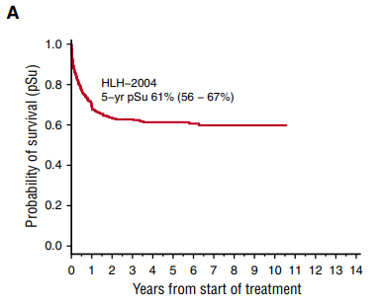
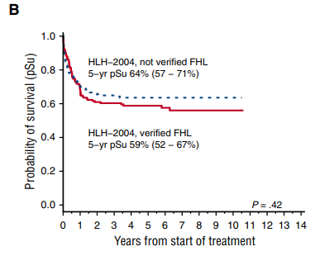
HLH-2004: survival DATA
Blood, 130(25), 2728–2738.

Slide 17
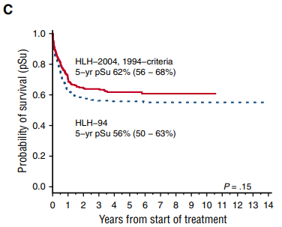
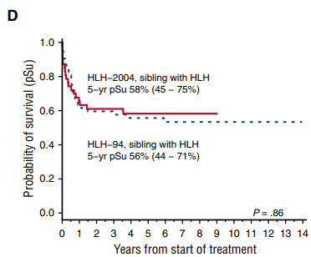
HLH-2004: SURVIVAL DATA
Blood, 130(25), 2728–2738.

Slide 18
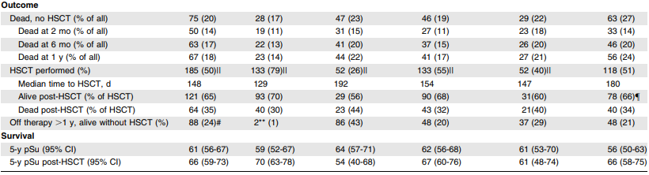
HLH-2004: hsct outcomes
Blood, 130(25), 2728–2738.
Notes:
No difference in OS post-HSCT or generally. Reduced median time to HSCT.

Slide 19
Audience poll question #1
Which statement is true regarding the HLH-94 and HLH-2004 protocols for the management of HLH?
HLH-94 protocol provides improved OS compared to the HLH-2004 protocol.
HLH-2004 protocol utilizes reduced dosing of agents to provide a treatment option for frail patients.
HLH-2004 relies on earlier implementation of CSA but does not show any greater OS benefit compared to HLH-94.
Both HLH protocols require patients proceed to HSCT regardless of disease status.

Slide 20
HLH-Directed therapies
Cytokine Impairment
Emapalumab
Ruxolitinib
Immune Cell Depletion
Antithymocyte globulin (ATG)
Alemtuzumab
Anakinra
Rituximab
Blood 2026; 147 (10): 1019–1036.
Notes:
Roles in therapy include salvage therapy for relapsed/refractory HLH but may also have some areas for initial adjunct therapy

Slide 21
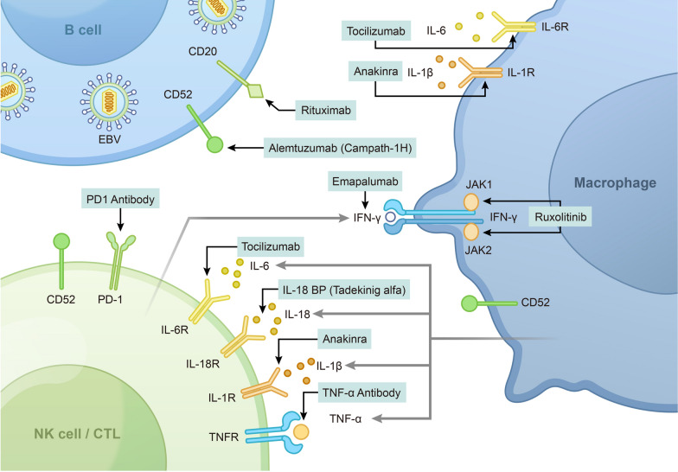
Targeted therapy mechanisms
Journal of Hematology & Oncology, 17(1), 106.

Slide 22
Emapalumab literature
 | NI-0501-04, 2020 (n=34) | REAL-HLH, 2024 (n=46)
Population | Pediatric patients with pHLH | Pediatric and AYA patients with pHLH
Intervention | Emapalumab Q3D and dexamethasone 5-10 mg/m² daily | Received ≤1 dose of emapalumab for the treatment of HLH
Outcomes | Primary Outcome: OS Secondary Outcomes: TTR DoR % eligible for HSCT Post-HSCT OS and EFS | Primary Outcomes: Demographics, clinical characteristics, and treatment patterns Secondary Outcomes: % patients eligible for HSCT OS RR and TTR
Key Findings | 27 patients were pretreated, while 7 patients received upfront treatment RR of 63% in previously treated and 65% in those receiving emapalumab OS of 69.3% 73.4% survived to HSCT, with post-HSCT OS of 90.2% | 35 patients were pretreated, while 11 patients received upfront treatment 44 patients received concurrent therapy OS 74% at 12 months OS post-HSCT 73.7% at 12 months
Blood Advances, 8(9), 2248–2258.
The New England Journal of Medicine, 382(19), 1811–1822.

Slide 23
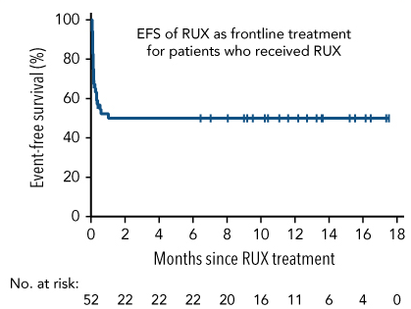
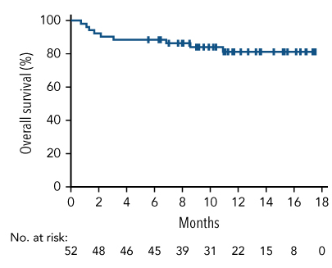
Ruxolitinib literature
 | Zhang et al., 2022 (n=52)
Population | Pediatric patients with newly diagnosed HLH
Intervention | Monotherapy ruxolitinib for 28 days, followed by treatment intensification for 8 weeks, if unfavorable response occurred
Outcomes | Primary Outcome: ORR of monotherapy ruxolitinib Secondary Outcome (Monotherapy Ruxolitinib): TTR DoR 12-month EFS Secondary Outcome (Intensified Treatment): % achieving CR 12-month EFS
Key Findings | ORR 69.2% (36/52 patients) 22 patients achieved CR (42.3%) 12-month EFS 50.1% (monotherapy) 30 patients required intensification 16 patients achieved CR (53.3%) 1-year OS 86.4%
Blood, 139(24), 3493–3504.

Slide 24
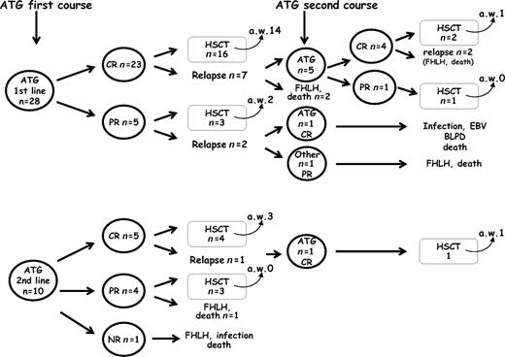
Antithymocyte globulin literature
 | Mahlaoui et al., 2007 (n=38)
Population | Pediatric patients with fHLH
Intervention | ATG 25-50 mg/kg over 5 consecutive days with methylprednisolone 4 mg/kg daily for 5 days
Outcomes | RR Tolerance of ATG HSCT outcomes
Key Findings | Infection rates – 22% (10 patients) Median time to infection was 15 days CR – 73% (33 patients) PR – 24% (11 patients) Median time to HSCT – 6 weeks
Pediatrics, 120(3), e622–e628.

Slide 25
Summary of Literature
Emapalumab
Ruxolitinib
ATG
Alemtuzumab, Anakinra, Rituximab
Limited data mostly founded on pediatric studies for pHLH
Promising post-HSCT survival in the relapsed/refractory setting
Limited data
Data supports use as monotherapy, but may see more benefit as adjunctive agent, primarily in relapsed/refractory disease
Minimal data
Greater toxicity profile compared to other agents and comparatively higher relapse rates
Primary use as salvage therapy in relapsed/refractory disease
Use founded on case reports and case series
May be considered if prior agents unavailable

Slide 26
Audience poll question #2
Which of the following is true regarding targeted therapies for relapsed/refractory HLH?
Anakinra has the most robust data for the management of primary HLH.
Current approaches for managing relapsed/refractory HLH are cytokine blockade and immune cell depletion.
ATG proved to be a tolerable regimen for patients with relapsed/refractory HLH with durable response pre-HSCT.
Most data surrounding relapsed/refractory HLH is found in adult studies so pediatric application may be limited

Slide 27
Ongoing clinical trials
NCT04551131
Newly diagnosed and relapsed/refractory HLH
NCT07497438
Severe HLH in intensive care
Early vs delayed approach to initiating etoposide
NCT06951971
Previously untreated HLH
Dose-modified emapalumab and ruxolitinib
Ruxolitinib, etoposide, and dexamethasone
Active
Not Yet Recruiting
Not Yet Recruiting

Slide 28
Closing Remarks
HLH is a sepsis-like, hyper-inflammatory syndrome characterized by heterogeneous etiologies and non-specific clinical manifestations
  Prompt and accurate diagnosis remains crucial for tailoring treatment in an often acutely ill patient population
Despite longstanding treatment protocols with etoposide/dexamethasone backbones, our understanding of HLH management continues to grow
  In continuous pursuit of treatment optimization, targeted therapies may prevail

Slide 29
References
Abdelhay A, Mahmoud A, Al Ali O et al. Epidemiology, characteristics, and outcomes of adult haemophagocytic lymphohistiocytosis in the USA, 2006–19: a national, retrospective cohort study. eClinicalMedicine, 2023; 62.
Aqsa Sorathia, Nagihan Orhun, Hasan Munshi, Rouba Isshak, Mehandar Kumar; Rising burden of hemophagocytic lymphohistiocytosis in the United States: A nationwide analysis of mortality, disparities, and underdiagnosis. Blood 2025; 146 (Supplement 1): 4757. doi: https://doi.org/10.1182/blood-2025-4757
Bethany Verkamp, Michael B. Jordan, Carl E. Allen; Pediatric hemophagocytic lymphohistiocytosis: current conceptualization, diagnosis, and treatment. Blood 2026; 147 (10): 1019–1036. doi: https://doi-org.ezproxy.uky.edu/10.1182/blood.2025028762.
Bergsten, E., Horne, A., Aricó, M., Astigarraga, I., Egeler, R. M., Filipovich, A. H., Ishii, E., Janka, G., Ladisch, S., Lehmberg, K., McClain, K. L., Minkov, M., Montgomery, S., Nanduri, V., Rosso, D., & Henter, J. I. (2017). Confirmed efficacy of etoposide and dexamethasone in HLH treatment: long-term results of the cooperative HLH-2004 study. Blood, 130(25), 2728–2738. https://doi.org/10.1182/blood-2017-06-788349
Cetica, V., Sieni, E., Pende, D., Danesino, C., De Fusco, C., Locatelli, F., Micalizzi, C., Putti, M. C., Biondi, A., Fagioli, F., Moretta, L., Griffiths, G. M., Luzzatto, L., & Aricò, M. (2016). Genetic predisposition to hemophagocytic lymphohistiocytosis: Report on 500 patients from the Italian registry. The Journal of allergy and clinical immunology, 137(1), 188–196.e4. https://doi.org/10.1016/j.jaci.2015.06.048.
Chandrakasan, S., Jordan, M. B., Baker, A., Behrens, E. M., Bhatla, D., Chien, M., Eckstein, O. S., Henry, M. M., Hermiston, M. L., Hinson, A. P., Leiding, J. W., Oladapo, A., Patel, S. A., Pednekar, P., Ray, A. K., Dávila Saldaña, B., Sarangi, S. N., Walkovich, K. J., Yee, J. D., Zoref-Lorenz, A., … Allen, C. E. (2024). Real-world treatment patterns and outcomes in patients with primary hemophagocytic lymphohistiocytosis treated with emapalumab. Blood advances, 8(9), 2248–2258. https://doi.org/10.1182/bloodadvances.2023012217
Fardet, L., Galicier, L., Lambotte, O., Marzac, C., Aumont, C., Chahwan, D., Coppo, P., & Hejblum, G. (2014). Development and validation of the HScore, a score for the diagnosis of reactive hemophagocytic syndrome. Arthritis & rheumatology (Hoboken, N.J.), 66(9), 2613–2620. https://doi.org/10.1002/art.38690.
Henter J. I. (2025). Hemophagocytic Lymphohistiocytosis. The New England Journal of Medicine, 392(6), 584–598. https://doi.org/10.1056/NEJMra2314005.
Henter, J. I., Horne, A., Aricó, M., Egeler, R. M., Filipovich, A. H., Imashuku, S., Ladisch, S., McClain, K., Webb, D., Winiarski, J., & Janka, G. (2007). HLH-2004: Diagnostic and therapeutic guidelines for hemophagocytic lymphohistiocytosis. Pediatric blood & cancer, 48(2), 124–131. https://doi.org/10.1002/pbc.21039.
Jan-Inge Henter, AnnaCarin Samuelsson-Horne, Maurizio Aricò, R. Maarten Egeler, Göran Elinder, Alexandra H. Filipovich, Helmut Gadner, Shinsaku Imashuku, Diane Komp, Stephan Ladisch, David Webb, Gritta Janka; for the Histiocyte Society, Treatment of hemophagocytic lymphohistiocytosis with HLH-94 immunochemotherapy and bone marrow transplantation. Blood 2002; 100 (7): 2367–2373. doi: https://doi.org/10.1182/blood-2002-01-0172.
Joanne I. Hsu, Sarah Nikiforow, Nancy Berliner; Hemophagocytic lymphohistiocytosis in adults. Blood 2026; 147 (10): 1037–1047. doi: https://doi-org.ezproxy.uky.edu/10.1182/blood.2025031100.
Locatelli, F., Jordan, M. B., Allen, C., Cesaro, S., Rizzari, C., Rao, A., Degar, B., Garrington, T. P., Sevilla, J., Putti, M. C., Fagioli, F., Ahlmann, M., Dapena Diaz, J. L., Henry, M., De Benedetti, F., Grom, A., Lapeyre, G., Jacqmin, P., Ballabio, M., & de Min, C. (2020). Emapalumab in Children with Primary Hemophagocytic Lymphohistiocytosis. The New England journal of medicine, 382(19), 1811–1822. https://doi.org/10.1056/NEJMoa1911326.
Mahlaoui, N., Ouachée-Chardin, M., de Saint Basile, G., Neven, B., Picard, C., Blanche, S., & Fischer, A. (2007). Immunotherapy of familial hemophagocytic lymphohistiocytosis with antithymocyte globulins: a single-center retrospective report of 38 patients. Pediatrics, 120(3), e622–e628. https://doi.org/10.1542/peds.2006-3164
Strippoli, R., Caiello, I., & De Benedetti, F. (2013). Reaching the threshold: a multilayer pathogenesis of macrophage activation syndrome. The Journal of rheumatology, 40(6), 761–767. https://doi.org/10.3899/jrheum.121233
Trottestam, H., Horne, A., Aricò, M., Egeler, R. M., Filipovich, A. H., Gadner, H., Imashuku, S., Ladisch, S., Webb, D., Janka, G., Henter, J. I., & Histiocyte Society (2011). Chemoimmunotherapy for hemophagocytic lymphohistiocytosis: long-term results of the HLH-94 treatment protocol. Blood, 118(17), 4577–4584. https://doi.org/10.1182/blood-2011-06-356261
Wu, Y., Sun, X., Kang, K., Yang, Y., Li, H., Zhao, A., & Niu, T. (2024). Hemophagocytic lymphohistiocytosis: current treatment advances, emerging targeted therapy and underlying mechanisms. Journal of hematology & oncology, 17(1), 106. https://doi.org/10.1186/s13045-024-01621-x.
Zhang, Q., Zhao, Y. Z., Ma, H. H., Wang, D., Cui, L., Li, W. J., Wei, A., Wang, C. J., Wang, T. Y., Li, Z. G., & Zhang, R. (2022). A study of ruxolitinib response-based stratified treatment for pediatric hemophagocytic lymphohistiocytosis. Blood, 139(24), 3493–3504. https://doi.org/10.1182/blood.2021014860

Slide 30
Primary hemophagocytic Lymphohistiocytosis – A Review of Management
Christopher L. Cornett II, Pharmd
Baptist Health Louisville – Hematology/oncology pharmacy specialist

