Slide 1
Inpatient Management of Cancer-Related Symptoms
Katrina Nickels, MD
Assistant Professor
University of College of Medicine
Department of Internal Medicine, Division of Palliative & Supportive Care
Marianne Carter, PharmD
Clinical Pharmacy Specialist
Palliative Care & Pain Management

Slide 2
Financial Disclosures
No relevant disclosures

Slide 3
Objectives
Develop inpatient management plans for cancer-related pain based on cancer pain pathophysiology
Define inpatient management plan for cancer-related intractable nausea and vomiting based on pathophysiology
Use communication frameworks in patient and family conversations regarding change in cancer trajectory

Slide 4
Meet Neil
Chief complaint
Oncologic history
56 year old male
Admitted to the hospital for intractable nausea/vomiting and pain
Stage IV colorectal cancer, diagnosed at age 45
Has received many lines of therapy, including:
  Bevacizumab, capecitabine, fluorouracil, ipilimumab, irinotecan, leucovorin, oxaliplatin
Notes:
On interview, Ned tells you that he has issues with fabric on his feet – wool socks and bed sheets cause him pain.
Ned received multiple iterations of oxaliplatin-containing regimens over 11 years (FOLFOX, FOLFIRINOX, CAPEOX), including immediately after diagnosis; each iteration was typically 6 cycles in length.

Slide 5
Meet Neil
Social history
PMH, medications, and allergies
Widowed with two adult daughters
Retired engineer
Occupies his time with home renovation and woodworking
PMH: none
Medications: ibuprofen 200 mg by mouth twice daily PRN, gabapentin 600 mg by mouth every 8 hours, duloxetine 60 mg by mouth daily, prochlorperazine 10 mg by mouth every 6 hours as needed for nausea/vomiting
Allergies: hydrocodone/APAP – paranoia

Slide 6
CANCER PAIN

Slide 7
Objectives
Develop inpatient management plans for cancer-related pain based on cancer pain pathophysiology
Develop inpatient management plan for cancer-related intractable nausea and vomiting based on pathophysiology
Use communication frameworks in patient and family conversations regarding change in cancer trajectory

Slide 8
Cancer Pain from Tumor Burden
Often diffuse, poorly localized
Deep, aching, gnawing, cramping, bloating
Moving or radiating
Burning, lightning
Localized, fingers, toes
Pinprick, burning, shooting
Well-localized
Sharp, throbbing, aching
Nociceptive Somatic
Infiltrative/ Inflammatory
Pain from bone metastases
Pathologic fracture
Nociceptive Visceral
Perforation
Obstruction
Neuropathic
Compressive
Central pain from CNS metastases
Nociceptive & Neuropathic
Ischemic
Lymphedema
Extensive infiltration with compression
Nociplastic
Chronic cancer pain
Chronic non-cancer pain
Chronic pain after cancer treatment
Notes:
Let’s say that Ned had abdominal pain and he has GI cancer. So, he has cancer pain. However, how the cancer is causing pain is important to determine in order to develop a treatment plan
– Is it localized, sharp and aching indicative of painful liver metastasis or malignant effusion or large rectal tumor?
Is it cramping and diffuse indicative of ileus or partial bowel obstruction?
Does he have painful feet with burning aching pain of lower legs indicative of chemo induced neuropathy?
Does he have lumbar radicular pain from a large sacral tumor causing nerve compression?
The first step in managing Cancer Pain is to get that history which will point you to the pain generator.
As for the Purple box with chronic pain, this is a different entity. This would be applicable to the patient with STABLE tumor burden, but tumor burden still present, patients with No Evidence of Disease on imaging who developed pain from cancer and throughout the course of treatment but no longer has tumor burden, or the patient with pre-existing chronic pain prior to cancer. These are arguably the most challenging cases.

Slide 9
Cancer Related Pain from Treatment Side Effects
-Itises
Neuropathy
Radiation-induced inflammation
Post-procedural pain
Lymphedema
Notes:
-itises
Mucosa - mouth to anus, GU/GYN
Skin
Joints, muscles, bones

Slide 10
Cancer-Related Pain
Acute
Usually severe, comes on quickly, lasts for a short time
Chronic
Pain lasting more than three months
Breakthrough
Sudden, intense pain flare that occurs while taking medications for chronic pain
US Department of Health and Human Services, National Institutes of Health, National Cancer Institute. Updated November 17, 2022. https://www.cancer.gov/about-cancer/treatment/side-effects/pain
Notes:
NIH – pain management for people with cancer (https://www.cancer.gov/about-cancer/treatment/side-effects/pain)

Slide 11
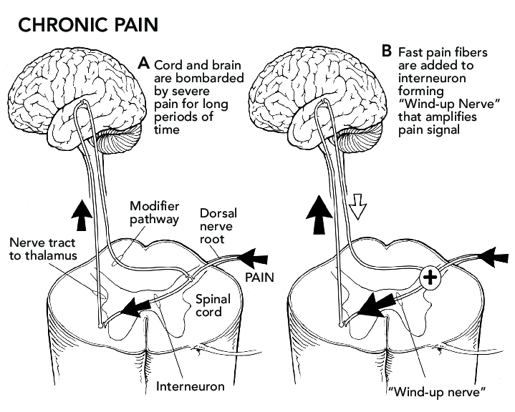
Importance of Early Effective Pain Management
Zasler, Nathan & Martelli, Michael & Nicholson, Keith. (2012). Post-Traumatic Pain Disorders: Medical Assessment and Management. 10.1891/9781617050572.0057.
Notes:
It is important to formulate a diagnosis and pain treatment plan executed as soon as possible because undertreated acute pain can lead to chronic pain and Wind Up where the pain signal is amplified making pain management more challenging

Slide 12
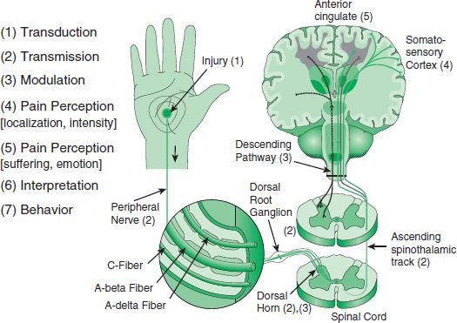
Pain Pathophysiology
PAIN
https://basicmedicalkey.com/the-pathophysiology-of-chronic-pain-and-clinical-interfaces-with-addiction/
Notes:
LAST SLIDE – HAND OFF TO MARIANNE AFTER THIS SLIDE
So, this picture is a broader review of the basics of pain to describe the transition from ACUTE pain (#1 and 2) to that Wind Up to CHRONIC pain (#3 and up)
Nociceptive pain is injury and transmission of signal through peripheral nerves to the spinal cord where modulation occurs through ascending pathway to brain then descending pathway calming neurotransmitters.
When we have wind up, or a prolonged injury, such as during a prolonged hospitalization with repeated events of tissue injury, or cancer, we can have wind up sensitization. We can address the increase in transmission and enhance modulation of that signal as well a localization and intensity with multi-modal pain management strategies.

Slide 13

Multi-modal Pain Management
Non-pharmacologic and pharmacologic
Targeted to pain pathophysiology
  Don’t “throw the kitchen sink”
Stepwise
Interventions are to be considered early
  Radiation
  Tumor radiofrequency ablation
  Surgical resection or diversion
  Stenting
  Trans-arterial embolization
  Interventional regional blocks
Notes:
MARIANNE START
What is multi-modal pain management?
It is a TARGETED, STRATEGIC approach based on the working diagnosis of the patient’s sources of pain. And they may have more than one pain generator
It is NOT a “throw all medications” approach
It is NOT “just avoid opioids” approach
It is Stepwise – use targeted low risk treatments first, then escalate up to higher risk treatments
Interventions are to be considered early, and this includes interventional pain procedures that are underutilized in cancer care

Slide 14
Nonpharmacologic Pain Therapy – Start Immediately
Physical Therapy
Heat/Ice
Mind-Body Therapy
Mindfulness/ Relaxation
Guided Imagery
Biofeedback
Hypnosis
Cognitive Therapy
Distraction
Pain Coaching
Integrative Therapy
Art Therapy
Music Therapy
Pet Therapy
Mirror Therapy
Narrative Medicine
Reiki
Interventional Pain (Consider)
Joint Injections
Acupuncture
CBT, ACT
Neurolytic Block
Rhizotomy/Ablation
Nerve Stimulation (Peripheral or Spinal Cord)
Vertebroplasty/ Kyphoplasty
Massage
TENS
Trigger Point Injections
Strengthening/ Prehabilitation/ Rehabilitation

Slide 15
Pharmacology – Try First
Analgesic
Acetaminophen
Anti-inflammatory
NSAID
Steroid
Dexamethasone
Prednisone
Prednisolone
Ketorolac
Ibuprofen
Celecoxib
Muscle Relaxants
Skeletal
Cyclobenzaprine
Methocarbamol
Spasticity
Baclofen
Tizanidine
Visceral
Dicyclomine
Topical
Lidocaine
Menthol
Diclofenac
Capsaicin
Neuromodulator
Tricyclic Antidepressant
SNRI
Nortriptyline
Amitriptyline
Desimipramine
Venlafaxine
Duloxetine
Notes:
APPs and even first year residents should be able to order these on their own. These are GREEN for GO.
Topicals are good for localized somatic pain. Lidocaine and Capsaicin or helpful topical neuropathic medications for peripheral neuropathy. Keep in mind that capsaicin can burn and requires in office observed administration for the transdermal patch.
Anti-inflammatories are great acutely for inflammatory tumor pain, especially with bone metastases. For liver metastases, due to concern of liver function, use steroids instead.
For muscle relaxants, use them for both skeletal and smooth muscle pain, like from painful bladder or intestinal spasms. Dicyclomine, being an anticholinergic, may decrease smooth muscle contraction. However, cyclobenzaprine and methocarbamol can also be effective for painful spasms with urination that may be less about the bladder and more due to the pelvic floor of skeletal muscles. The anti-spastic medications can be used for muscle spasms related to vertebral encroachment or compression from tumors
Consider the neuromodulating antidepressants which can be TCAs or SNRIs for patients with chronic duration of pain or even neuropathic pain, given their activity in the spinal cord as well as improved mood for improved pain tolerance

Slide 16
Pharmacology – Add On
Muscle Relaxant
Neuropathic
Gabapentinoids
Opioid
Ketamine
Diazepam
Lorazepam
Clonazepam
Methadone
Gabapentin
Pregabalin
AED
Carbamazepine
Oxcarbazepine
Gabapentinoids
Cannabinoids
CBD
Medical Cannabis
Gabapentin
Pregabalin
Benzodiazepine
Atypical
Buprenorphine (Partial Agonist)
Methadone (NMDA antagonist)
Tramadol (serotonergic)
Full Agonist
Fentanyl
Morphine
Hydromorphone
Oxycodone
Low Dose Naltrexone
NMDA receptor antagonist
Na channel blockers
Lidocaine
Suzetrigine
Notes:
I put in YELLOW, medications with some risk, which is why many of them are controlled medications. APPs can prescribe these independently.
Optimize the GREEN light muscle relaxants prior to considering these medications. We prefer optimizing gabapentinoids that help both neuropathic pain and serves as a muscle relaxant at high doses, over adding benzodiazepines
Other antiepileptics have data more for specific neuralgias like trigeminal neuralgia
We put cannabinoids in yellow since due to limited data, they would not be considered first second or even third line but could be options that patients want to pursue.
Then the opioids. Buprenorphine is grouped with the others, but due to superior safety, as I will discuss, it should actually be in the YELLOW. We put low dose naltrexone in pink since like

Slide 17
Opioids – When Do We Use Them?
Acute pain
Cancer pain
Opioid dependence
Refractory dyspnea in end stage respiratory conditions
Promote rest, healing, and rehabilitation
Promote function and tolerability of treatment
Stabilize cycle of withdrawal and craving
Promote function and decrease hyperventilation
MOUD (sublingual buprenorphine)
Buprenorphine transdermal patch
Low dose morphine
IV or immediate release PO options and titrate every shift as needed
Appreciate if opioid naïve vs opioid tolerant
Notes:
There are scenarios for which expeditious use of opioids are indicated, such as severity of pain that brings patients to the hospital, moderate to severe cancer pain, severe dyspnea not managed with multimodal approach to dyspnea (disease management, pulmonary rehab). However, ALL patients then will develop opioid dependence.

Slide 18
Opioid Prescribing – Basic Dosing
Initiation
Increase total daily dose 25-50%
Severe Pain
Outpatient setting
Moderate pain
Inpatient setting
Increase total daily dose 50-100%
Severe Pain
Inpatient
Opioid Rotation:
Calculate equianalgesic dose
Reduce by 25-50% for cross-tolerance (if pain is controlled)
Opioid Titration
Low starting dose for opioid naïve
Morphine 7.5mg po
Hydromorphone 1mg po
Oxycodone 2.5mg po
Hydrocodone 5mg po
Dose efficacy assessment
60-90 minutes po
15 minutes IV
Start equianalgesic Long-acting opioid when IR opioid is taken ATC (4 doses/day) and continued mod to severe pain
IR opioid dose 10-15% of total daily dose for BTP
IR opioid dose 10-15% of scheduled Long acting opioid for BTP
Efficacy 3-4 hours
Should not be taken ATC
capc.org/documents/download/324/

Slide 19
Medication Selection
Age
Intolerances vs Allergies
Drug-Drug Interactions
Muscle mass
Caution with transdermal fentanyl
Allergy = rash or hives, angioedema
Intolerance = side effect, may be dose dependent
Itching is an opioid side effect, not an allergy if no rash
Nausea is a side effect, not allergy
Logistical Considerations
Insurance
Routes of Administration (eg: rectal, transdermal or transmucosal if NPO)
Lower doses (e.g. duloxetine 20mg, gabapentin 100mg, hydrocodone 2.5mg)
Transdermal buprenorphine preferred long-acting opioid or initial opioid

Slide 20
Clinical Pearls for Choosing Medications
Renal impairment
  Avoid NSAIDs, codeine & meperidine, higher doses of morphine
  Reduce dose of duloxetine, gabapentinoids, oxycodone
  Preferred opioids: buprenorphine, fentanyl, methadone, hydromorphone if IV or short acting needed
Hepatic failure
  Avoid duloxetine, codeine & meperidine
  Limit acetaminophen and NSAIDs
  Extend dosing interval of morphine
  Reduce dose of venlafaxine, hydrocodone, oxycodone and methadone
  Preferred opioids: buprenorphine, fentanyl, lower dose morphine if IV or short acting needed
https://www.mypcnow.org/fast-fact/opioid-use-in-renal-failure/
https://www.mypcnow.org/fast-fact/opioid-use-in-liver-failure/

Slide 21
Back to Neil
56 year old male
Stage IV colorectal cancer, diagnosed over 10 years prior
Treatment history includes immunotherapy and chemo associated with CIPN
Intolerance to hydrocodone (paranoia)
Medications: ibuprofen 200 mg by mouth twice daily PRN, gabapentin 600 mg by mouth every 8 hours, duloxetine 60 mg by mouth daily
Severe sharp pain in buttock, hip, and radiating to knees, but numb from knee to feet since last chemo regimen. Diagnosis?
  Nociceptive tumor pain
  Neuropathic compressive pain
  Chronic CIPN
Tumor burden involves liver and sacral mass on CT scan, after recent hospitalizations for AKI related to dehydration
  Butrans 5mcg patch
  Oxycodone 2.5mg (0.5 tablet of 5mg) po every 4 hours PRN
Notes:
MARIANNE LAST SLIDE

Slide 22
Now meet Niall
56 year old male
Stage IV colorectal cancer, just diagnosed, staged, and with genetic testing. PMHx of chronic low back pain treated with oxycodone 10 mg 4 times daily for 20 years prior to cancer diagnosis
To start chemotherapy in a few weeks
Medications: ibuprofen 200 mg by mouth twice daily PRN, gabapentin 600 mg by mouth every 8 hours, duloxetine 60 mg by mouth daily, AND oxycodone has been titrated 30 mg every 4 hours.
Severe sharp pain in buttock, hip, and radiating to knees, with constant chronic dull aching pain in back. Diagnosis?
  Nociceptive tumor pain
  Neuropathic compressive pain
  Chronic low back pain
Tumor burden involves liver and sacral mass, recent hospitalizations for AKI related to dehydration
  NOW WHAT??
Notes:
MARIANNE LAST SLIDE

Slide 23
Now meet Kyle
56 year old male
Stage IV colorectal cancer, just completed 3 cycles of chemotherapy. PMHx of remote history of IV heroin use
Treatment history includes chemo associated with CIPN
Medications: ibuprofen 200 mg by mouth twice daily PRN, gabapentin 600 mg by mouth every 8 hours, duloxetine 60 mg by mouth daily, AND oxycodone 30 mg every 4 hours. He is being admitted due to frequent calls for early refills of oxycodone over the past month.
Severe sharp pain in buttock, hip, and radiating to knees, but numb from knee to feet since last chemo regimen. Diagnosis?
  Nociceptive tumor pain
  Neuropathic compressive pain
  Chronic CIPN
Tumor burden involves liver and sacral mass, recent hospitalizations for AKI related to dehydration
  NOW WHAT??
Notes:
MARIANNE LAST SLIDE

Slide 24
CANCER PAIN…………
BUT IT’S COMPLICATED
Notes:
KATRINA START

Slide 25
Pain & Suffering
PAIN
https://basicmedicalkey.com/the-pathophysiology-of-chronic-pain-and-clinical-interfaces-with-addiction/
Notes:
This understanding of pain perception, interpretation, and fear avoidant behavior explains why some patients do not improve functionally with the stepwise approach and ultimately end up on opioids

Slide 26
Another way to categorize chronic pain
Complex Maladaptive or Chronic Pain
NOCIPLASTIC
CHRONIC NOCICEPTIVE
Primary pain
Secondary pain
Chronic migraine
Irritable bowel syndrome
Chronic musculoskeletal pain
Fibromyalgia
Cancer-related pain (tumor burden or from treatments)
Post-surgical pain
Inflammatory autoimmune –itises
Diabetic neuropathy
Notes:
If only multi-modal pain management worked, then this would be as simple as acute pain management. Why is it more challenging? So, now we are going to dive into the psychotherapeutic modalities for chronic pain

Slide 27
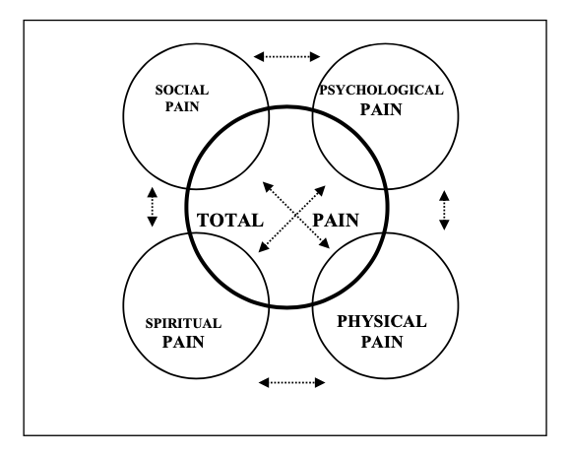
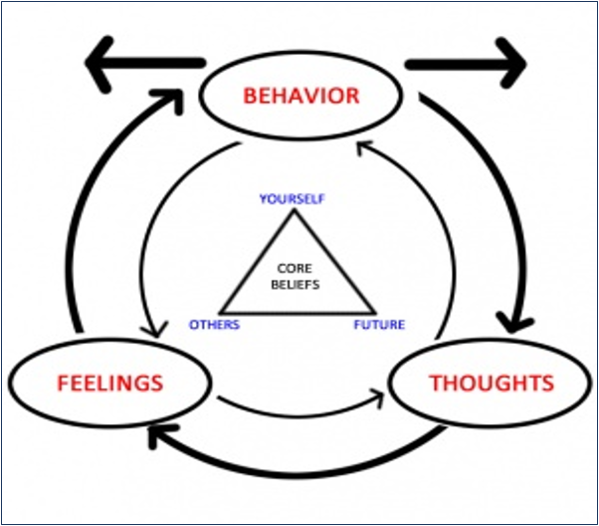
Comprehensive Pain Management
https://www.mypcnow.org/fast-fact/total-pain/
https://www.physio-pedia.com/Behavioural_Approaches_to_Pain_Management
Notes:
From Palliative Care, we understand the concept of total pain. The patient with chronic pain, where the pain signal is no longer beneficial, they will have to do some reprocessing of their interpretation of pain

Slide 28
What about Opioid Use Disorder??
4 Diagnostic "Buckets"
Control
Impaired
Consequences
Socially
Compulsive
Use
Craving
Physiologic
Opioids taken in larger amounts or over a longer period than was intended
Continued opioid use despite persistent/recurrent social or interpersonal problems
Recurrent opioid use in situations which it is physically hazardous
Craving or strong desire/urge to use opioids
Persistent desire or unsuccessful efforts to cut down or control use
Important social, occupational, or recreational activities are given up or reduced due to opioid use
Continued use despite knowledge of physical or psychological problems caused or exacerbated by opioids
Exhibits tolerance *
Great deal of time spent in activities to obtain, use, or recover from effects
Exhibits withdrawal *
Recurrent opioid use resulting in a failure to fulfill obligations at work, school, or home
*Not considered to be met for those individuals taking solely under appropriate medical supervision

Slide 29
Who Develops Opioid Use Disorder?
ORT-OUD (Cheatle 2019)
Family history of unhealthy substance use
Alcohol
Illegal drugs
Prescription drugs
Personal history of unhealthy substance use
Alcohol
Illegal drugs
Prescription drugs
Age 16-45
Psychological disease
ADD, OCD, bipolar, schizophrenia
Depression
If 2 or less, low risk. If >2, high risk.
Family History
Genetic
Exposure
Past Use
Co-Occurring Conditions
Serious Mental Illness
Patterns
https://nida.nih.gov/nidamed-medical-health-professionals/screening-tools-resources/opioid-risk-tool-oud-ort-oud
(Not validated in cancer pain)

Slide 30
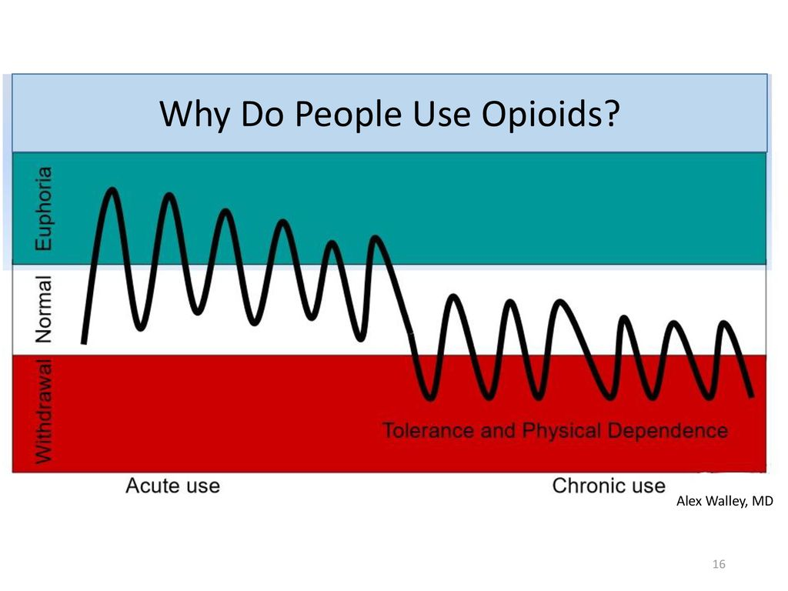
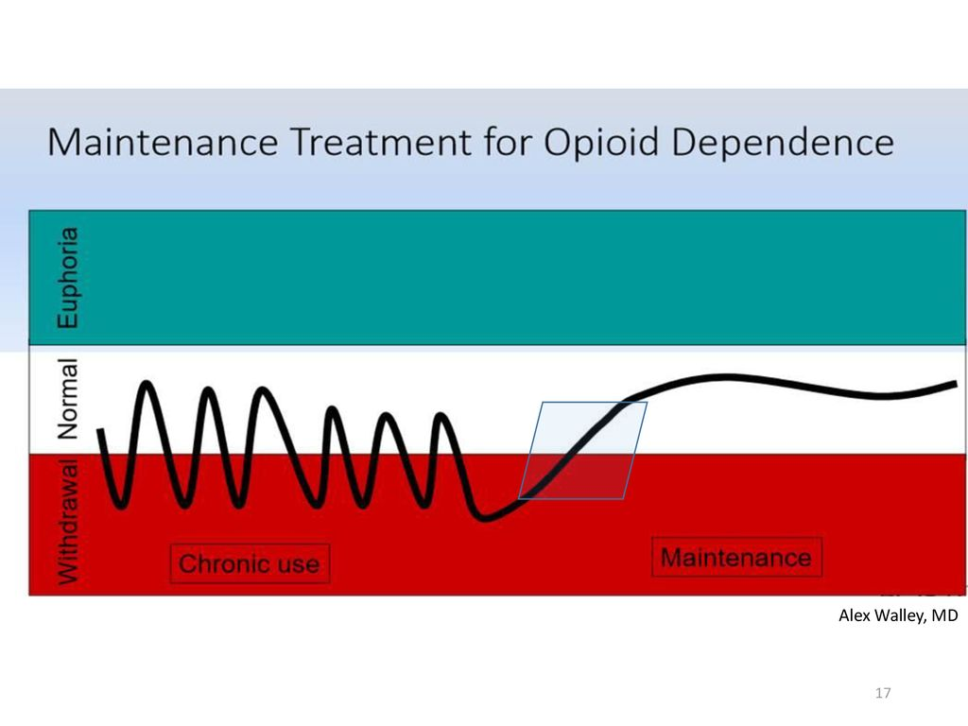
Medication for Opioid Dependence
Notes:
Which brings us to MOUD
Why do people use opioids? Euphoria or positive feeling. But, it could also be for relief of negative feelings if that be physical pain, emotional pain like post traumatic stress from past trauma or depression. For vulnerable people whose brain is primed to feel better or have more energy from opioids due to genetic variability or chronic dysphoric state, they will continue to have that desire to feel normal and continue to use opioids.
But, the body and brain wants homeostasis. So there is an allostatic response that happens where the body decreased its own endogenous opioids and internalizes opioid receptors and increases dynorphins and stress response to offset the exogenous opioid load. This happens more quickly and more pronounces in the vulnerable patient. Then they feel HORRIBLE without opioids and continue to use to feel normal.
What pharmacologic properties might be good treatments for OUD? Medications that keep the patient feeling normal

Slide 31
Opioid Agonist Medications for OUD treatment
Methadone
Full agonist opioid (C2 controlled med)
Long half-life (T ½ - 8-59 hours)
Low opioid receptor binding affinity
Treats Pain
  Usual pain doses 5-10mg TID; Usual OUD doses 40-120mg/day
Treats Withdrawal
  Starting doses start 20-40mg/day
Treats Craving
  Moderate Maintenance doses 80-120mg/day
For OUD treatment – Can only be dispensed with in person supervised doses at federally licensed Opioid Treatment Programs (OTPs or "methadone clinics")
  Poses restrictions to discharge planning
  Gradual increase of take home doses
  Oral liquid formulation
When performing opioid conversions involving methadone consult pain & palliative care pharmacist
Buprenorphine
Partial agonist (C3 controlled med)
Long half-life (T ½ - 25-70 hours)
High opioid receptor binding affinity
Treats Pain
  Different formulations for pain and OUD
Treats Withdrawal
  Traditional induction 2mg after COWS >12-15
  Low dose initiation allows for no disruption in acute pain opioid management
  No difference which protocol, just start it!
Treats Craving
  Moderate Maintenance dose 8-12mg/day
  Patients with Fentanyl Use Disorder may require 16mg/day or greater
ANYONE with DEA license can prescribe

Slide 32
Buprenorphine Safety Superiority as MOUD and as Long-Acting Opioid for Cancer Pain
Mu-receptor activity: partial agonist, high binding affinity
Half-life: SL 37 hours; buccal 27 hours; transdermal 26 hours
Full agonist
(e.g., methadone)
Preferred in liver failure, renal failure, and elderly
Partial agonism produces "Ceiling Effect“ on respiratory depression, constipation, cognitive impairment
Schedule 3 – APPs can prescribe independently
Partial agonist
(e.g., buprenorphine)
Antagonist
(e.g., naloxone, naltrexone)
Notes:
Long half life in both
Doses in OTP higher 40-120mg/day or more
Doses for pain usually effective much lower

Slide 33
Buprenorphine Formulations
Indicated for Pain | Route | Dosage Strengths
Belbuca® | Buccal | Film: 75-900 μg
Butrans® | Transdermal | Weekly Patch: 5-20 μg/hour
Buprenex® | Intravenous/ Intramuscular | Vial & Ampule: 0.3 mg/mL
Indicated for OUD | Route | Dosage Strengths
Subutex® | Sublingual | Tablet: 2 mg & 8 mg
Suboxone®* | Sublingual | Tablet: 2 mg/0.5 mg & 8 mg/2 mg Film: 2 mg/0.5 mg – 12 mg/3 mg
Zubsolv®* | Sublingual | Tablet: 0.7mg/0.18mg – 11.4 mg/2.9 mg
Sublocade® (monthly only) | Subcutaneous | Prefilled Syringe: 100 mg/0.5 mL & 300 mg/1.5 mL
Brixadi® (weekly & monthly) | Subcutaneous | Prefilled Syringe: 8 mg/0.16 mL – 128 mg/0.36 mL
*buprenorphine/naloxone combo product
Notes:
Pain vs OUD formulations.
Don’t use OME for higher dose sublingual formulation. Once you start these you are close to 100mg OME daily, not agreed upon.
Unique pharmacology – antidepressant effect, offset hyperalgesia, not an immediate release effect. We know that oral long actings are actually closer to immediate release compared to Buprenorphine which plays an effect on pain perception

Slide 34
Cancer Pain with Opioid Misuse & OUD
Palliative care & addiction medicine expert majority consensus recommendations:
Do not force opioid tapering if benefits outweigh risks in non-opioid SUD
Increase intensity of monitoring and counseling
Use buprenorphine/naloxone in patients with cancer pain and OUD
Only consider full agonists alone if there is a short prognosis (weeks to months)
Fitzgerald Jones et al. JAMA Oncol 2022. PMID: 35771550
Notes:
So, for Julia, she meets we offer to prescribe buprenorphine/naloxone instead of refilling oxycodone early.

Slide 35
Current KY Regulatory Considerations to Sublingual Buprenorphine
As of January 2026, if patients have substantiated cancer diagnosis and cancer pain, buprenorphine regulations do not apply, IF prescribed by oncologist or palliative care physician
For OUD treatment otherwise - Maximum 16/4mg SL daily for longer than 12 months unless addiction medicine consultation (peer to peer counts) recommends higher dose. Maximum 32/8mg SL daily for any prescriber in KY
Anyone with DEA prescriptive authority can prescribe to treat OUD (Schedule 3)
Notes:
Takeaway for inpatient teams is that it may be challenging to find prescribers for doses exceeding 16/4mg daily or willing to allow the patient to split their dose, so reach out to the potential outpatient prescribers early. Not all MOUD clinics have addiction certified physicians on site.

Slide 36
Inpatient plan for Kyle
56 year old male
Stage IV colorectal cancer, diagnosed over 10 years prior, AND remote history of IV heroin use
Treatment history includes immunotherapy and chemo associated with CIPN
Medications: ibuprofen 200 mg by mouth twice daily PRN, gabapentin 600 mg by mouth every 8 hours, duloxetine 60 mg by mouth daily, AND oxycodone 30 mg every 4 hours. HE IS BEING ADMITTED BY ONCOLOGY DUE TO CALLS FOR EARLY REFILLS OF OXYCODONE
Severe sharp pain in buttock, hip, and radiating to knees, but numb from knee to feet since last chemo regimen. Diagnosis?
  Nociceptive tumor pain
  Neuropathic compressive pain
  Chronic CIPN
Tumor burden involves liver and sacral mass, recent hospitalizations for AKI related to dehydration
  Inpatient initiation of Suboxone treatment of OUD titrated to 8/2mg sublingually every 8 hours
  Rotated from oxycodone 30mg to hydromorphone 6mg every 6 hours as needed
Notes:
MARIANNE LAST SLIDE

Slide 37
Prescribing Structure as Treatment
Set treatment goals and expectations with Informed Consent process
Clinical rationale = pain generator
Set realistic Goals and Exit plans
  Anticipated duration of treatment
  Exit plan =
  Opioid effects = constipation, physiologic tolerance and dependence, nausea, drowsiness
  Co-prescribe stimulant laxative (senna, bisacodyl)
Long term effects = hypogonadism, osteoporosis, depression, chronic pain
Risk of death = co-morbidities, opioid dose, co-prescribed medications, metabolic factors
  Co-prescribe rescue naloxone
Risk of OUD = ORT-OUD
Expectations of patient responsibility & physician/clinic care coordination
  Plan to periodically check toxicology labs (serum, urine)
  Plan to dispose unused medications
Notes:
Neurobiologic changes cause challenges with reward processing
tapering to discontinuation, maintenance and monitoring during cancer surveillance, primary care or pain clinic, or starting MOUD and addiction clinic
GO QUICKLY THROUGH THE SLIDE

Slide 38
Prescribing Structure as Treatment
2. Tier duration of script and follow up based on risk
Contingency Management as treatment (take-homes, longer duration scripts from weekly to monthly)
3. Opioid selection
Full agonist only
  High risk ORT-OUD score, no OUD history
  Emerging prescription OUD concern only
  OUD in sustained remission and declines MOUD
MOUD as long-acting analgesic
  Strongly encourage in OUD in early remission (<12months remission)
Necessary for active OUD of unregulated opioids (high potency fentanyl analogues)
  Methadone treatment at Opioid Treatment Program only, OR
  Buprenorphine for OUD
Notes:
GO THROUGH THIS QUICKLY

Slide 39
Universal Precautions
Med Counts
Risk tool (eg: ORT-OUD)
Refill Request History
KASPER
Misuse & Diversion Concern
Periodic toxicology monitoring
Notes: ORT-OUD is a risk tool for INITIATION. Use other tools or assessments during monitoring.
No screening tools validated in cancer pain population.
Tiered Refill & Visit Workflow

Slide 40
Caveats to Application of Structure
Always consider undertreated pain
  Cancer progression
  Treatment related pain
  Sub-optimal multimodal pain management
  Consult with pharmacist or palliative care
Accommodate for barriers to care
  Transportation dependence
  Declining performance status
  Social workers and nurses provide valuable input!
Adjust for clinic workflow
  Consider support staff visits, pre-dated scripts, adding toxicology to labwork, etc.
Notes:
KATRINA LAST SLIDE

Slide 41
Back to Neil
56 year old male
Stage IV colorectal cancer, diagnosed over 10 years prior
Treatment history includes immunotherapy and chemo associated with CIPN
Intolerance to hydrocodone (paranoia)
Medications: ibuprofen 200 mg by mouth twice daily PRN, gabapentin 600 mg by mouth every 8 hours, duloxetine 60 mg by mouth daily
Severe sharp pain in buttock, hip, and radiating to knees, but numb from knee to feet since last chemo regimen. Diagnosis?
  Nociceptive tumor pain
  Neuropathic compressive pain
  Chronic CIPN
Tumor burden involves liver and sacral mass on CT scan, after recent other hospitalizations for AKI related to dehydration
  Butrans 5mcg patch
  Oxycodone 2.5mg (0.5 tablet of 5mg) po every 4 hours PRN
Notes:
MARIANNE LAST SLIDE

Slide 42
NAUSEA
Notes:
MARIANNE START

Slide 43
Back to Neil
56 year old male
Stage IV colorectal cancer, diagnosed over 10 years prior
Treatment history includes several lines of chemo and immunotherapy. Currently not receiving treatment.
Medications: ibuprofen 200 mg by mouth twice daily PRN, gabapentin 600 mg by mouth every 8 hours, duloxetine 60 mg by mouth daily, prochlorperazine 10mg every 6 hours as needed, Butrans 5mcg patch, oxycodone 2.5mg every 4 hours as needed (takes 1-2 doses daily), and self-medicating with cannabis
Continues to experience nausea and vomiting

Slide 44
Objectives
Develop inpatient management plans for cancer-related pain based on cancer pain pathophysiology
Develop inpatient management plan for cancer-related intractable nausea and vomiting based on pathophysiology
Use communication frameworks in patient and family conversations regarding change in cancer trajectory

Slide 45
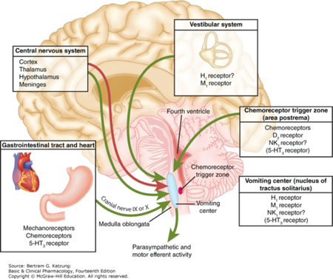
Pathophysiology
Incited by thought or smell of food
Sensitive to motion or visual changes
Tinnitus
Biochemical changes, medications
Predictable after chemotherapy
Cannabis Hyperemesis Syndrome
Often post-prandial
Dyspepsia, bloating, cramping
Epigastric tenderness
Gastric stasis, constipation, bowel obstruction
Also consider: anxiety, raised intracranial pressure
Glare P, et al. Clin Interv Aging. 2011:6:243-59.
Katzung BG, et al. Basic and Clinical Pharmacology 14th Edition. 2018.
Notes:
Anxiety: cerebral cortex (GABA), raised intracranial pressure: pressure receptors

Slide 46
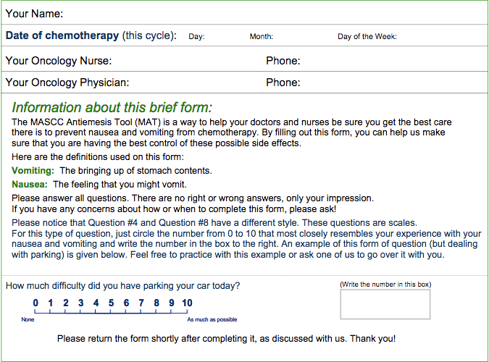
MASCC Antiemesis Tool (MAT)
Molassiotis A, et al. J Pain Symptom Manage. 2007 Aug; 34(2): 148-159.
Notes:
Pathophysiology

Slide 47
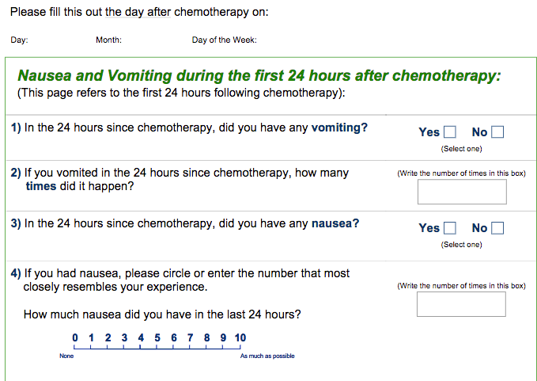
MAT
Molassiotis A, et al. J Pain Symptom Manage. 2007 Aug; 34(2): 148-159.

Slide 48
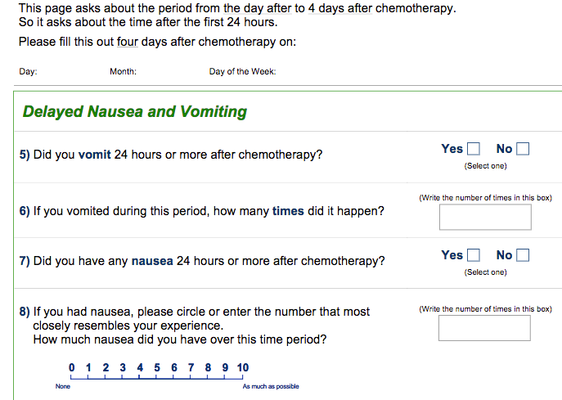
MAT
Molassiotis A, et al. J Pain Symptom Manage. 2007 Aug; 34(2): 148-159.

Slide 49
Antiemetic Medications
Medication | Chemoreceptor Trigger Zone |  |  | Vomiting Center |  |  |  | Vestibular Input |  | Gut |  |  |  | Cortex | CB1
 | D2 | 5HT3 | NK1 | H1 | Ach-m | 5HT2 | 5HT3 | H1 | Ach-m | 5HT3 | 5HT4 | D2 | NK1 | GABA
Haloperidol
Prochlorperazine
Chlorpromazine
Metoclopramide**
Domperidone
Olanzapine
Promethazine
Hyoscine/ Scopolamine
Ondansetron
Mirtazapine
Aprepitant
Lorazepam
Dexamethasone* |  |  |  |  |  |  |  |  |  |  |  |  |  | ?
Marijuana/ Dronabinol
Red: antagonist, green: agonist, shades of red and green indicate relative potency
Modified from Clinical Interventions in Aging (2011)6: 243-259 & Goodman & Gilman Table 16-2
CB1: cannabinoid 1 receptor
*mechanism unclear to date
**the potency of metoclopramide’s antagonism of 5HT2 is dose-related & not significant at lower doses

Slide 50
Clinical Pearls for Choosing Anti-Emetic
Pathophysiology and targeted medications are key
  Similar to how we approach pain management
Drug-drug interactions
QTc prolongation
Movement disorder – caution with dopaminergic agents
Risk of bowel obstruction – caution with metoclopramide, PAMORAs
Constipation – caution with ondansetron
  Treat constipation as part of nausea management!
Ask about vision and motion sickness
  E.g., patient has emesis after imaging during hospitalization
Hot showers can help with Cannabis Hyperemesis Syndrome

Slide 51
Back to Neil
He reports crampy abdominal pain, does not smoke much cannabis, nausea no better with hot shower, nausea worse with eating and drinking. Having BM daily but small, however doesn’t eat much. Ondansetron was added without improvement.
CT scan shows fecal impaction and cancer progression
Plan:
Treat constipation with stimulant laxative
Stop ondansetron
Consider olanzapine for generalized nausea
Steroid may help both tumor pain and nausea

Slide 52
COMMUNICATION
Notes:
MARIANNE START

Slide 53
Neil returns to the hospital
Neil was discharged from the hospital 6 weeks ago. He returns to the hospital for periodic confusion, low appetite, and weight loss. He presents to ED and has AKI again. CT scan shows progressive liver and lung metastases despite resuming systemic treatment since the last hospitalization. He is awake but still hypotensive after 2 L IVFs given overnight. His telemetry shows few PVCs. He is now on 2L supplemental oxygen
Family is at bedside

Slide 54
Objectives
Develop inpatient management plans for cancer-related pain based on cancer pain pathophysiology
Develop inpatient management plan for cancer-related intractable nausea and vomiting based on pathophysiology
Use communication frameworks in patient and family conversations regarding change in cancer trajectory

Slide 55
Breaking Bad News
GUIDE
  Get Ready – Info, People Place
  Understand what the patient/family knows
  Inform starting with a headline
  Demonstrate empathy
  Equip the patient for the next step

Slide 56
Demonstrate Empathy
NURSE
  Name emotion
  Understand
  Respect
  Support
  Explore
  Tell me more
  Ask-tell-ask
  “I wish” statements (and “I worry”)

Slide 57
Family Conference
Gather for pre-meeting
Introduce everyone and agenda
Explain what is happening
Empathize with each person
Highlight the patient’s voice
Plan the next steps together
Reflect post-meeting

Slide 58
Goals of Care, Transitions
REMAP
  Reframe why the status quo isn’t working
  Expect emotions and empathize
  Map the future
  Align with the patient’s values
  Plan medical treatments that match patient values
  Expect questions about more cancer directed treatment
  Talk about services that would help before introducing hospice

Slide 59
RESOURCES
Notes:
MARIANNE START

Slide 60

Center to Advance Palliative Care (CAPC)

Slide 61
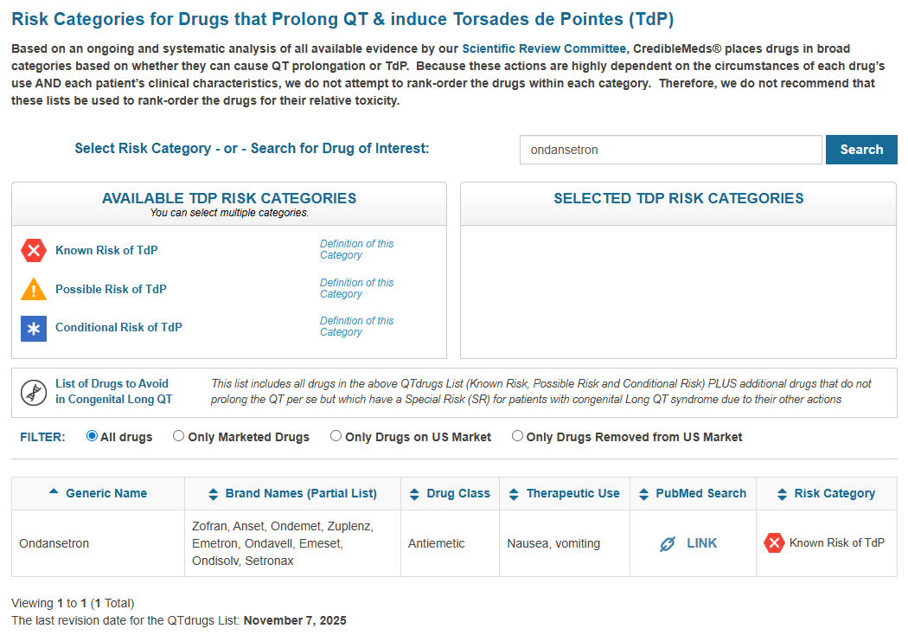
CredibleMeds

Slide 62
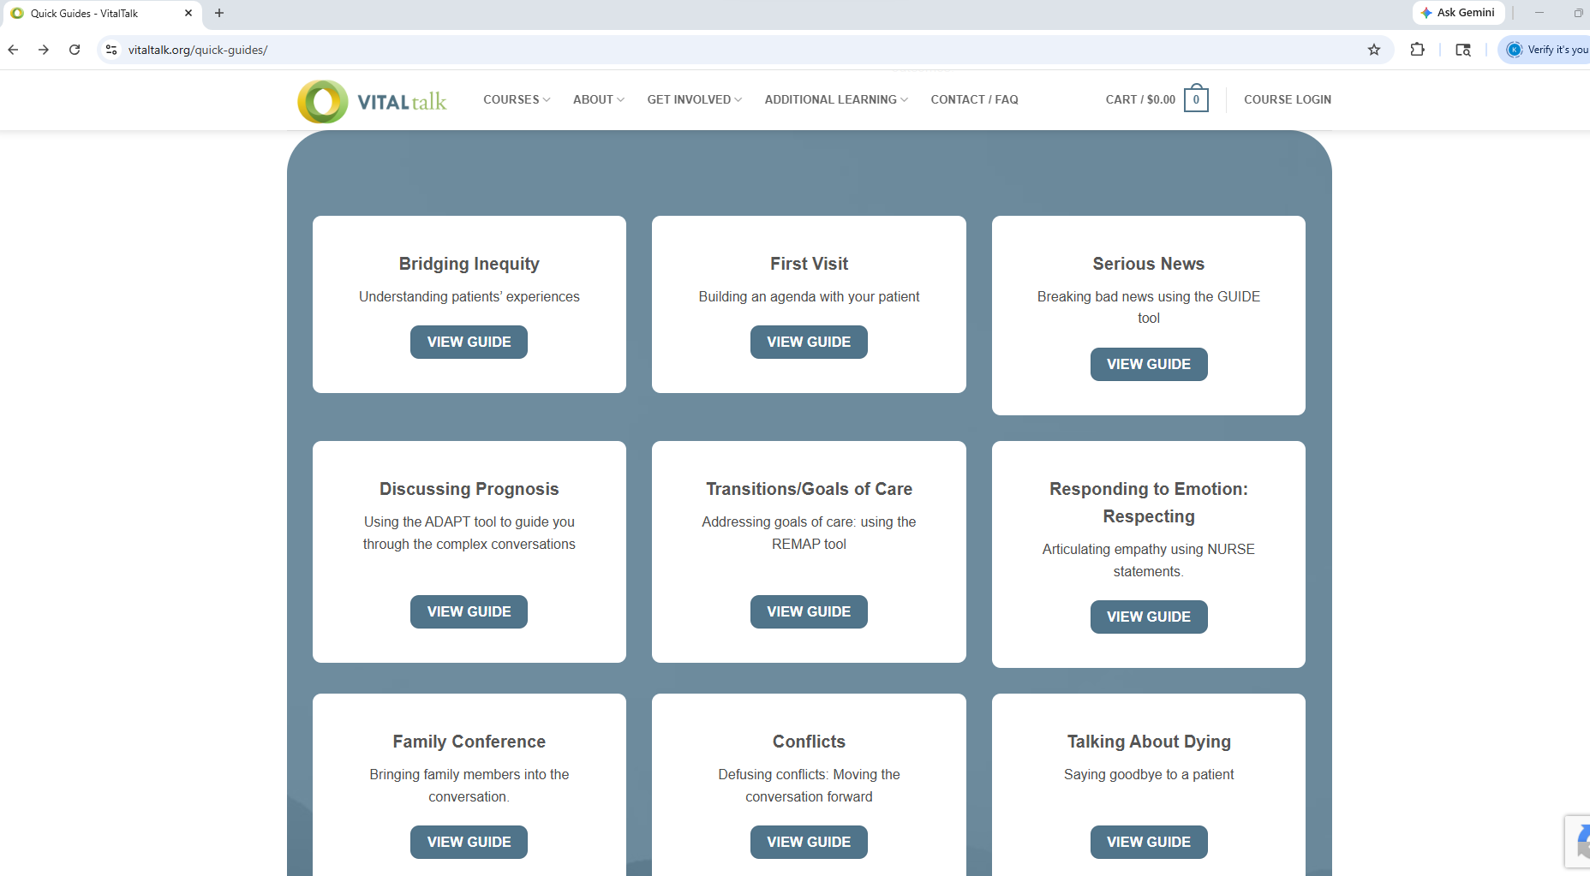
Vital Talk

Slide 63
Questions?
Marianne Carter, PharmD marianne.carter@uky.edu
Katrina Nickels, MD katrina.nickels@uky.edu

Slide 64
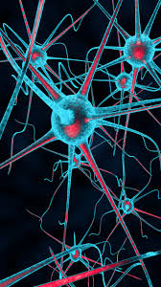
Pain treatment considerations
Etiology
  Nociceptive
  Neuropathic
  Inflammatory
Chronicity
  Acute
  Chronic
  Maladaptive
Notes:
JC

Slide 65
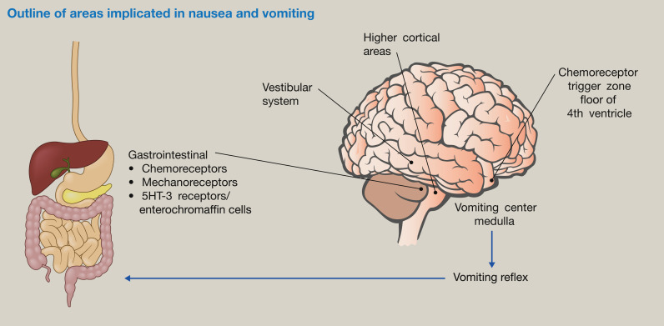
Nausea Pathophysiology
Denholm, L., & Gallagher, G. (2018). Physiology and pharmacology of nausea and vomiting. Anaesthesia and Intensive Care Medicine, 19(9), 513–516. https://doi.org/10.1016/j.mpaic.2018.06.010

Slide 66
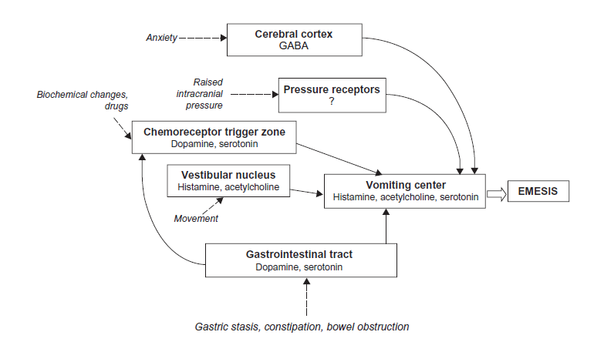
The Emetic Pathway
Glare P, et al. Clin Interv Aging. 2011:6:243-59.
Notes:
Glare P, et al. Treating nausea and vomiting in palliative care: a review. Clin Interv Aging. 2011:6:243-59.

Slide 67
Julia
42 yrs old with DLBCL s/p chemotherapy with metabolic response to treatment on last PET Scan. Reports persistent severe aching pain in the muscle of the upper arm, back, and legs that started during chemotherapy and has persisted.
PMHx: ADHD, Bipolar Disorder, Panic Disorder, bladder prolapse
Medications: Ibuprofen 600mg BID, Cyclobenzaprine 10mg TID, Oxycodone 15mg every 6 hours, Amphetamine/Dextroamphetamine 20mg daily, Clonazepam 1mg BID, Lamotrigine 200mg daily
She requests an increase of her oxycodone
Team discusses her stressors and offers counseling with LCSW, cancer support groups, and referral to Integrative Medicine for massage therapy, which she agrees is a good plan

Slide 68
John & Julia
John continues Bup/Nal and restarts oxycodone 15mg every 6 hours with weekly then bi-weekly then monthly prescriptions. Urine toxicology always shows presence of prescribed opioids and expected metabolites without other substances other than THC. You eventually increase doses of both for cancer pain related to cancer progression and get few calls about early refills of oxycodone that result in bi-weekly or weekly prescriptions and periodic toxicology obtained with lab draws.
He meets with the chaplain during infusions and appears overall less anxious over time
Julia receives oxycodone for cancer pain with weekly then bi-weekly then monthly prescriptions and urine toxicology that never showed cocaine. She had few calls for early refills that resulted in bi-weekly or weekly prescriptions and periodic toxicology.
She continues to engage in counseling with LCSW.
Notes:
Early refills means that there is not a reason to explain why the patient may have had undertreated pain

Slide 69
Julia
42 yrs old with DLBCL s/p chemotherapy with metabolic response to treatment on last PET Scan. Reports persistent severe aching pain in the muscle of the upper arm, back, and legs that started during chemotherapy and has persisted.
PMHx: ADHD, Bipolar Disorder, Panic Disorder, bladder prolapse
Medications: Ibuprofen 600mg BID, Cyclobenzaprine 10mg TID, Amphetamine/Dextroamphetamine 20mg daily, Clonazepam 1mg BID, Lamotrigine 200mg daily, Oxycodone 15mg every 6 hours
She requests an increase of her oxycodone

Slide 70
John
45 yr old with stage IV lung cancer and large hilar chest mass and bone metastasis lumbar spine reports severe left sided chest pain and back pain. He is scheduled for radiation and chemotherapy
PMHx: Opioid Use Disorder
Medications: Ibuprofen 600mg BID, Duloxetine 60mg daily, Gabapentin 800mg TID, Oxycodone 15mg q6h PRN
He was previously on Buprenorphine/Naloxone 16/4mg daily, but decided to stop going to that clinic after diagnosis of cancer and has not taken it in 2 weeks
He calls for urgent refill of oxycodone, as he has run out of a 30 day supply 10 days early

Slide 71
John & Julia – a busy clinic day
John
  He reports restarting buprenorphine/naloxone 16/4mg sublingually daily as you prescribed, which has helped, but he has persistent pain in his chest and requests to restart oxycodone
Julia
  The next PET scan shows relapse of lymphoma. She also reports that she used cocaine once after receiving the bad news, after being abstinent for over 10 years, something you did not know about before. She ran out of oxycodone 2 days early due to increase pain that correlates to PET findings. She does not feel she needs buprenorphine treatment.

