Slide 1

Content updated: December3, 2025
Notes:
Introduce yourself, your module, explain your expertise in the area
This chapter describes the concept of monitoring, evaluating and improving the performance of the trauma program.
Trauma program need to demonstrate continuous process for improving care of the injured.
Safety in medical practice must be monitored.

Slide 2
Introduction & Welcome to the Course
Welcome
Course Agenda
This course contains copyrighted materials that are used with permission from the American College of Surgeons
The course faculty represents the Society of Trauma Nurses and utilize their personal expertise and experience in teaching this content.

Slide 3
Successful Completion Requirement:
Participants must attend the entire event

Slide 4
Continuing Education
Upon course completion:
Email link to online evaluation
Evaluation closes within 7 days
Completion → link to download CE certificate

Slide 5
Continuing Nurse Education
Society of Trauma Nurses is an accredited provider of nursing continuing professional development by:
American Nurses Credentialing Center’s
Commission on Accreditation
This event has been awarded
6.3 contact hours.

Slide 6
Financial Disclosure
Faculty/Presenters/Authors/Content Reviewers/Planners have no conflict of interest relative to this activity to disclose.

Slide 7
Objectives
Upon completion of this activity, participants will be able to:
Discuss optimal trauma center Administrative and Leadership commitment
Define the scope & governance required to be a verified trauma center including the staffing, facilities, services, and equipment required to care for the injured patient
Review best practices in caring for specific trauma populations.
Discuss clinical specialties and services roles in assisting the trauma center to enhance and promote the trauma center’s efficiencies and effectiveness
Discuss the foundational role of the trauma registry, data quality, and data plan in data collection, analysis, and reporting for a trauma center
This course contains copyrighted materials used with permission from the American College of Surgeons.

Slide 8
Objectives (continued)
Describe strategies to standardize trauma care through best practices in caring for specific trauma populations.
Review Performance Improvement (PI) standards
Describe PI structures, concepts, and strategies
Articulate Performance Improvement and Patient Safety best practices
Describe trauma center requirements to provide education and requirements for research and scholarly activities
Apply methods to prepare for a successful virtual site visit and methods to showcase a program’s value.
This course contains copyrighted materials used with permission from the American College of Surgeons.

Slide 9
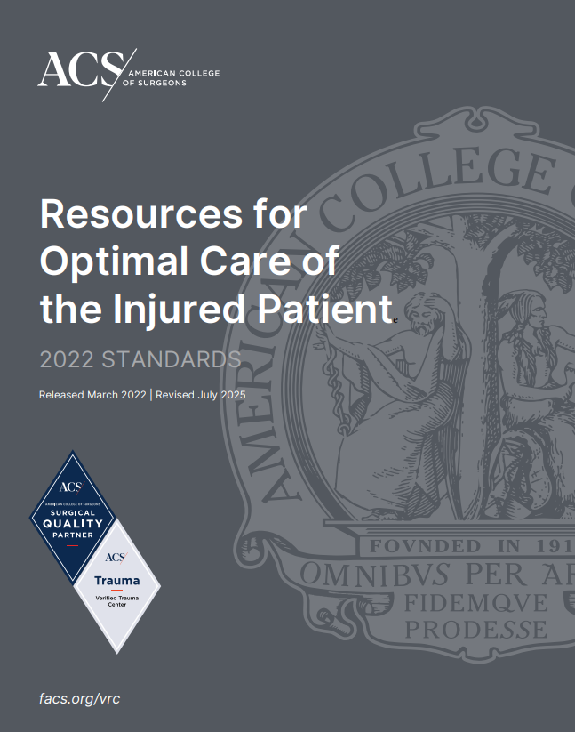
Resources for the Optimal Care of the Injured Patient July 2025 Edition
Book Layout
Structured Template used across ACS programs
Concise Language
Applicable Levels
Definition & Requirements
Additional Information
Measure of Compliance
Resources & References
Notes:
The new grey or charcoal book is formatted to have the same layout across all ACS Quality programs to ensure consistency for hospitals participating in multiple programs.

Slide 10
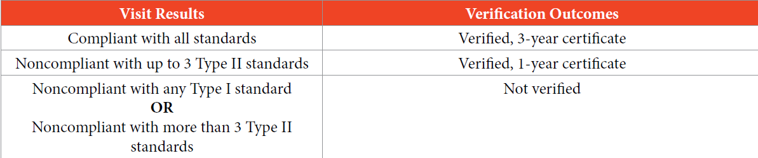
Resources for the Optimal Care of the Injured Patient Dec 2022
Book organized around 9 categories
No longer CDs but compliance or noncompliance with standards
Standards divided into Type I and Type II
Type I standards are considered “critical” and directly impact patient care
Verification Cycle: 36 months preceding expiration date of current status

Slide 11
Nine Categories
Institutional Administrative Commitment
Program Scope and Governance
Facilities and Equipment Resources
Personnel and Services Resources
Patient Care: Expectations and Protocols
Data Surveillance and Systems
Performance Improvement and Patient Safety
Education: Professional and Community Outreach
Research
Notes:
Standard are organized based on 9 categories.

Slide 12
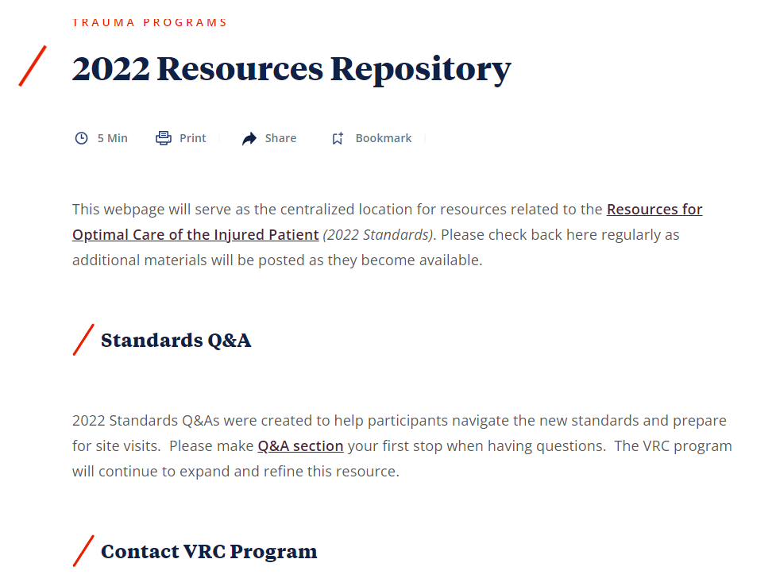
https://www.facs.org/quality-programs/trauma/quality/verification-review-and-consultation-program/standards/2022-resources-repository/

Slide 13
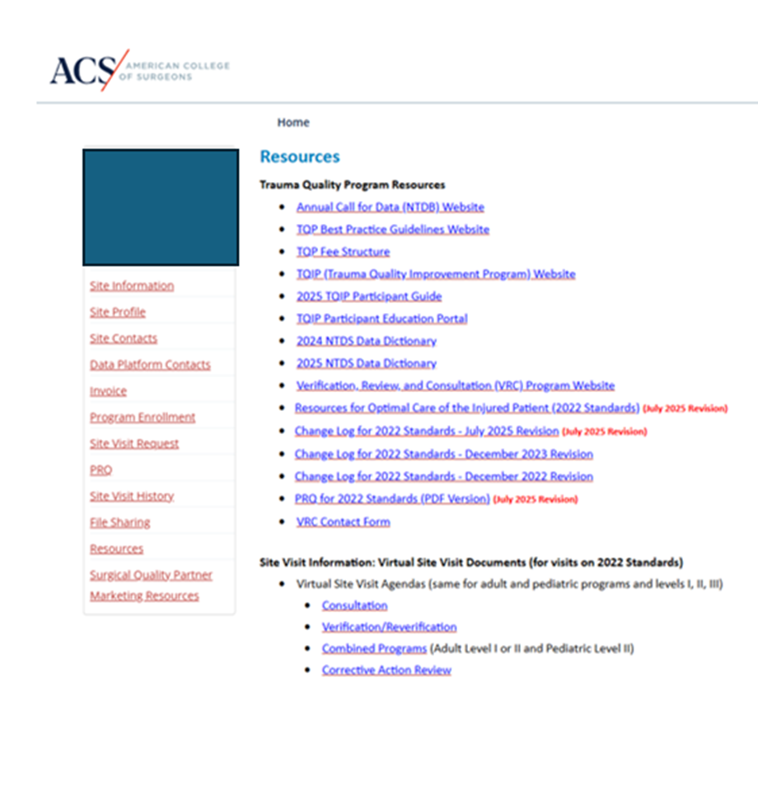
Qport Resources

Slide 14
Questions

Slide 15


1. Institutional & Administrative Commitment
Content update: October 29, 2025

Slide 16

1.1 Administrative Support-Type I
“In all trauma centers, the institutional governing body, hospital leadership, and medical staff must demonstrate, continuous commitment and provide the necessary human and physical resources to properly administer trauma care consistent with the level of verification throughout the verification cycle.”
Method to demonstrate compliance:
Attestation of Commitment (Board of Directors or other administrative authority)
Approval of establishment of trauma center at the specified level
Commitment to adherence of the standards through verification cycle
Commitment to assuring personnel, facilities and equipment are available
Notes:
“In all trauma centers, the institutional governing body, hospital leadership, and medical staff must demonstrate, continuous commitment and provide the necessary human and physical resources to properly administer trauma care consistent with the level of verification throughout the verification cycle.”

Slide 17
1.1 Administrative Support: Key to Success
Administrative Champion
Necessary for program success and growth
Understands Trauma –what it is, depth of resources, supports trauma leaders' responsibility and authority across the organization
Influence with executive leadership
Knowledge of trauma standards and financial impact
Facilitates program and removes barriers
Notes:
This key element is under valued
Needs to understand your resources and fail to retain them
Risk of not managing growth
Person is on speed dial

Slide 18

1.2 Research Support-Type I
Full commitment to trauma research, including:
Lab facilities
Support staff
Equipment
Budget & salary support
Protected research time
Grant funding
Category 9: Research and Scholarly Activities
Methods to demonstrate compliance:
Describe the infrastructure of the trauma research program, including the space, facilities, and human resources that enable the research activity and how this infrastructure is supported.
Highlight any specific successes or challenges.
Notes:
PRQ:
PRQ Question Text [Field Type]
*1. Describe the infrastructure of the trauma research program, including the space, facilities, and human resources that enable the research activity and how this infrastructure is supported. Highlight any specific successes or challenges. [Text box]

Slide 19
2. Program Scope & Governance
Content update: October 29, 2025

Slide 20

2.1 State & Regional Involvement Type II
All trauma centers must participate in the regional and/or statewide trauma system.
Examples include:
Participation in regional and state committees
Participation in EMS advisory committees
Collection & analysis of state/regional data
Provide public & professional trauma education
Work with legislators/authority to promote the trauma system
Notes:
PRQ questions
Describe your center’s participation in regional & state activities
Upload documents that demonstrate/support participation

Slide 21

2.2 Regional Disaster Committees -Type II
All centers must participate in regional disaster/emergency management committees, health care coalitions and regional mass casualty exercises.
Notes:
PRQ
Describe your center’s participation in preparations for a regional disaster response
(for example, committee participation or involvement with health care coalitions).
2. Describe your center’s participation in regional mass casualty exercises over the course of the reporting period.

Slide 22


2.3 Disaster Management Planning-Type II
All trauma centers must be integrated into the hospital’s disaster plan to ensure a robust surgical response.
Trauma Surgeon included as a member of disaster committee and responsible for development of surgical response to a mass casualty event.
Level I must also include an orthopedic surgeon as a member of the disaster committee.
New 4.36 – Level I Trauma Surgeon must complete the DMEP course once.
Response must outline personnel, means of contact, initial surgical (including subspeciality) triage and coordination of secondary procedures
Orthopedics at a minimum
Participation in at least TWO drills or disaster plan activations per year.
Notes:
Make sure you review the response bullet point

Slide 23
2.3 Disaster Management Planning-Type II
To demonstrate compliance:
Describe preparations for a regional disaster response
Describe participation in a regional mass casualty exercise
Provide Hospital-Specific:
Meeting attendance records
Disaster plan
Dates of drills / Reports
*NEW: Address any changes or gaps identified and action plan to address
Date | Drill or Activation | Description of Event
Notes:
PRQ questions:
1. Upload attendance records or meeting minutes demonstrating trauma surgeon
participation (and orthopaedic surgeon participation for LI and PTCI) in disaster
committee meetings over the course of the Reporting Period.
2. Upload your hospital’s disaster plan that includes a surgical response and the
following elements of orthopaedic trauma care: definition of critical personnel
requirements and means of contact, initial triage of orthopaedic patients, and
coordination of secondary procedures.
3. Enter the dates and nature of drills or activations completed during the Reporting
Period in the table below.
4. Highlight any challenges or gaps that have been identified in your center’s disaster
response, and outline the plans to address them.

Slide 24
2.4 & 2.5 Trauma Volume -Type I
LI, PTCI
Adult L1 Center
Volume ≥ 1200 or at least 240 trauma patients with ISS > 15
Pediatric L1 Center
Volume ≥ 200 injured patients < 15 years of age
* Patient must meet NTDS inclusion criteria which include Observation and DOA patients.
ISS | Total #
0-9
10-15
16-24
25+
Total

Slide 25
2.6 Adult Trauma Centers Admitting Pediatric -Type I
LI, LII, LIII
Adult centers ≥ 100 pediatric NTDB patients < 15 years must have:
Designated pediatric Emergency Department area
PICU
Appropriate equipment (check pediatric readiness toolkit)
* Removed: previous surgeon credentialing requirement

Slide 26

2.7 Trauma Multidisciplinary PI PS Committee-Type I
All trauma centers must have a trauma multidisciplinary PIPS Committee chaired by the TMD or an Associate TMD.
*Associate TMD
Combined adult and pediatric trauma centers:
Must hold separate PIPS meetings
Separate attendance and minutes
Demonstrated by providing reference (PIPS Plan/Policy) identifying committee’s scope, membership, frequency and decision-making process.
Notes:
1. Upload terms of reference (policy) that define the committee’s scope, membership,
frequency of meetings, and decision-making process

Slide 27
2.8 TMD Responsibilities-Type II
Board certified or eligible
Direct a single center
Participates in call panel / credentialed
Maintains current ATLS
36 CME/verification cycle
Peds TMD: 9/36 (peds-specific)
Level I TMD
Active member national trauma organization
(ACS, AAST, EAST, WSA, PTS) [not TQIP]
Must attend minimum 1 meeting/cycle
Level II & III TMD
Active member regional, state, or national organization
Must attend minimum 1 meeting/cycle
Notes:
Review what national organizations count (EAST, WEST, AAST) TQIP is not counted in this standard
Only applies to TMD – not associate director
7. Upload appointment letter and attendance records from a national or regional trauma
organization during the Verification Cycle for centers undergoing a reverification review
or Reporting Period for centers undergoing a consultation or initial verification review.

Slide 28
2.9 TMD Responsibility & Authority -Type II
Develops & enforce policies/procedures
Ensures providers meet requirements
Ensures adherence to standards of care
Works across departments to address deficiencies in care
Determine (with liaisons) provider participation in care based on finding from PIPS and Ongoing Professional Practice Evaluation (OPPE)
Oversees PIPS program
Notes:
1. Upload the roles and responsibilities document for the TMD’s position. (This
question is shared between Standards 2.8 and Standard 2.9).

Slide 29
TMD Methods to Demonstrate Compliance
Upload:
Evidence of board certification or board eligibility
Roles and responsibilities document for the TMD’s position. (Job description)
TMD’s credentialing letter
ATLS certificate for the TMD
Call schedules for the most recent three months of the reporting period.
CME certificates and maintenance of certification transcripts
Appointment letter and attendance records from national or regional trauma organization
Is the pediatric TMD board-certified or board-eligible in pediatric surgery? If no, upload:
PALS certificate
Written affiliation agreement and evidence of participation of the affiliate pediatric TMD in process improvement, guideline development, and complex case discussions
Attendance records (including meeting dates) demonstrating the participation in PIPS committee meetings

Slide 30

2.10 TPM Requirements-Type II
Level I
1.0 FTE commitment to the trauma program
36 hours CE/verification cycle
Membership in national or regional trauma organization
Level II & III and Combined Adult Level II/Peds Level II)
At least 0.5 FTE dedicated to TPM-related activities
Remaining time dedicated to other roles within trauma program
Notes:
PRQ:
1. Describe the responsibilities of the TPM and estimate their FTE commitment
associated with these responsibilities.
2. Upload the roles and responsibilities document for the TPM’s position, including
allocation of FTE across roles described above.
3. Upload the TPM’s CE certificates or transcripts obtained during the Verification Cycle
for centers undergoing a reverification review or during the Reporting Period for
centers undergoing a consultation or initial verification review.
4. Upload appointment letter from national or regional trauma organization.

Slide 31
2.11 TPM Responsibilities-Type II
• Partners with the TMD in development of polices and oversight (dotted line)
• Assist with the budgetary process for the trauma program
• Develop and implement clinical protocols and practice management guidelines
• Provide educational opportunities for staff development
• Monitor performance improvement activities
Serve as a liaison to administration and represent the trauma program on hospital and regional committees to enhance trauma care
• Provides oversight of the trauma registry
Notes:
Roles and responsibility document and reporting structure

Slide 32
TPM Methods to Demonstrate Compliance
Describe the responsibilities and estimate their FTE commitment associated with these responsibilities.
Upload the roles and responsibilities document, including allocation of FTE across roles described above (job description)
Upload the TPM’s CE certificates or transcripts
Upload appointment letter from national or regional trauma organization
Upload the relevant organizational chart

Slide 33

2.12 Injury Program -Type II
All centers must have a designated IP professional.
*Level I: IP professional must be someone other than TPM or PI RN
IP Program must:
Prioritize based on registry trends and epidemiological data
Implement at least 2 activities over cycle (based on two separate MOI)
Include objectives and deliverables
Demonstrate partnerships with community organizations

Slide 34
I P Methods to Demonstrate Compliance
Describe the impact your center’s injury prevention program has had in its community.
Upload the job description for relevant staff.
Upload graphs/tables highlighting recent injury mechanism trends in your center’s trauma registry.
Upload the completed “Injury Prevention Activities Report”.
Upload materials related to your trauma center’s injury prevention initiatives: such as posters, flyers, and press release.
Activity Name | Description | Date | Injury Trend Addressed | Participation Data | Evaluation of Outcomes
Notes:
You need to enter your data into the ACS template- number of centers start entering data early (especially if you’re a big IP program)

Slide 35

2.13 Organ Procurement Program-Type II
Affiliated with an organ procurement program (OPO)
Policy for notification of OPO
Brain death protocols defining clinical criteria & confirmatory tests
Notes:
See next slide for specifics
PRQ:
PRQ Question Text [Field Type]
Straight forward with uploading documents

Slide 36
Organ Procurement Methods to Demonstrate Compliance
Upload OPO affiliation agreement
Upload regional OPO notification policy
Upload protocol for brain death
Additional Considerations:
Incorporate OPO activities into PI meetings
Provide ongoing education for team members:
OPO triggers
Family approach policy

Slide 37

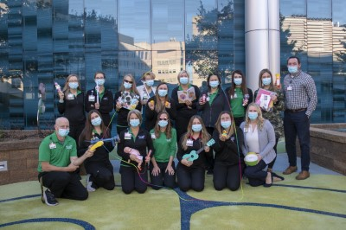
2.14 Child life Specialist-Type II
Child Life Specialist Position
Required for all pediatric centers
Define the program scope
Define roles & responsibilities (scope)
Methods to demonstrate compliance
Describe scope of CLS
Upload roles and responsibilities document (job description)
Notes:
Great opportunity to highlight this resource.

Slide 38
Summary:
It starts from the top
Trauma program must be integrated to State, Region, Local and hospital services
Involve the administrative champion
Understand the standards for your level center
Know your stakeholders

Slide 39
Questions

Slide 40
3. Facilities & Equipment Resources
Content update: October 29, 2025

Slide 41
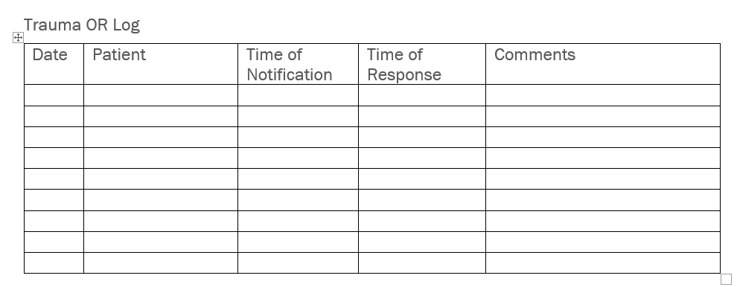
3.1 Operating Room Availability – Type I
LI, LII, LIII, PTCI, PTCII
Keep OR room staffed and available within:
15 minutes (Level I & II)
30 minutes (Level III)
Maintain 24-hour OR staffing with 1 RN and 1 tech
Track OR response time (logbook, EMR, badge swipe)
Time of notification
Time of response
Notes:
An operating room must be available emergently for Level I, II and III trauma centers
When a trauma patient is bleeding or in hemorrhagic shock, they need to get to an OR for surgical intervention
The OR is available within 15 minutes for Level I & II centers and 30 minutes for Level III centers
If you can staff with 2 with an RN and tech 24 hours ( 2 staff) you may not need additional resources

Slide 42
Operating Room Availability
Maintain an OR staffing policy
Document notification and response times
Monitor delays through PIPS
Monthly dashboard
Quality indicator for Delay to OR Room Availability
Trend delays
Show the process during the site visit
Notes:
Compliance is shown through the documentation and tracking of the response times
Delays will be reviewed through the PIPS processes
Can be tracked monthly on your PI dashboard, monthly reports
Can utilize an indicator for delay to OR Room Availability
Trend delays

Slide 43
3.2 Additional Operating Room – Type II
LI, LII, PTCI, PTCII
If the first OR is occupied, an additional OR must be staffed and available for an emergent surgical intervention
Staffing includes nursing and anesthesia
Measured through
OR policies outline the process, staffing & expectations for preparing a second OR
Defined for regular working hours and after hours
Notes:
Timely access to surgical care is critical for the patient with life threatening bleeding. When a first OR is encumbered, a second OR room must be available for life threatening needs.

Slide 44
3.3 Operating Room for Orthopaedic Trauma Care – Type II
LI, LII, LIII, PTCI, PTCII
Level I & II
Dedicated OR prioritized for fracture care for nonemergent orthopaedic trauma.
Level III
OR access made available for nonemergent orthopaedic trauma.
Notes:
Skeletal fixation is secondary to life threatening and immediate resuscitative intervention. Predictable access can lead to planned and or staged surgeries.
The OR availability should be sufficient to provide timely fracture care. This can lead to decreased complications and length of stay.
Ultimately approved by the TMD and Orthopedic Liaison.
Can be tracked in your PI dashboard

Slide 45
3.3 Nonemergent Orthopaedic Room Access
LI, LII, LIII, PTCI, PTCII
Maintain orthopaedic room for prioritizing trauma care
Ability to add cases as needed
Enable timely operative repair of:
open fractures
femur fractures
hip fractures
Monitor timeliness through PIPS
Measured through the orthopedic OR schedules
Written OR policy
Notes:
The standard is met by having a discretionary room for orthopedic surgery that has priority for a trauma.
This can be met by scheduled OR time or block-time but this is just an options not a requirement.
Measure timeliness of orthopedics repair as showing successful room access or avoidance of delay for OR access

Slide 46

3.4 Blood Products – Type I
Level I and II Centers
Must have an adequate supply of [PRC, FFP/plasma, PLTs]
LeveI III Centers
Must have an adequate supply of [PRBCs, FFP/plasma]
Maintain adequate supply to meet facility needs
PIPS: review and monitor MTP
Product timeliness, product access, product ratios
Notes:
Blood products are key to resuscitation in the trauma patient. An adequate blood product supply is important to monitor and trend based on patient needs.
What do you have at your facility? Whole blood, Liquid/frozen Plasma?
This can be done through review of MTP cases

Slide 47
3.5 Medical Imaging – Type I
Availability Requirements
 | Level I and II | Level III
Imaging available | 24 hr/day | 24 hr/day
X-rays | 15 min | 30 min
CT | 15 min | 30 min
US (point of care) | 15 min | 15 min
IR | 60 min
MRI | 2 hr
Notes:
The necessary human resources and equipment are required for each type of imaging. They have a specific required time based on patient need. The response time is based on the time consulted/called and the time imaging initiated. Compliance measured by policies and procedures. Delays are monitored and tracked through the PIPS processes.

Slide 48


3.6 Radiology Imaging Remote Access – Type II
Must have a mechanism to remotely view radiographic images from referring hospitals within their catchment area
Can include email, phone app, picture archiving, and communications (PACS)
Notes:
Compliance- description of the process for remote radiologic access.

Slide 49
Formal Definition of III-N Center
A Level III center that provides neurotrauma care for patients with moderate to severe TBI (GCS of <12) at ED arrival

Slide 50
3.7 Cerebral Monitoring – Type I
LI, LII, LIII-N, PTCI, PTCII
Must have cerebral monitoring equipment available
(measure ICP and/or cerebral oxygenation)

Slide 51
3.8 Cardiopulmonary Bypass Equipment – Type II
LI, LII, PTCI, PTCII
Level I & II centers must have bypass equipment immediately available
Contingency plan for emergent cardiac care if not available
Compliance- measured onsite during the site visit or through the contingency plan
Contingency plan should be written in a guideline/policy
Notes:
Not all centers will have cardiopulmonary bypass equipment.
If your center does not have cardiopulmonary bypass equipment- a contingency plan written in a guideline should be developed.
Any time the contingency plan is activated- it should be reviewed in PI

Slide 52
Summary
Maintain key facilities, services, and equipment
Understand your resources and limitations
Develop contingency plans when resources are encumbered or unavailable
Review through the PIPS program

Slide 53
Questions

Slide 54
4. Personnel and Services
Content update: October 29, 2025

Slide 55
Personnel and Services
Primary and backup Trauma Surgeon call schedules
Specialty Liaison Care
Emergency Medicine
Neurosurgery
Orthopedic Surgery
Anesthesia
Radiology- Interventional radiology
ICU
Medical and Surgical Specialties
Trauma Registry

Slide 56
4.1 Trauma Surgeon Requirements - Type II 4.2 Trauma Surgeon Coverage - Type I
Direct patient care responsibilities
ATLS at least once but *No longer a CME requirement
Privileges in general/pediatric surgery
Board certified/eligible/approved alt pathway
Pediatric Centers
Surgeons are board certified/eligible in pediatric surgery
Level I pediatric centers must have at least 2 ped surgeons
Level II pediatric centers must have at least 1 ped surgeon
Surgeon Coverage: continuously available & dedicated to a single center

Slide 57

4.3 Trauma Surgery Backup Call Schedule-Type II
Published backup call schedule
Backup surgeon not required to be dedicated to one hospital
Notes:
Level I and II centers must have a back up call schedule for trauma surgery. Level III centers will have a back-up call schedule or back-up plan
The back up plan will be published

Slide 58
4.4 Trauma Surgeon Presence in OR-Type II
Must be present for key portions of operative procedures for which they are the responsible surgeon and must be immediately available throughout the procedure.

Slide 59
Alternate Pathway
Applies to:
Trauma Surgeons, Neurosurgeons, Orthopaedic Surgeons, Emergency Medicine, and Anesthesia (Liaison)
Certification/Eligibility:
American Board of Medical Specialties (ABMS)
American Osteopathic Association (AOA)
Royal College of Physicians and Surgeons of Canada (RCPS-C)
Physicians trained outside US/Canada may participate if approved by Alt Pathway
Alt Pathway Requirements:
Completion of equivalent training
36 hours of trauma-related CME (12 hours/yr)
Current ATLS certification
Active membership in 1 national/regional org & attended 1 meeting during reporting period
50% attendance at trauma multi-disciplinary meetings during reporting period
Credentialed to provide trauma care & care is comparable to other physicians
Notes:
Applicable to Trauma surgeons, Neurosurgeons, Orthopedic Surgeons, Emergency Medicine physicians, Anesthesia liaisons only
Exempt if a fellow of ACS prior to January 1, 2017 but must still provide 36 hours of trauma related CME
Put in place by the TMD and specialty liaison and monitored for compliance
Once approved in the alternate pathway, no need to re-apply but must continue to have 36 hours of trauma related CME

Slide 60
4.5 Specialty Liaisons-Type II
Emergency Medicine
Orthopaedic Surgeon-
Anesthesiologist
Neurosurgeon
Radiologist
ICU physician
Geriatric Provider
Emergency Medicine
Orthopaedic Surgeon
Level I must have OTA Trauma Fellowship
OTA Fracture Fellowship does not meet the standard
Adult & Peds program can share OTA trained
Anesthesiologist
Neurosurgeon * includes Level III-N
Radiologist
ICU physician
Geriatric Provider (LI, LII)
Notes:
The specialty Liaisons must be board certified or board eligible in their specialty.
Level III- not required to have a Radiologist or Neurosurgeon ( unless a Level III-N) can also have a CRNA as liaison
The adult and pediatric program can share the same OTA trained Orthopedic Surgeon
See above per the OTA the fracture fellowship does not meet this requirement

Slide 61


Geriatric Provider Liaison
Geriatrician
Physician with expertise and focus in geriatrics
APP with geriatric certification, expertise, or focus in geriatrics
Notes:
The population is aging with a high number of geriatric patients who suffer trauma related injuries. The number one mechanism in many programs is a ground level fall. Further complicated by the geriatric patient taking an anticoagulant who has suffered a fall. Having geriatric expertise as part of the trauma program is key to understanding their care and being proactive about their special needs.
The Geriatric Liaison will assist in the development of geriatric protocols and be available for patient consultation.

Slide 62
4.6 Emergency Department Director – Type I
4.6 ED Physician Medical Director
All centers: Must be board-certified/eligible (in something)
Level I & II: Must be board-certified/eligible in EM or Peds EM
Level III, the ED director must be board-certified or board-eligible
Measure of Compliance:
Roles & responsibilities defined for ED MD
Evidence of board certification/eligibility
Notes:
If completed primary training in specialty other then emergency medicine prior to 2016, may participate in trauma care
Pediatric centers must have at least one physician board certified or board eligible in pediatric emergency medicine
Level III-ACS does not state EM board certified for this level center.

Slide 63

4.7 Emergency Department Requirements –Type II
4.7 ED Physicians
All centers: Must be board-certified/eligible/alt pathway AND have ATLS at least once
All Level I & II: EM trained in non-EM specialties (before 2016) may participate but must hold current ATLS
In addition, Level I Peds: Must have at least 1 board-certified/eligible in Peds EM
Level III: Must be board-certified/eligible in EM, Peds EM, or other specialty

Slide 64
4.8 Emergency Department Physician Coverage -Type I
LI, LII, PTCI, PTCII
Board-certified or board-eligible EM physician must always be present in the ED (defined as 24/7/365) without gaps in coverage.

Slide 65
4.9 Pediatric Critical Care Staffing -Type II
PTCI
Level I Pediatric Trauma Centers
Min 2 physicians board-certified/eligible in either:
Pediatric Critical Care Medicine
Both Pediatric Surgery and Surgical Critical Care
2 physicians must practice at least part of their time in the ICU where most pediatric trauma patients are cared for.
Notes:
Applies to a Level I only

Slide 66
4.10 Neuro Trauma Care -Type I
LI, LII, LIII-N, PTCI, PTCII
Level I & II:
Board-certified/eligible NS coverage continuously (24/7/365) available
Level I Peds:
Min 1 board-certified/eligible neurosurgeon with Pediatric NS fellowship
Level III-N:
Board-certified/eligible neurosurgeons
Evidenced by call schedules and board documents
Notes:
Neurosurgery is an integral the trauma program in a Level I, II and II-N program. Need consistent coverage 365 days/year. Not all trauma centers have adequate neurosurgical coverage, which is why the liaison should be involved in developing the system resources for neurotrauma care. Each facility will have different needs and different models. What resources do you have in your community?

Slide 67
4.11 Orthopaedic Trauma Care-Type I
All Centers
Must have board-certified/eligible orthopaedic surgeon
Coverage continuously (24/7/365)
Contingency plan when encumbered/overwhelmed
Level I Peds
Min 1 board-certified/eligible orthopaedic surgeon with pediatric orthopaedic fellowship

Slide 68
4.12 Specialized Orthopaedic Trauma Care-Type II
LII, PTCI, PTCII
Min 1 orthopaedic surgeon with an OTA Trauma Fellowship or met alt criteria
OTA has clarified that an OTA Fracture Fellowship does not meet standard
May be met with transfer protocols:
Specifying type patients/injuries transferred
Transferred to center with OTA fellowship trained orthopaedic surgeon or meets the alternate training criteria (4.5 outlines the criteria)
Evidenced by Ortho CV and Transfer Protocols
Notes:
The Level II center may have an OTA trained orthopedic surgeon or transfer guidelines specifying the types of injuries that will be transferred to a center with an OTA trained orthopedic surgeon
The trauma versus fracture fellowship is also talked about in 4.5

Slide 69
4.13 Anesthesia – Type I
LI, LII, LIII, PTCI, PTCII
From Time of Request | Level I & II | Level III
Anesthesia Services: -Anesthesiologists -Residents (CA-3, CA-4) -CRNA or CAAs | Present within 15 min | Present within 30 min
Anesthesiologist: -in-house not required | Present within 30 min
Surgical services should track & report to trauma
Monitor delays through PIPS program
Notes:
Anesthesia is a key resource to the trauma center. Define roles and responsibilities of Anesthesia especially when they respond outside of the operating room ( Emergency Dept, ICU, Radiology), etc.
How do you monitor/track response times in the PIPS program? Review cases with any response time delay of Anesthesia.
Be able to speak to your Anesthesia coverage model.
The TPM does not have to track the, surgical services can track and give the TPM reports
Delays reviewed in PIPS program

Slide 70
4.14 Radiology Access-Type I
LI, LII, LIII, PTCI, PTCII
Radiologist will have access to images AND be available to interpret (in person or by phone) within 30 mins of request
Time measured from time of request to time of interpretation
Guideline to support the current practice
Evidenced by Radiology policy, chart review
Notes:
Radiology

Slide 71
4.15 Interventional Radiology (IR) Response Hemorrhage -Type II
LI, LII, PTCI, PTCII
Level I and II
Must have necessary human (physicians, nurses, and technologists) and facility resources
Continuously available (24/7/365)
For endovascular or IR procedures for hemorrhage control in need of rapid response
To begin procedure within 60 minutes (previously arrival of radiologist was 30 min) of request
Time tracked from request to arterial puncture
Track through the PIPS (include mobilization of IR personnel)
Patients requiring a rapid response for hemorrhage control as defined above are those where blood transfusion has been initiated and there is a confirmed blood pressure less than 90 mm Hg at any time prior to angioembolization in adults, or age-specific hypotension in children.
It is not expected that every case undergoing intervention must be initiated within 60 minutes. The expectation is that if the clinical situation dictates the need for rapid intervention, that it can be initiated within 60 minutes. (July 2025)
Notes:
Facility resources – angiography suite or hybrid operating room
This is a new standard and changed from the 30 minutes response at the bedside to 60 minutes to arterial puncture for patients who need interventional radiology for hemorrhage control- an emergent scenario
Can be an interventional radiologist, neurosurgeon/neurologist or vascular surgeon credentialed to perform angiography and embolization and or stent placement
For patients that may need embolization in the pelvis, spleen, etc.
This can be difficult to track/monitor. Can run reports from the registry for emergent angio
Can request the team to utilize a dot phrase to define emergent vs urgent

Slide 72
4.15 Establish Process/Guideline Example
Establish expectations
Monitor compliance
PIPS review
Category A
Procedure initiated within 60 minutes
Hypotensive requiring transfusion; has a lesion that can be embolized (liver, pelvis fracture, intercostal artery)
Category B
Procedure initiated within 2 hours
Active extravasation who do not meet above criteria
Category C
Procedure initiated on same day or first case next day
Pseudoaneursym (liver, spleen, other)
Credit: Avery Nathens, MD, Sunnybrook Health Sciences Centre, TraumaCon 2024

Slide 73
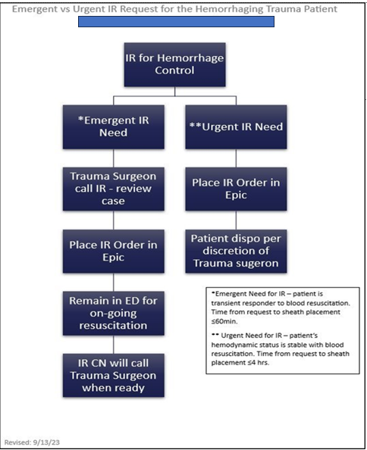
4.15 Establish Process/Guideline Example

Slide 74
Documentation of IR for hemorrhage control
Create registry report to capture critical elements: time of notification, documentation of emergent/hemorrhage control, time of puncture.
Opportunity to create EMR order sets & provider templates
PI process that documents review of cases, action items, loop closure

Slide 75
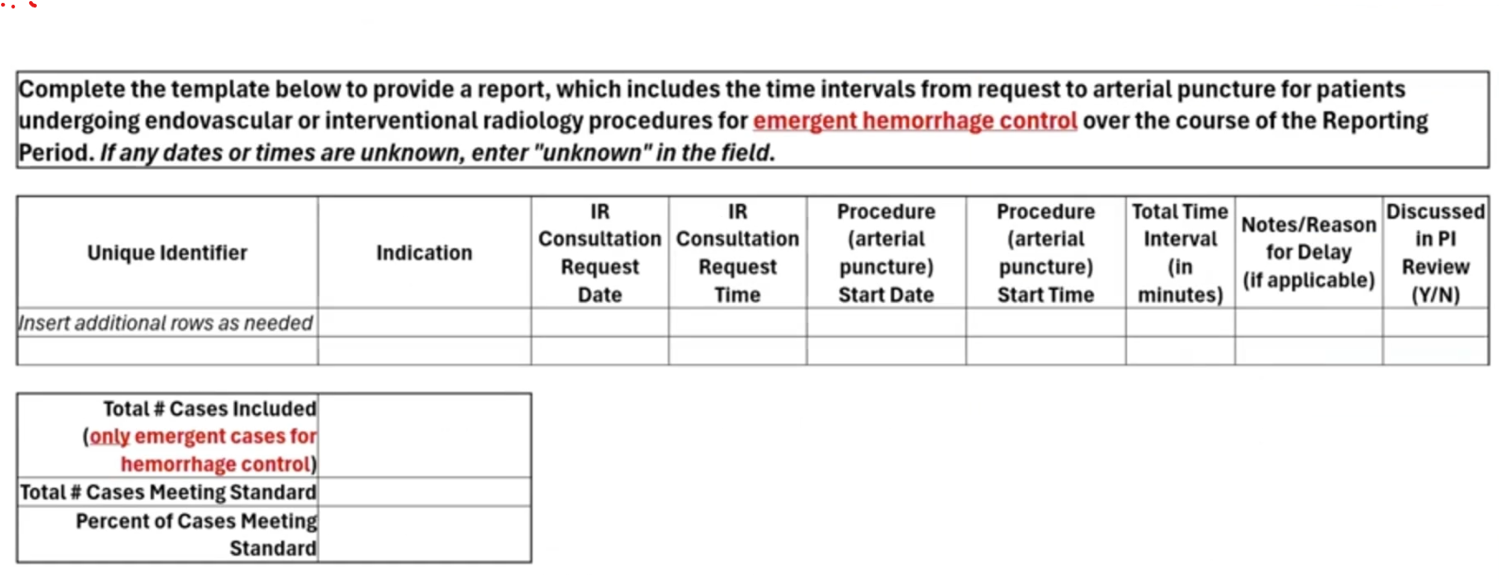
Standard 4.15 – PRQ Template
Notes:
If the center has documented the response time, utilized their PI process to identify an issue, and taken steps to address it – t

Slide 76
4.16 ICU Director-Type II
All Trauma Centers:
ICU Surgical Director is board-certified/eligible in general surgery
Actively participates in unit administration (unit protocols & unit PI)
Provides patient care in ICU, where majority of trauma is cared for
TMD may serve as ICU Director or Co-Director
Adult Level I Center:
ICU Surgical Director is board certified/eligible in surgical critical care
Notes:
The ICU Director is part of your trauma leadership team. Develop guidelines that will drive patient care and good patient care/TQIP outcomes. Track guideline compliance.
How do you incorporate the ICU Director into the Department? ICU Committee involvement, quality projects, rounds…

Slide 77
4.17 ICU Physician Coverage-Type I
LI, LII, PTCI, PTCII
Level I and II Centers
ICU staffed by physicians (Attendings, Fellows, Residents), and APPs
Continuously (24/7/365) available within 15 minutes of request
Primary responsibility to the ICU
Notes:
July 2025
Removed “whose primary responsibility is to the
ICU” from the standard.
Revised to allow coverage to be provided by
physicians (residents, fellows, or attendings) and
APPs
Know your ICU coverage model. Who do you call at 2am when the trauma patient is desating or bleeding? How is trauma notified?
If delays in response, these need to be reviewed in your PI plan
E-ICU physicians has not been addressed by ACS

Slide 78
4.18 Intensivist Staffing-Type II
LII
Level II Centers
Min 1 surgeon must be board-certified/eligible in surgical critical care
Notes:
E-ICU physicians has not been addressed by ACS

Slide 79
4.19 ICU Provider Coverage for Level III -Type I
LIII
Level III Center
ICU provider available within 30 minutes of request with a plan of care
Provider may include Hospitalist, Intensivist, APP
Must have a formal plan to address patients’ immediate needs until attending surgeon is available.
Notes:
E-ICU physicians has not been addressed by ACS

Slide 80

4.20 ICU Nursing Staffing-Type II
LI, LII, LIII, PTCI, PTCII
All Trauma Centers:
ICU nurse-to-patient ratio
1:1 or 1:2 depending on patient acuity as defined by hospital policy for ICU nurse staffing.
Note. ACS book p.60 incorrectly states as patient-to-nurse ratio
Notes:
ACS uses 2 patients/1nurse. This is in all of their documents

Slide 81
4.21 Surgical Specialist Availability-Type I
LI, LII, PTCI, PTCII
Level I and II Centers: In addition to Orthopaedic & Neurosurgery
Must have continuous (24/7/365) coverage of:
Cardiothoracic surgery
Vascular surgery
Hand surgery
Plastic surgery
OB/GYN surgery
Otolaryngology
Urology
**Contingency plan for sporadic gaps (vacation, conferences, etc)
Notes:
Expertise implies the surgeon is credentialled by the hospital to provide services for the trauma patient.
Contingency plan if there are sporadic gaps in coverage due to vacation, conference, etc.

Slide 82
4.22 Ophthalmology Services-Type II
LI, LII, PTCI, PTCII
Level I and II must have continuous availability of ophthalmology or contingency plan to ensure ophthalmic trauma care.
Contingency plan must include an ophthalmologist capable of providing timely surgical care.
While tele-ophthalmology can support initial triage and evaluation, it cannot replace the availability of an ophthalmologist to perform surgical care.
Continuous defined as 24/7/365
Continuous includes both coverage or a contingency plan
Measure of Compliance: narrative of coverage model with support documents (call schedules and a contingency plan and report of transfer-out patients)
Notes:
October update comment:
Tele-ophthalmology can meet initial triage & evaluation but does not meet standard if can’t provide surgical aspect of care.
July 2025 revision wording:
Revised to accept continuous coverage or a
contingency plan.
Revised to require that a contingency plan
ensures optimal and timely care.
Revised to require a narrative of the model of
coverage and relevant supporting
documentation.

Slide 83
4.23 Soft Tissue Coverage-Type I
LI, PTCI
Comprehensive soft tissue coverage of wounds
Includes microvascular expertise for free flaps
Coverage for
Open fractures
Soft tissue coverage - mangled extremity
Soft tissue defects of the head and neck
Notes:
Applicable to the Level I Center
Evidenced by specialty surgeon call schedules

Slide 84
4.24 Craniofacial Expertise-Type I
LI, PTCI
Capability to diagnose/manage
Acute facial fractures
Skull
Cranial base
Orbit
Midface
Occlusal skeleton
Coverage by following specialists:
Otolaryngology
Oral maxillofacial surgery
Plastic surgery
Notes:
The model for coverage of craniofacial injuries can be one single specialty service or a combination of the specialties listed with a call schedule to show coverage and definition of the expertise depending on the nature of the injury

Slide 85
4.25 Replantation Services-Type II
LI, LII, PTCI, PTCII
Replantation capabilities continuously available 24/7/365
OR
Triage and transfer process with a replant center
Notes:
Replantation Services can include the replantation of severed limbs, digit or other body part, including care of the mangled extremity

Slide 86
4.26 Medical Specialists-Type II
LI, LII, LIII, PTCI, PTCII
Availability | Level I & II | Level III
Continuous 24/7/365 (no gaps) | Cardiology Gastroenterology Internal Medicine or Pediatrics Infectious Disease Nephrology Pulmonary Medicine | Internal Medicine
7 days per week | Pain Management (reg nerve blocks) Physiatry Psychiatry
Measure of Compliance: Removed Physician call schedules to align with PRQ

Slide 87
4.27 Child Abuse (Nonaccidental Trauma) Physician-Type II
PTCI, PTCII
Peds Level I and II
Physician board certified/eligible in child abuse pediatrics OR
Physician with special interest/expertise in child abuse
Develops nonaccidental care policies & procedures
Provides inpatient assessment & care (where necessary)
Notes:
This physician will provide leadership to address the needs of children with nonaccidental trauma.
Include development of relevant policies, procedures, inpatient assessment and care

Slide 88
4.28 Allied Health Services-Type II
LI, LII, LIII, PTCI, PTCII
Level I/II
Level III
Respiratory therapy- 24/7/365
Nutritional Support
Speech Therapy
Social work 7 days/week
Occupational Therapy 7 days/week
Physical Therapy 7 days/week
Respiratory therapy 24/7/365
Nutritional Support
Speech Therapy
Social Work
Occupational Therapy
Physical Therapy

Slide 89
4.29 Renal Replacement Therapy Services-Type II
LI, LII, LIII, PTCI, PTCII
Level I & II
Have continuous renal replacement therapy services (no gaps in care)
Intermittent hemodialysis or any form of continuous renal replacement (CRRT)
Level III
Have renal replacement therapy services available OR
Transfer agreement in place
Notes:
July changes:
Added acronym from continuous renal
replacement therapy (CRRT).
Removed “Continuously” is defined as 24/7/365
and implies there are no gaps in coverage.
Level III- may have these services or a transfer agreement in place for where the patient with acute renal failure will be transferred

Slide 90
4.30 Advanced Practice Providers (APP)-Type II
LI, LII, LIII, PTCI, PTCII
Trauma or ED APPs
Who clinically participate in initial evaluation & resuscitation of trauma patients during the activation phase require current ATLS certification.
Does not apply to:
Advanced practice providers for Neurosurgery and Orthopedic surgery
CRNA
CAA
Scribes
Notes:
You will note the name and ATLC certificate expiration date for all the APPS in the PRQ

Slide 91
4.31 Trauma Registry Staffing Requirements-Type II
LI, LII, LIII, PTCI, PTCII
Account for Additional Work
Report Writing:
Research
Injury Prevention
Perf Improvement
Guideline Compliance
Administrative Dashboards
Data analysis
Data cleaning
Data validation
Data submission
Backlog closure, etc.
All Centers:
0.5 FTE for 200-300 annual patient entries
1.0 FTE for maximum of 600 annual patient entries
Registrar can be either on-or-off site
Note: change from admissions to entries
Entries: Patients meeting NTDS criteria AND patients required by hospital, region, state
Combined adult/ped center may share resources
** Additional staff as required to
ensure data integrity & quality
Notes:
July change states on –or – off site
The trauma registry is the foundation for the evaluation of the trauma program. All data that is collected can be analyzed or utilized to support the trauma program functions such as performance improvement, guideline compliance, quality dashboard, injury prevention, and research.

Slide 92
Data Burden & Registry Staffing
300
0.5 FTE per
200-300 annual pt entries
that meet NTDS, TQIP
hospital, state requirements
NTDS
(~100 data points )
TQIP Data Elements
(~35 data points)
PRQ Required/Elements
State Trauma Registry
(varies with state requirements)
Hospital Trauma Registry
(data points vary with guidelines, PI projects, research)
200

Slide 93
Registry FTE Scenario
If your annual registry volume is 2000 admitted patients and 400 activation patient discharges. What is the minimum FTE needed?
3 trauma registry staff
4 trauma registry staff
5 trauma registry staff
6 trauma registry staff
Do you need more information?
If 1 FTE for a max of 600 patients
2400/600 = 4 minimum
May be altered based on additional duties
Assess chart closure timeliness w/i 60 days
Assess data quality (data validation)
Assess existing chart backlog
Additional fields due to State, Research, CPGs
Education, center and external mtgs
Notes:
Answer would be A for minimal registry staff but may be altered based on the additional duties of the trauma registry staff.
Monitor chart closure data within 60 days to determine if adequate FTE

Slide 94
4.32- 4.33- 4.34 Trauma Registry-Type II
LI, LII, LIII, PTCI, PTCII
Min 1 registrar is a current Certified Abbreviated Injury Scale Specialist (CAISS)
All staff who contribute to registry [abstraction, entry, injury coding, ISS calculation, data reporting, data validation] must participate & pass:
AAAM Abbreviated Injury Scale (AIS) Course
Trauma Registry Course [abstraction, data management, reports, validation HIPPA]
ICD-10 course or ICD-Refresher course every 5 years
Min 24 hrs trauma-related CE during the verification cycle (accept prorated CE for registrars hired during verification cycle)
Registrars hired within the Reporting Period will have 12 months from the date of hire to complete all the registry courses.
Notes:
All trauma staff who have a role in data abstraction and entry, injury coding, ISS calculation, data reporting or data validation for the trauma registry must fulfill the requirements
Trauma related CE can be external, internal or online
For consultation ACS visits- staff must have 8 hours of CE during the reporting period

Slide 95
4.35 Performance Improvement Staffing Requirements-Type II
LI, LII, LIII, PTCI, PTCII
PI Personnel
Min 0.5 FTE PI personnel for annual volume >500 patient entries
Min 1.0 FTE PI personnel for annual volume >1000 patient entries
Entries: patients meeting NTDS inclusion criteria AND other hospital, regional, or state inclusion criteria.
When greater than 1000 entries, the facility will determine PI personnel FTE based on program needs and the ability to support the PIPS plan

Slide 96
4.36 Disaster Management & Emergency Preparedness Course-Type II
LI, PTCI
Successful completion of the Disaster Management and Emergency Preparedness (DMEP) course by the trauma surgeon liaison to the disaster committee at least once
Notes:
Need to go to web site
Virtual options are available

Slide 97
Summary
Know and understand your facility resources
Track delays in response times through the PIPS program
Discuss inadequate resources with your Administrative Liaison
Ensure adequate trauma registry resources

Slide 98
Questions

Slide 99
5. Patient Care: Expectations & Protocols
Content update: October 29, 2025

Slide 100
5.1 Guidelines – Type II
LI, LII, LIII, PTCI, PTCII
Rationale
Promote
standardization
of care
↑ Quality of care
Facilitates auditing
Facilitates training
Guidelines
Protocols
→
→

Slide 101
5.1 Guidelines-Type II-Sustainability
Dated
Revised:
q 3 yrs (min)
based on new evidence
opportunities for improvement
Resources: Websites
AAST, EAST, TQIP, WTA

Slide 102
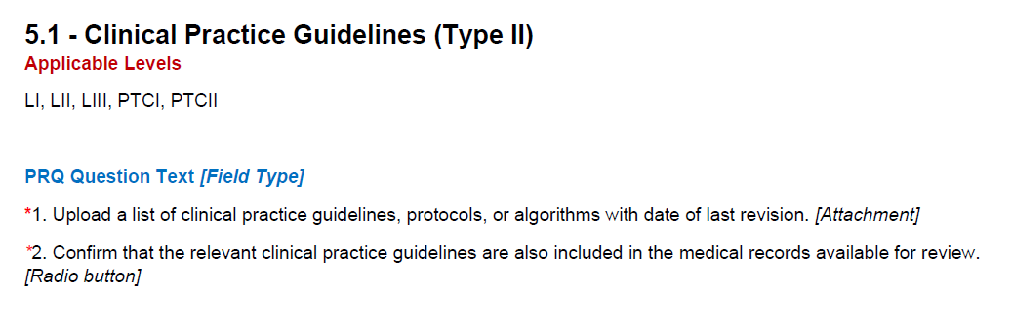
PRQ

Slide 103
5.2 Trauma Surgeon & Emergency Medicine Shared Responsibilities – Type II
The trauma surgeon & emergency medicine physician shared responsibilities for resuscitations must be defined and approved by the TMD

Slide 104
5.3 Levels of Trauma Activation – Type II
LI, LII, LIII, PTCI, PTCII
Minimum 8 Criteria - Highest Level Activation
Confirmed Hypotension
BP < 90 (at any time) adults
Age-specific hypotension peds
GSW neck, chest, or abdomen
GCS < 9 (trauma mechanism)
Transfers in blood infusing)
Transfers in ongoing resp compromise (excludes ETT outside facility resp stable)
Field intubation direct to trauma center
Respiratory compromise or emergent airway
EM physician discretion
Tiered activations define the criteria for each
Center may have additional criteria
Update routinely
Use registry data (under/over triage)

Slide 105
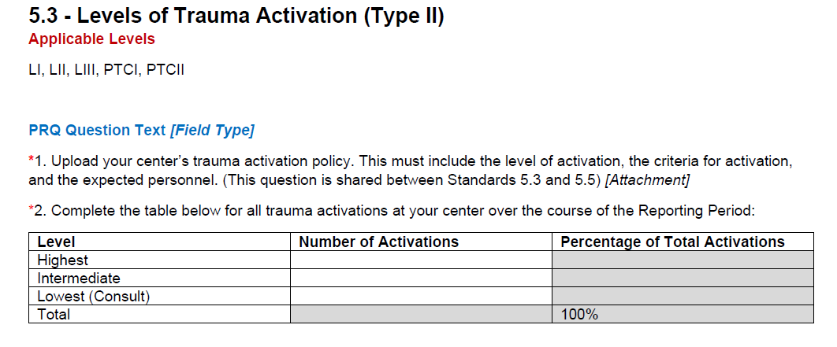
PRQ

Slide 106
5.4 Trauma Surgeon Response Highest Level Activation – Type I
LI, LII, LIII, PTCI, PTCII
80%
of the time
Level I/II: Surgeon at bedside within 15 min of patient arrival
Level III: Surgeon at bedside within 30 min of patient arrival
Walk-in/arrived by private car patient activation “clock” starts at time of notification/page
(ACS communication, reviewed with Dr. Nathens March 2025)
Times must be documented and tracked
Report of highest-level activations & proportion of surgeon response
APPs, & Residents may start resus but do not count for this standard

Slide 107
5.5 Trauma Surgical Evaluation for Activations below the Highest Level – Type II
LI, LII, LIII, PTCI, PTCII
Trauma program defines criteria requiring trauma surgical evaluation
Trauma program defines response time
Track & enforce your policy through PIPS
Create report for time to surgical evaluation for lower-level activations
Time of
initial activation or consultation
Time of
trauma surgery team evaluation
Notes:
This may be something that your center monitors on a dashboard presented at peer review

Slide 108
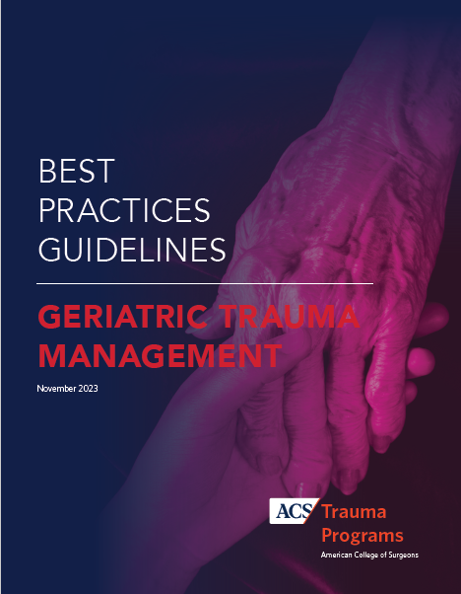
5.6 Injured Older Adult Protocol – Type II
LI, LII
Level I and II Centers Must Have The Following Protocols for Geriatric Trauma:
• Identify vulnerable geriatric patients
• Identify those needing geriatric provider expertise
• Prevent, identify, and manage dementia, depression, delirium
• Process to capture and document patient preferences:
[care goals, code status, advanced directives, proxy decision maker]
• Medication reconciliation and avoidance of inappropriate meds
• Screening for mobility: Ensure early, frequent, and safe mobility
• Implement safe transitions to home or other facilities

Slide 109

5.7 Child Nonaccidential Trauma (NAT) Assessment -Type II
LI, LII, LIII, PTCI, PTCII
All trauma centers must have a process to assess NAT
Show integration with other resources like:
Child Protective Services
Child Advocacy Center

Slide 110

5.8 Massive Transfusion Protocol (MTP) -Type I
LI, LII, LIII, PTCI, PTCII
All trauma centers must have MTP
Collaboration between Trauma Service & Blood Bank
MTP Should Include
Activation trigger
Cessation process
Unused blood preservation
Immediate availability of clotting studies

Slide 111
5.9 Anticoagulation Reversal Protocol -Type II
LI, LII, LIII, PTCI, PTCII
All centers must have rapid reversal protocol
Protocol should include:
Therapeutic options
Indications for use of each reversal agent

Slide 112
5.10 Pediatric Readiness -Type II
LI, LII, LIII, PTCI, PTCII
Pediatric Readiness To Treat Injured Child
Infrastructure
Administration
Coordination of care
Personnel
Pediatric-specific policies
Equipment
Other resources
All centers EDs must perform:
Pediatric readiness assessment
During verification cycle
Plan to address identified gaps
Compliance:
Pediatric Readiness Assessment Gap Report
Resource:
https://www.pedsready.org/

Slide 113
5.11 Emergency Airway Management -Type I
LI, LII, LIII, PTCI, PTCII
Provider & equipment immediately available
Provider capable of advanced airway techniques + surgical airway
Compliance:
Emergency Airway Plan
Specify provider, means of escalation, and equipment

Slide 114
Transfer Related Protocols – Type II
LI, LII, LIII, PTCI, PTCII
# | Protocol | Requirements
5.12 | Transfer Protocol | -Patient type, expected time for frame initiating & accepting transfers -Predetermined referral centers for outgoing transfers
5.13 | Decision to Transfer | -Transfer must be based on patient needs (not payor status) -Transfer in managed care network made only after patient stabilized
5.14 | Transfer Communication | -Direct communication between transferring & receiving provider -Includes communications through transfer center -Communication documentation may include call logs, emails, EMR documentation, patient summary reports

Slide 115
Diversion Protocol – Type II
LI, LII, LIII, PTCI, PTCII
Diversion: time trauma center is not accepting patients from scene or interfacility transfer
5.15 Diversion Protocol
Protocol must be approved by the TMD
Trauma surgeon of pt must agree to diversion
Notification process for dispatch & EMS
Diversion log: reasons & duration documented
Possible Diversion Reasons:
CT scanner down
Critical infrastructure failure
weather, electrical, IT
Lack of essential services
Neurosurgeon encumbered
Trauma Surgeon encumbered
ICU beds, Staffing
5.16 Diversion Hours
Not to exceed 400 hrs during reporting year
Maintain diversion log/report

Slide 116
5.17 Neurosurgeon Response - Type II
LI, LII, LIII-N, PTCI, PTCII
All Centers NS evaluation must occur within 30 min of request:
Severe TBI (GCS <9) + CT evidence intracranial trauma
Mod TBI (GCS 9-12) + CT evidence pot intracranial lesion
Spinal cord injury + deficits (neuro/ortho spine surgeon)
Trauma surgeon discretion
Level I, II, III-N Response Documentation:
NS attending response times document
(request time, eval start time)
Resident/APP response times document
(request time, eval start time, communication time to NS attending)
All centers:
NS attending involved in decision making
Notes:
For neurosurgery they can call in for the assessment or start of imaging and not be at bedside but good documentation must be available in the chart to confirm this.

Slide 117
5.18 Neurotrauma Plan of Care for Level III Trauma Centers -Type II
L III
All Level III trauma centers must have a written plan approved by the TMD that defines the types of neurotrauma injuries that may be treated at the center.

Slide 118
5.19 Neurotrauma Contingency Plan – Type II
LI, LII, LIII-N, PTCI, PTCII
Definition: Neurosurgery capabilities are encumbered or overwhelmed when inability to meet standards of care for time-sensitive injuries
Level I, II
Implement plan when NS encumbered, overwhelmed, unavailable
Level III-N
Have contingency plan that includes the potential for diversion
Implement plan when NS encumbered, overwhelmed, unavailable
Plan must include:
PI review of each instance
Monitor effectiveness of the process through PIPS
Notes:
NS Backup call no longer required

Slide 119
5.20 Treatment Guidelines for Orthopaedic – Type II 5.21 Orthopaedic Surgeon Response – Type II
LI, LII, LIII, PTCI, PTCII
# | Protocol | Requirement
5.20 | Ortho Injuries | Must have treatment guidelines for: Unstable pelvic ring (hemodynamically unstable) Long bone fx (multi-injured) [time & order fix, damage control vs defin fix] Open extremity fx [time to abx & OR, wnd coverage] Hip fx geriatric [time to OR]
5.21 | Ortho Response APP/Resident may act as consultant with documented communication with Orthopaedic Surgeon | Orthopaedic Surgeon at bedside within 30 min of request: Pelvic fx (hemodynamically unstable) R/O compartment syndrome Fx/dislocation with risk of avascular necrosis Fx/dislocation with vascular compromise Trauma surgeon discretion
Document Times:
-Request time
-Eval start time
-Communicate to attending time

Slide 120
5.22 Operating Room Scheduling Policy – Type II
LI, LII, LIII, PTCI, PTCII
All trauma centers must have an OR booking policy that specifies targets for timely access to the OR based on level of urgency and includes access targets for a range of clinical trauma priorities
Measure of Compliance
OR scheduling policy

Slide 121
ICU Patients – Type II
LI, LII, LIII, PTCI, PTCII
5.23 Surgical Evaluation – Type II
Patients requiring ICU admission
Must be admitted OR evaluated by a surgical service
Center defines timely response:
Example: tertiary exam completed within 2, 6, or 24 hrs of admission, or per center policy
ICU Policy: includes notification of changes in care to the trauma service
Compliance: ICU Policy, chart review
5.24 Trauma Surgeon ICU Responsibility-Type II
Trauma surgeon remains responsible for ICU patient care, is kept informed and concurs with major care decisions, until the trauma surgeon documents transfer of primary responsibility to another service.

Slide 122

Imaging Protocols – Type II
LI, LII, LIII, PTCI, PTCII
# | Protocol | Requirements
5.25 | Communicating Critical Results | Preliminary Report: Evidence critical findings were communicated to trauma team Final Report: Reflect chronology & content of communication to trauma team Include changes between preliminary and final interpretations
5.26 | Timely CT Scan Reporting | Documentation of final interpretation Within 12 hrs of scan completion
Notes:
December 2023 changes:
Radiology reports will be evaluated during the
site visit process and will no longer be collected
through the PRQ.
Added institutional policies that address timely
CT scan reporting for trauma patients.

Slide 123
5.27 Rehabilitation Services- Acute Phase of Care-Type II
LI, LII, LIII, PTCI, PTCII
All centers must meet rehabilitation needs during acute care:
Screen patients requiring rehabilitation services
Assess rehabilitation care, needs, services
Provide timely rehabilitation services during acute stay
Multidisciplinary assessment:
physician input
physiatry (where applicable)
physiotherapy
occupational therapy
speech language pathology
mental health providers
Compliance Measures:
Evidence of a Rehabilitation Protocol
Chart review showing:
early multidisciplinary assessment
multidisciplinary plan of care
timely provision of rehab services

Slide 124
5.28 Rehabilitation & Discharge Planning- Type II
LI, LII, LIII, PTCI, PTCII
All Centers Must Determine:
Level of care required after discharge
Specific services for next level of care
Med record documentation
Disposition options:
Home with services
Outpatient rehabilitation
Inpatient rehabilitation
Skilled nursing facility
Long term acute care hospital
Specific expertise: SCI, TBI, etc.
Patient Centered Care
Level I & II Centers should use
Patient-centered strategies such as:
Peer-to-peer mentoring
Trauma survivor program
ATS Trauma Survivors Network (TSN)
Pt reported outcomes (PROs) data collection
Continuous case management
Wrap around services, Navigator positions
Trauma center community linkages
Compliance Measures
Site visit review of the process
Chart review

Slide 125
5.29 Mental Health Screening -Type II
LI, LII, LIII, PTCI, PTCII
All centers must meet trauma patients mental health needs
LI, LII, PTCI, PTCII
Must have a protocol to screen patients at high risk for psychological sequelae with subsequent referral to a mental health provider
Level III
Must have a process for referral to a mental health provider when a problem case or risk is identified during inpatient admission
Compliance
Mental health screening and referral protocol (LI, LII, PTCI, PTCII)
Mental health referral process (LIII)

Slide 126
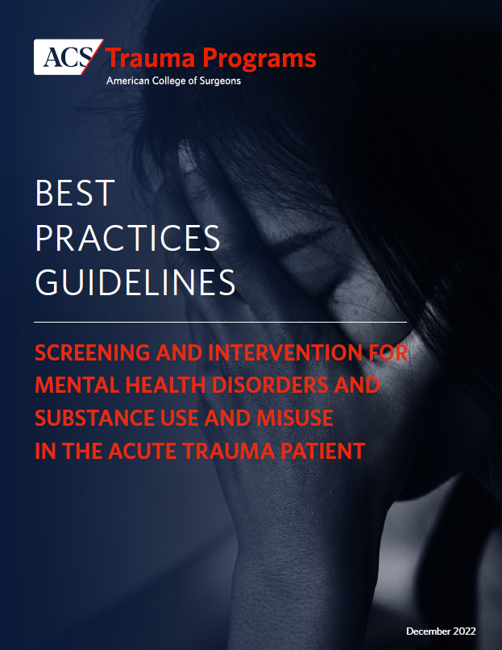
Identify at risk patients
Intervene to reduce risk
Refer chronic patients

Slide 127
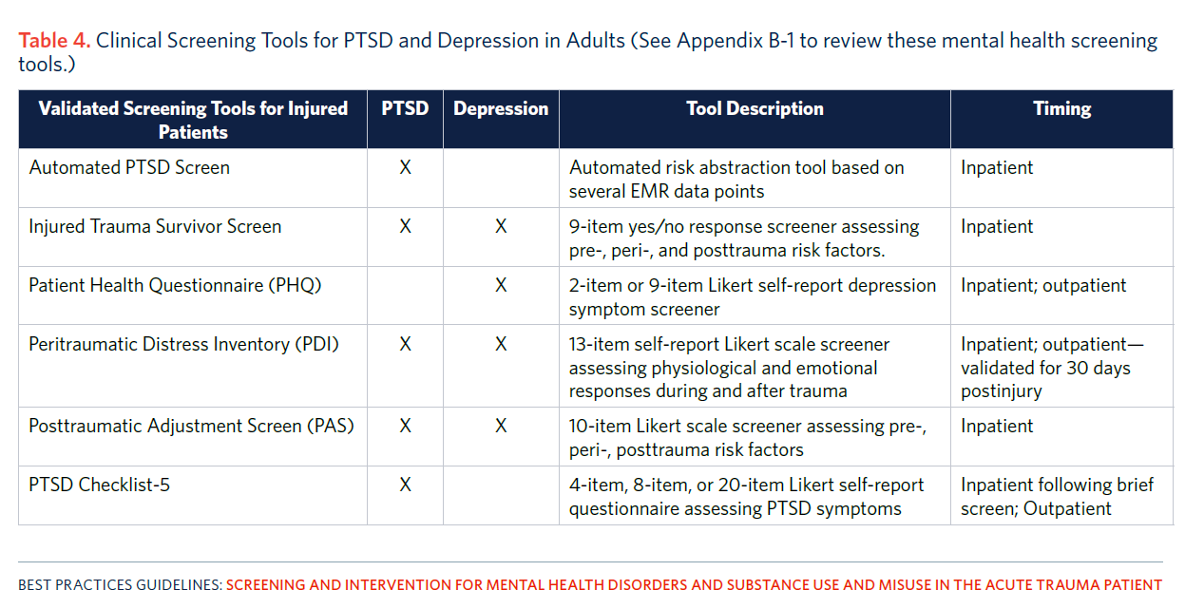
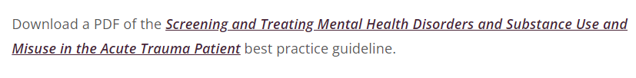
Notes:
Embed into EMR

Slide 128
Various Models
Partner with Psychology Departments
Integrate trauma psychologists → trauma team
Stepped care model→ Screen & Brief Intervention→ clinic follow up → long term follow up
Trauma team screens → Consultation-Liaison Service
Tech solutions
Integrate screening tool into EMR
Automated text messaging
Telephone screen 30-day p/dc
Telehealth follow up

Slide 129
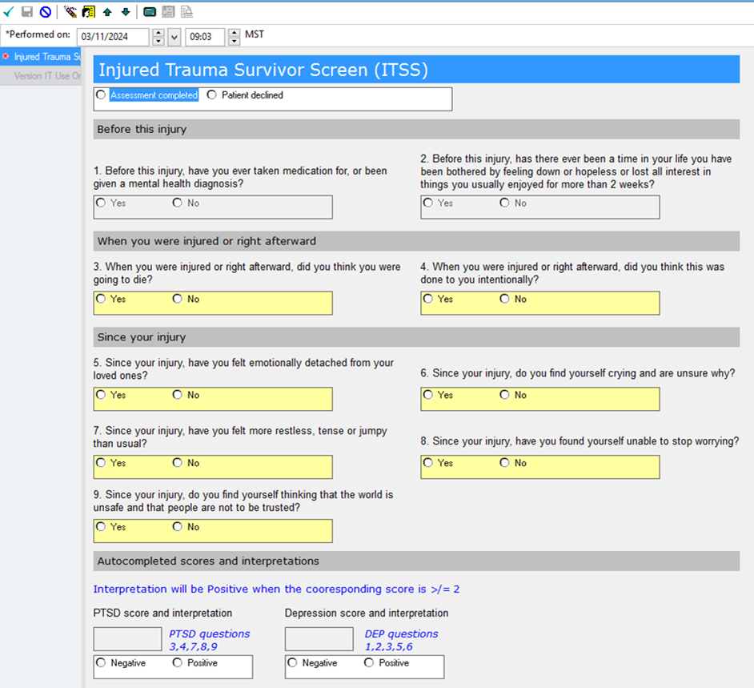
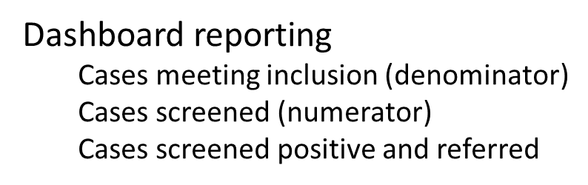
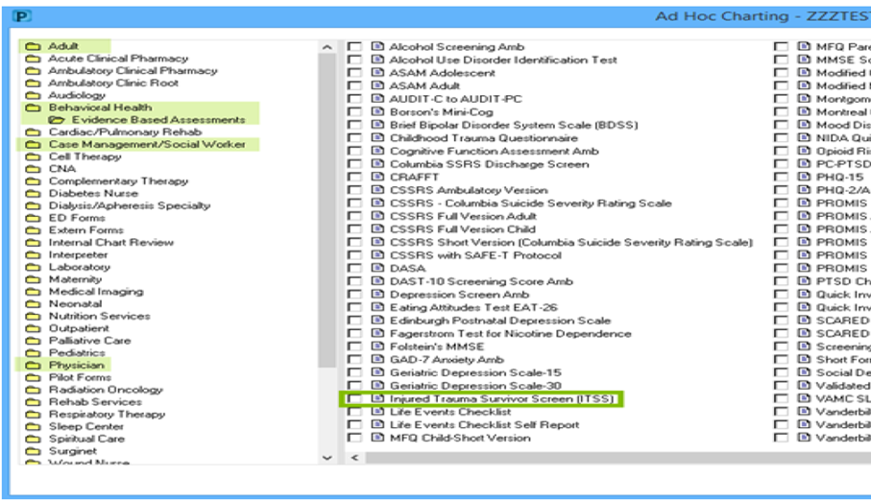
5.29 Documentation - ITSS

Slide 130
Alcohol Misuse -Type II
LI, LII, LIII, PTCI, PTCII
5.30 Alcohol Misuse Screening (min 80%)
All centers must screen all admitted trauma patients (age >12 yr) by:
Validated tool OR
Routine blood alcohol testing
5.31 Alcohol Misuse Intervention (min 80%)
All centers, at least 80% of patients who have screened positive for alcohol misuse:
Must receive a brief intervention before discharge
By staff trained & credentialed by center
May include RN, MSW
Level III
At least 80 percent of patients who have screened positive for alcohol misuse must receive a brief intervention by appropriately trained staff prior to discharge. This intervention must be documented. If brief intervention is not available as an inpatient, there must be a mechanism for referral.
Centers that do not have brief intervention available must be able to track referrals for those screened positive.
Compliance Measures
Alcohol Misuse Report
Screening Brief Intervention and Referral to Treatment (SBIRT) Protocol
Alcohol Misuse Intervention Report
Resource
COT, ACS Alcohol SBI for Trauma Patients
https://www.facs.org/-/media/files/quality-programs/trauma/publications/sbirtguide.ashx
Numerator | # pts (participatory/survived to DC) that received an intervention
Denominator | # pts (participatory/survived to DC) who screen + misuse
Notes:
Above bolded print is new clarification from July 2025 update.

Slide 131
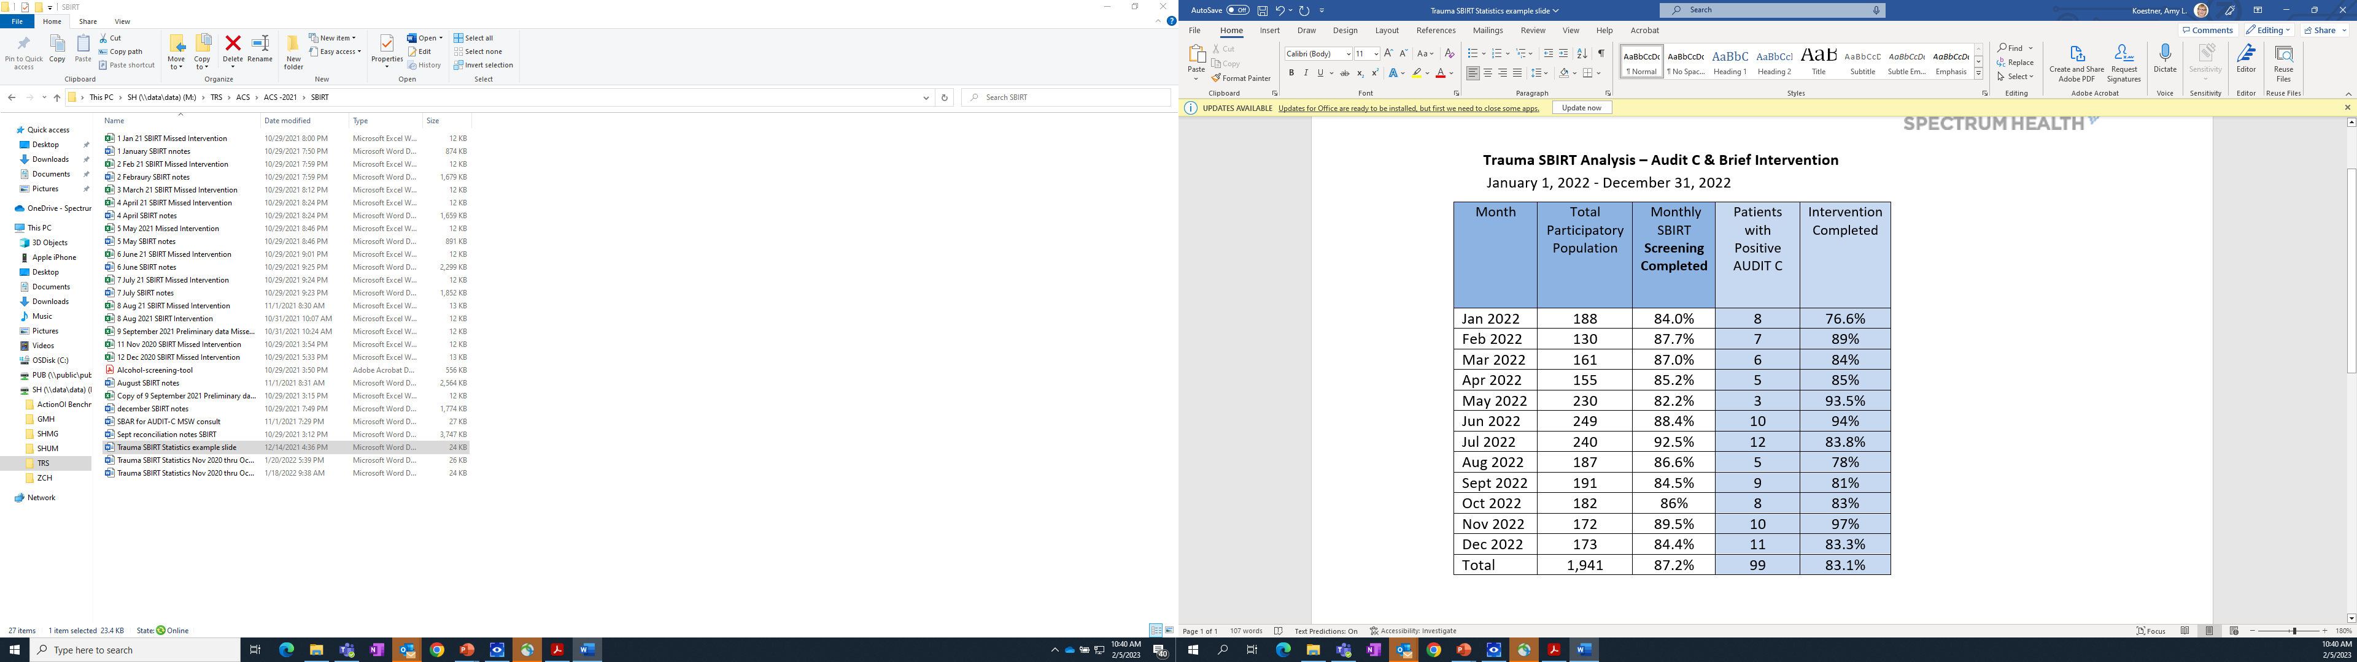
SBIRT Report Example

Slide 132
6. Data Surveillance and Systems
Content update: October 29, 2025

Slide 133
6.1 Data Quality Plan – Type II
LI, LII, LIII, PTCI, PTCII
Written data quality plan
Measures, monitors, identifies, and corrects data quality issues
Maintains a data validation process (internal or external)
Evidence of regular review of trauma registry data validation reports
Evidence of comprehensive review of external data validation reports
Demonstrate plan compliance
Minimum quarterly review of data quality

Slide 134
AIS Coding – AAAM Position Statement
ACS has been working with AAAM to confirm rules for AIS coding.
“It is the rule for AIS coding, that only the injuries identified during the time spent at the referring facility should be coded and entered into the trauma registry for that facility.”
“For the purposes of performance improvement (PI), the receiving facility may send a list of injuries, severity, and/or AIS codes to the referring facility. These should be noted in the PI modules of the registry, however, not entered into the diagnosis codes as they were not diagnosed at that referring hospital.”

Slide 135
6.2 Trauma Registry Patient Record Completion - Type II
LI, LII, LIII, PTCI, PTCII
All centers - trauma registry must be concurrent
Min 80% of records complete within 60 days of discharge
Compliance:
Registry report covering the reporting year

Slide 136
6.3 Trauma Registry Data Collection and Submission – Type II
LI, LII, LIII, PTCI, PTCII
Compliance with NTDS
Meets inclusion criteria
Meets data elements definitions
Must submit most recent call for data
Data that occurred >30 days prior to site visit
Measures of Compliance
Submit all records meeting NTDS
Records must pass the NTDS validation
Records must include at least 12 continuous and complete months

Slide 137
Questions

Slide 138
7. Performance Improvement (PI)
Content update: October 29, 2025
Notes:
This chapter reviews processes for identifying adverse events and implementing subsequent corrective action plans, measurable through patient outcomes.
Problem resolution, outcomes improvement, and loop closure are readily identifiable through the PI structure.
These are core functions- the framework of what we do. How we achieve the best patient outcomes and strive to continuously improve care to our patients and families.
Performance Improvement is the number one reason for programs not passing their visit, requiring a focus visit or need to strengthen their processes.

Slide 139
What are your challenges in doing PI?
Discoverability: Difficulty identifying PI issues or lack of culture of reporting PI issues
Fact Finding: Difficulty getting people to respond to requested information regarding a PI concern
Documentation: Poor or missing documentation surrounding events of a PI concern
EMR Timeline Challenge: Difficulty tracking exact
timeline of care within EMR hinders PI
Under Resourced Registry/PI Staff: Inadequate
registry/PI staff to stay concurrent with volume
TMD Engagement: Lack of TMD time or commitment
Trauma Team Engagement: Lack of trauma surgeon/trauma team engagement with PI
Liaison Engagement: Difficulty getting liaisons to engage with PI
Ancillary Services: Lack of PI support or follow-through from administration or department heads
Guideline Use/Adherence: Lack of surgeon/team accountability to adhere to established guidelines

Slide 140

Performance Improvement
#1 Reason
Unsuccessful Site Survey Visit
Or Need for Focus Visit
Can you Prove-Show-Demonstrate that you provide good care?

Slide 141
7.1 Trauma PIPS Program-Type II
LI, LII, LIII, PTCI, PTCII
The PIPS program must be independent of the hospital quality program, but it must report PI activities through the hospital quality program. (departmental PI program language removed).
PIPS should report events to the hospital to aggregate across the organization
PIPS program must be empowered to identify opportunities for improvement and develop action plans
This involves providers across departments and disciplines.
Describe process in PIPS plan and include organizational chart
PRQ- Upload hospital org chart showing relationship of PIPS to hospital PI program
Notes:
This is a collaborative relationship. The hospital quality program must have the ability to provide feedback and loop closure to the trauma program.
PRQ- Upload the hospital organizational chart reflecting the relationship of the PIPS program to the organizational PI program
Opportunity to show bi-directional PI
How do you communicate with Quality

Slide 142
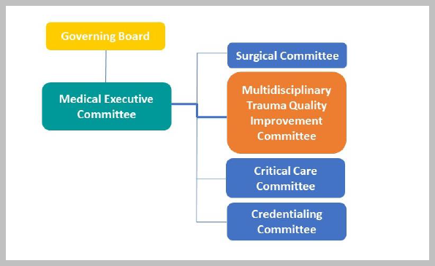
Example: Hospital Reporting Relationship

Slide 143
Links to Hospital Quality
Link through the levels of review for certain cases (tertiary review)
Quality representative sits on your Peer Review Committee
Participation in your Hospital Quality Committee
Sharing of confidential trauma PI meeting minutes
Monthly report to quality dept or Medical Executive Committee
Notes:
In Level III facilities, may have the trauma meeting in conjunction with the quality meeting

Slide 144
7.2 PIPS Plan-Type II
LI, LII, LIII, PTCI, PTCII
Outlines the organizational structure of your PIPS process
Details event identification, audit filters, reports
Defines levels of review (primary, secondary, tertiary, quaternary)
Who will perform the review and the level of closure
Includes action planning and event resolution
Specifies PI committees: purpose, members, responsibilities
Notes:
The PIPS plan is your standard work, outlining how you do PI in your trauma program. It is the explanation of what you do daily.
. Highlight any aspects of your center’s PI plan that you would like to call to the
reviewers’ attention. If you have challenges with specific aspects of the program,
please describe them.

Slide 145
Components of the PIPS Plan
Authority & Scope
Registry Roles & Processes
Data Management
Data Validation Process
Issue Identification
Levels of Review
Audit Filters/Reports
Committee Structure
Attendance
Roles & Responsibilities, Liaisons
Judgment Determination
Consent Agenda Use
Action Plan & Implementation
Event Resolution & Re-evaluation
Confidentiality
Integration into Hospital QI
Use of Benchmarking Data
Guideline development

Slide 146
Example Audit Filters
•Surgeon arrival time for the highest level of activation
•Delayed evaluation by specialists
•Delayed recognition or missed injuries
•Prehospital triage compliance
•Delays or adverse events in prehospital care
•Compliance of trauma team activation protocols
•Accuracy of trauma team activation (over & under triage)
•Delays in care due to EM physician unavailability (Level III)
•Unanticipated return to the OR
•Unanticipated transfer to the ICU or higher level of care
•Transfers out of the facility for appropriateness and safety
•All nonsurgical admissions
•Radiology interpretation errors/discrepancies between reports
•Delays to time-sensitive diagnostic or therapeutic interventions
•Timely access to OR for urgent surgical intervention
•Delays in response to the ICU for patients with critical needs
•Lack of essential resuscitation equipment
•MTP activations
•Significant complications and adverse events
•Transfers to hospice
•All deaths reviewed: inpatient, ED deaths (DIED), DOA
•Inadequate or delayed blood product availability
•Patient referral and organ procurement rates
•Delays in providing rehab services
•Screening and intervention for alcohol misuse
•Pediatric admissions to non-pediatric trauma centers
•Neurotrauma care at Level III trauma centers
•Trauma and neurotrauma diversion
•Benchmarking reports
•Screening and intervention for psychological sequelae
Notes:
These are a minimum set of required audit filters, events or report review. This is not an all-inclusive list as you may have additional audit filters or reports base don your program needs.
Over and under are back in with the caveate that is should be looking at use of your activation criteria

Slide 147
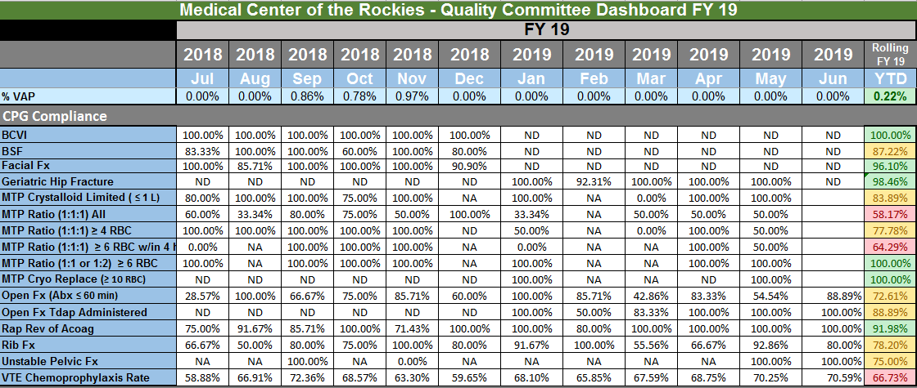
Example Guideline Compliance Dashboard

Slide 148
PI Role Responsibilities
TMD
Program authority
Empowered to lead
Change Agent
Chair Peer Review Meeting
Call panel authority
Ultimate responsibility
TPM
Empowered to Lead
Oversee trauma program staff
Day-to-day operations
Knows the patients
Collaborates across departments
Multidisciplinary responsibilities
Notes:
Reinforce that this info was already presented in an category

Slide 149
Liaison Expertise
Focused liaison meetings
TQIP benchmarking review
Protocol and guideline development
Specialty-related PI
Communicates with colleagues-how do you confirm?
Attends trauma peer review meetings (Standard 4.5)

Slide 150
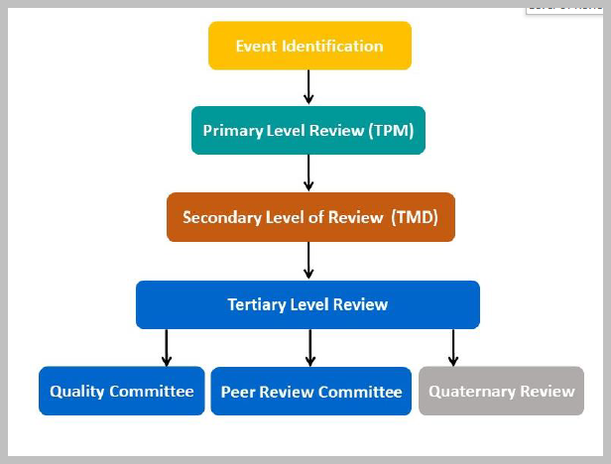
Levels of Review
+ PI Personnel

Slide 151

Examples: Level of Review
Primary Review
TPM
Direct admits
NSA ISS <9
Prehospital concerns
Nursing documentation
Transfers out
MTP
Secondary Review
TPM+TMD
Hospital Events
Audit filters with opportunity
Guideline noncompliance
Surgeon delays
OR delays
DVT/PE Prophy
Tertiary Review Committees
Process related opportunities
Clinical care opportunities
System opportunities
Define Levels of Review in PIPS Plan
Notes:
Address both what personnel are at each level of review (primary TPM. PI nurses)

Slide 152
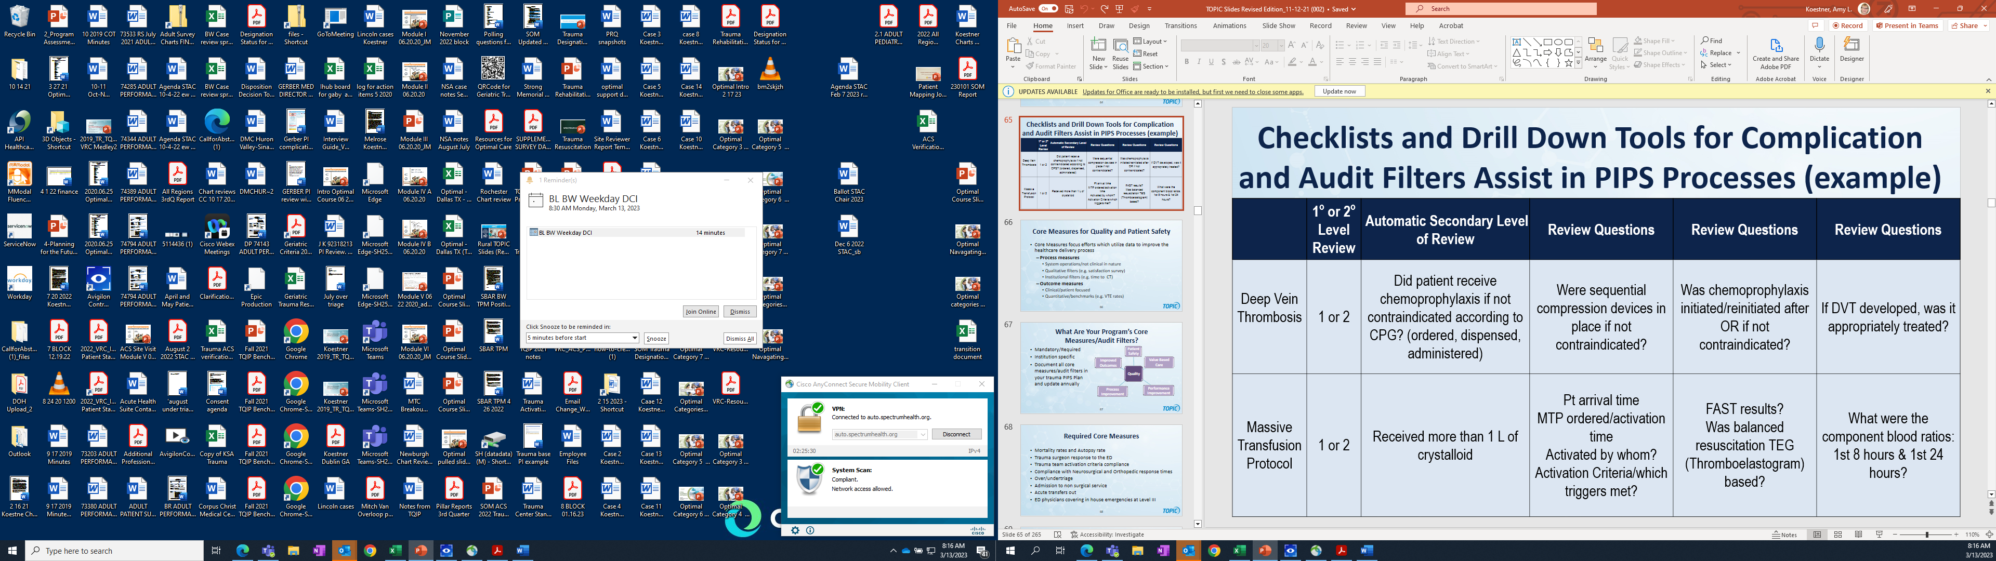
Example Levels of PI Review & Closure
Notes:
Process established with specific questions

Slide 153


Example Levels of PI Review & Closure
Notes:
Need process to be consistent and defined. All PI nurses follow same process to closing and elevating cases.

Slide 154
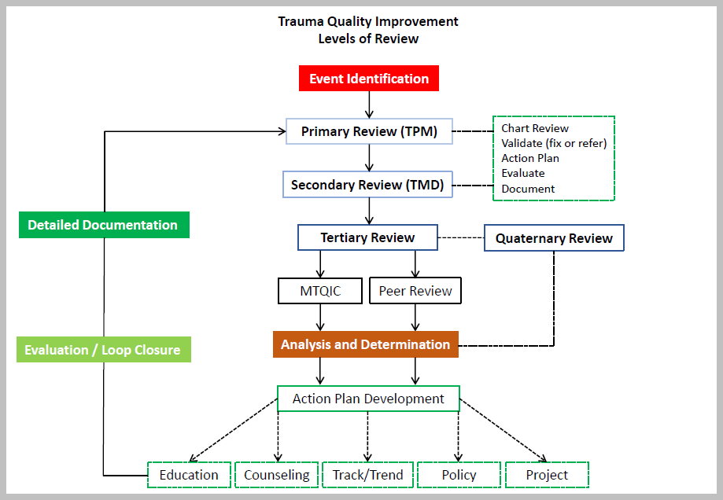
PI Personnel

Slide 155

Action Plans
Counseled & Advised (caution overuse…)
Trend & Report At Intervals (watchful waiting...)
Policy /Guideline Development (simplify/standardization)
Targeted Education (common but ineffective)
Call Privileges Revoked (rare)
Equipment / Facilities / Staffing (structure)
Clinical Decision Support (automation/computerization)
Systems
People
Notes:
Action plans are collaboration between the TPM and TMD

Slide 156
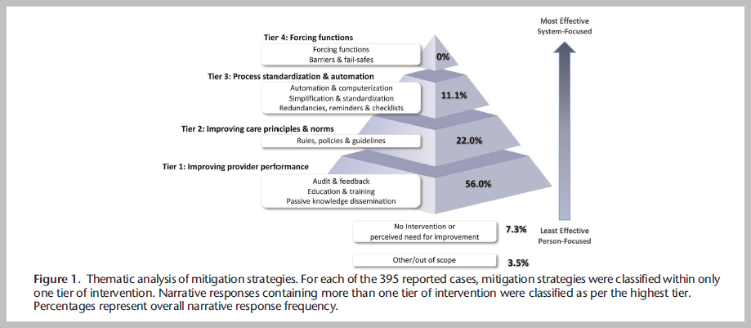
TQIP Mortality
Reporting System
Action Plans
(Mitigation Strategies)
Hamad et al 2022, 92(3):473-480 JTACS

Slide 157
Loop Closure: Completion & Hardwiring
Phase I
Document the action plan:
Education & Training
Meeting minutes
Rule/Policy/Guideline change
Checklist/Bundle implementation
EMR Computer decision support
Phase II
Show outcomes over time:
Track & Trend
Registry reports
Guideline compliance tracking
Typically, 3 months - but may be longer based on the scenario

Slide 158
7.3 Documented Effectiveness of the PIPS Program -Type II
LI, LII, LIII, PTCI, PTCII
Evidence PIPS plan is operationalized
Documentation of:
Event identification
Effective use of audit filters
Level of reviews
Loop closure with action plans
Improvement measured over time
Shown through:
Peer review minutes/attendance
Action plan activities
Protocol/Guideline adherence
Monitoring event rates
Process control charts
Benchmarking reports
OPPE
Notes:
This the documentation of your PIPS plan from event resolution through event resolution and case closure to show that it will not occur again or is hard-wired change
. Describe three initiatives that showcase the effectiveness of your center’s PI
program.

Slide 159
7.3 Documented Effectiveness of the PIPS Program
PRQ Question Text [Field Type]
1. Describe three initiatives that showcase the effectiveness of your center’s PI program. [Text]
2. Describe clinical practice guidelines that your center has developed over the last three years in response to identified opportunities for improvement and indicate how these new practices are monitored to ensure that results are sustained. [Text box]
3. Upload any clinical practice guidelines that address quality concerns during the verification cycle. [Attachment]
4. Provide a completed OPPE form. [Attachment]
5. Upload minutes from PIPS committees during the reporting period, including operations/systems and multidisciplinary peer review meetings. [Attachment]
Notes:
Slide is just to let attendees know they need to get into the PRQ and see what documents need to be uploaded to prove the work your program is doing.
Brevity is important with describing the 3 initiatives (consider using one that is in your welcome PowerPoint
Commonly see the TMD OPPE uploaded
Remind group that the PIPS minutes need to be redacted so no PHI

Slide 160
Case Example: Intimate Partner Violence (IPV)
Bad outcome case
Intimate partner abuse → mortality
Patient seen multiple times recently in ED by trauma service
Realization – lack of IPV screening or staff awareness
Opportunity for improvement
Reviewed the literature
Multiple educational Initiatives
Online module
In-person training sessions
No effect
Staff interviews over 1 month
Fishbone diagram of challenges

Slide 161
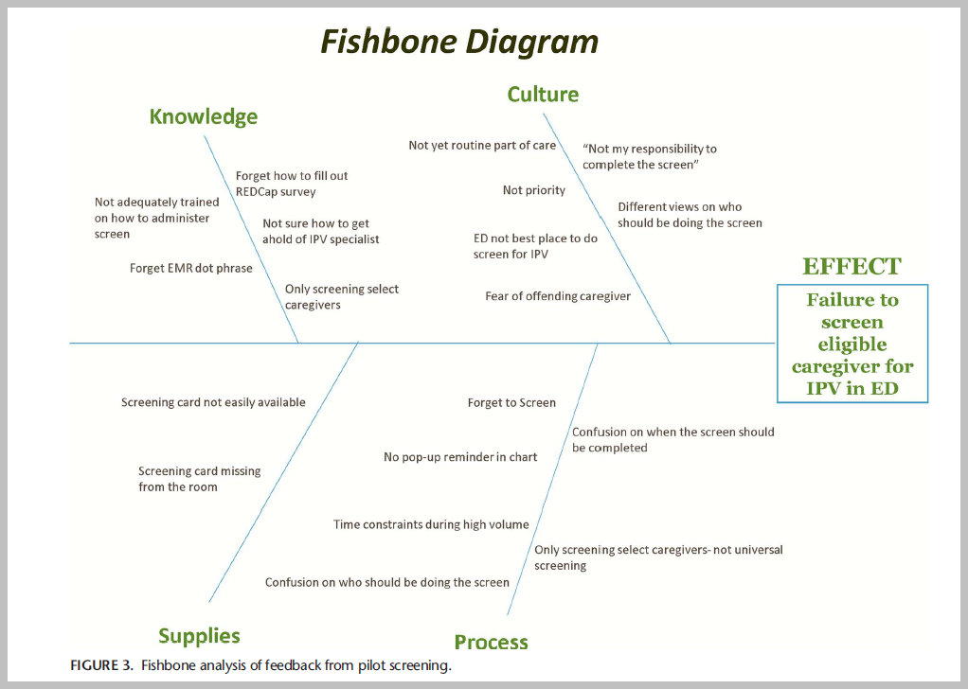
Mancheno, et al. 2020 Screening for Intimate Partner Violence in the Pediatric ED. Pediatr Emer Care

Slide 162
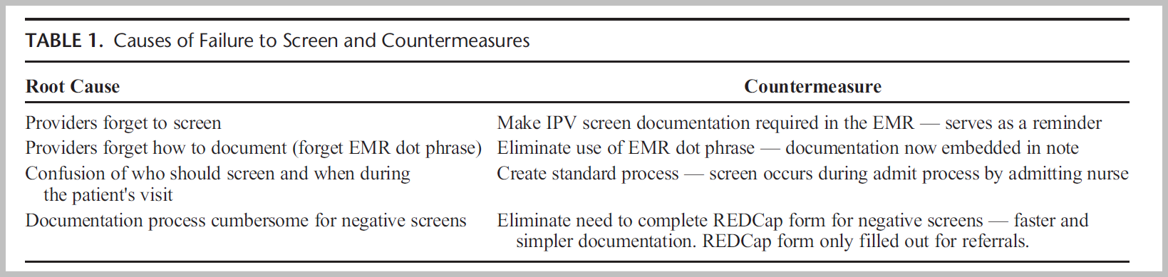
Tier 3 & 4 Action Plan - Mitigating Strategies

Slide 163
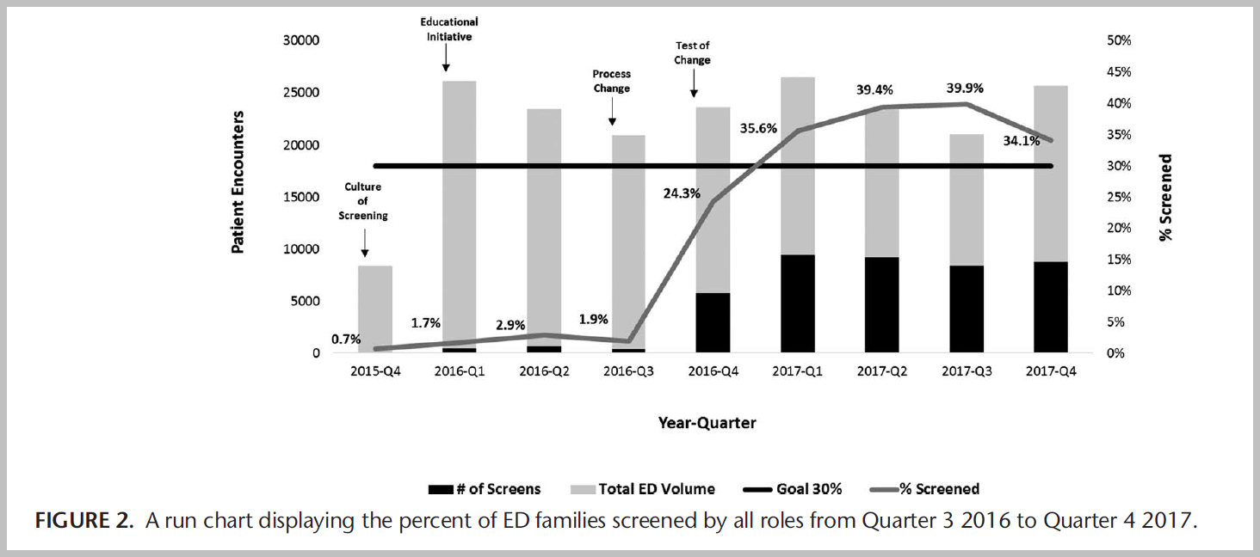
Diagrams “tell a story”

Slide 164
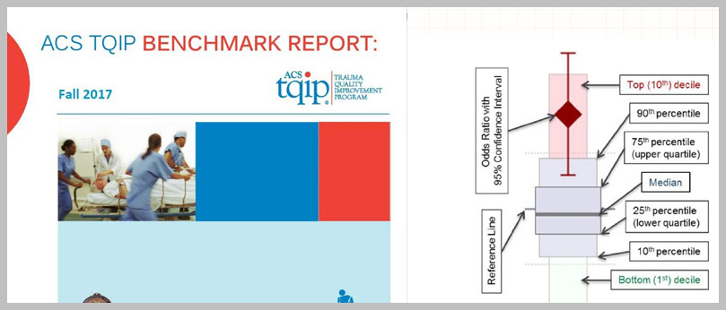
7.4 Participation in Risk-Adjusted Benchmarking Programs-Type II
LI, LII, LIII, PTCI, PTCII
Participate in a risk-adjusted benchmarking program (TQIP)
Use benchmarking results to improve care and registry data quality
Programs other than TQIP must meet the criteria on the TQP website
Notes:
The regular review of data provides the best opportunities for centers to understand where there might be gaps in quality of care.
Risk adjusted programs other than TQIP are listed on the TQIP website on www.facs.org
Share your report with the team- TQIP Committee or Systems Operations Committee. Share with your liaisons!

Slide 165
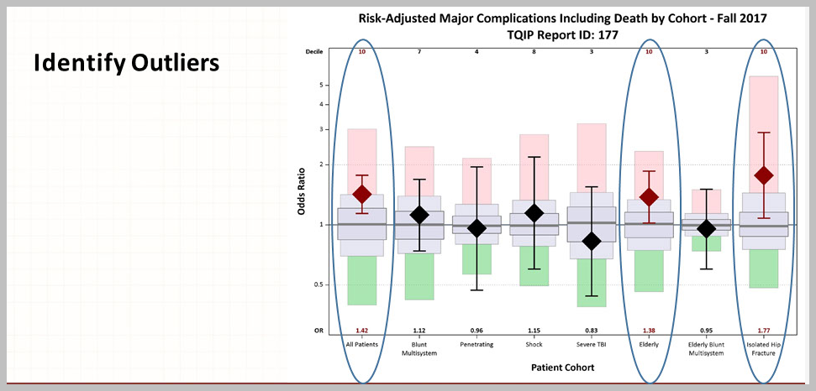
Verify definitions
↓
Clean the data
↓
Drill down
↓
Act on the data

Slide 166
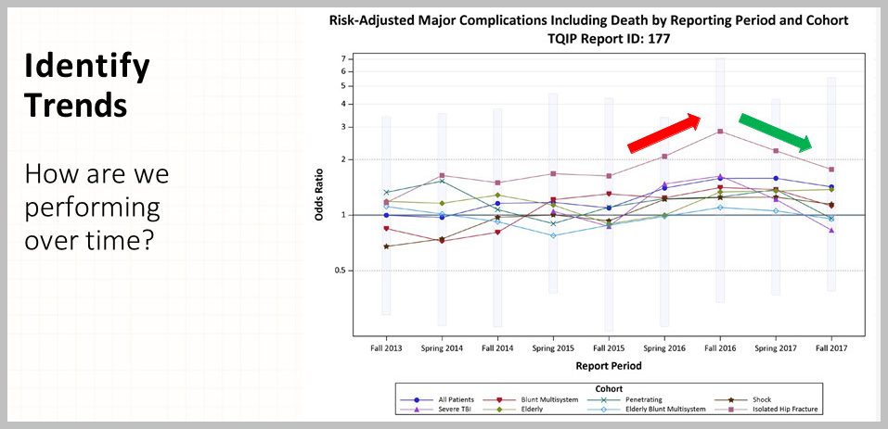

Slide 167
Risk Adjusted Benchmarking
Be prepared to discuss what you are doing to address outlier performance
Upload two most recent risk adjusted benchmarking reports, one during the reporting period
Assess:
Areas of Success
Areas of Opportunities
Data validation
Data drill down
Action plan
Results
Notes:
Prepare a brief presentation with the opportunities and the quality work done to make improvements. this will include your data validation, review of data, action plan and the monitoring for change in your data.
This is your PDSA process to show to improve patient outcomes.
PRQ Question Text [Field Type]
1. Does your trauma center participate in TQIP? [Radio button]
2. If no, upload copies of the two most recent risk-adjusted benchmark reports from the alternative risk-adjusted benchmarking program, with at least one received during your center’s Reporting Period. [Attachment]
3. Briefly describe opportunities for improvement and actions taken to improve patient care identified during evaluation of the risk-adjusted benchmarking report. Any relevant issues and opportunities for improvement related to data quality should be entered in the PRQ for Standard 6.1 (Data Quality Plan). [Text box]

Slide 168
7.5 Physician Participation in Prehospital Performance Improvement-Type II
LI, LII, LIII, PTCI, PTCII
EM physician participates in prehospital PI process
Participates in developing trauma-related prehospital protocols
Measure of Compliance:
Share meeting attendance records
Upload list of prehospital care protocols
List EMS opportunities for improvement that were addressed
Notes:
1. List the dates on which the emergency department physician or trauma surgeon
attended prehospital PI meetings over the course of the Reporting Period.
2. Upload a list of your center’s prehospital care protocols that are specific to the care
of trauma patients

Slide 169
7.6 Trauma Multidisciplinary PIPS Committee Attendance-Type II
LI, LII, LIII, PTCI, PTCII
60% attendance for the TMD
50% attendance for surgeons
50% attendance for liaisons (designated alternate)
EM, NS, OS, CC, Anesthesia, Radiology
Combined adult and peds
50% attendance for each others program’s meetings
Can be the TMD or the TPM
Attendance can be met by in-person or virtual
Notes:
Attendance can be waived for military deployment, medical leave or missionary work.
If the trauma surgeon serves as a back up only and never the first call- the surgeon is not subject to attendance requirements but should have a process for information dissemination.,

Slide 170
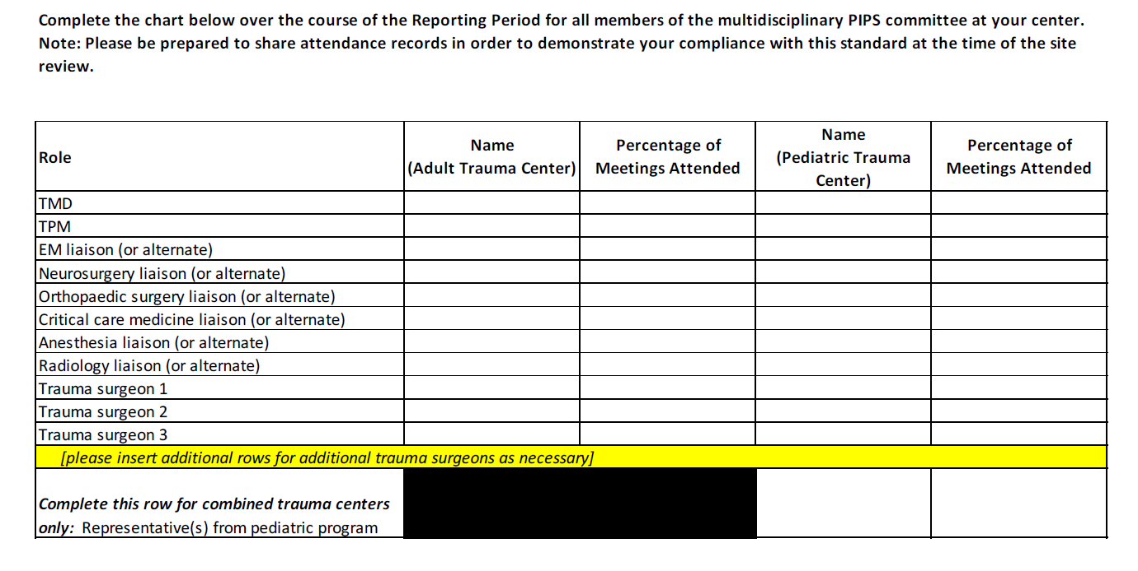
7.6 Trauma Multi-disciplinary PIPS Committee Attendance

Slide 171
7.7 Mortality Review-Type II
LI, LII, LIII, PTCI, PTCII
All trauma-related mortality cases and transfer to hospice are reviewed
Classified for potential opportunities for improvement
Mortality with opportunity for improvement
Mortality without opportunity for improvement
Use consent agenda to close out Hospice Cases to stay timely
Notes:
Mortality review included DOA, DIED in ED and patients who died after withdrawal of life-sustaining care.
Mortality review provides the greatest assurance to review cases to identify opportunities in care that could be prevented form re-occurring.
Hospice cases should be reviewed in the same manner to review the clinical care leading up to the decision for hospice care.
New categorization.
Standard defines mortality type
Opportunity for improvement if
Anatomic injury or combination of injuries may have been survivable under optimal conditions
Standard guidelines were not followed- possibly resulting in an unfavorable consequence
Provider care was suboptimal

Slide 172
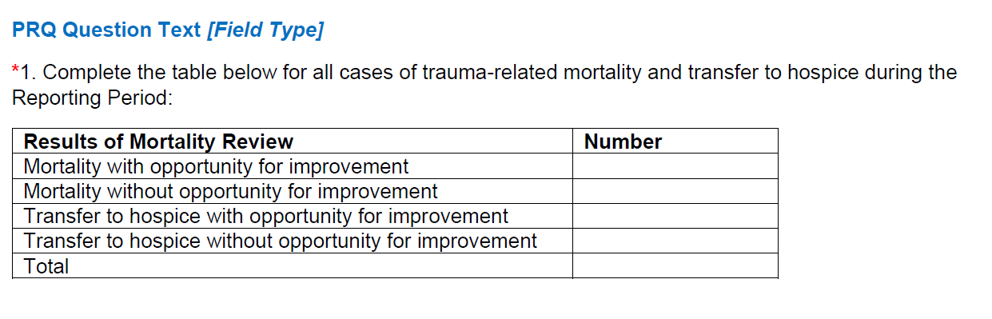
7.7 Mortality Review

Slide 173
7.8 Nonsurgical Trauma Admissions Review-Type II
LI, LII, LIII, PTCI, PTCII
All nonsurgical admissions reviewed by the trauma program
NSA reviewed in secondary review by the TMD:
ISS > 9
Without a trauma or other surgical consult
With opportunity for improvement identified at primary review
Nelson Score ≤ 5
NSA case closed at primary review:
Admission that had surgical or trauma consultation
ISS ≤ 9
Nelson Score ≥ 6
Describe this process in the PIPS plan
Notes:
Measures of Compliance
• Written PI plan that includes NSA review process
(submitted as part of Standard 7.2)
• Report on all NSA
• Documentation that the cases were reviewed

Slide 174
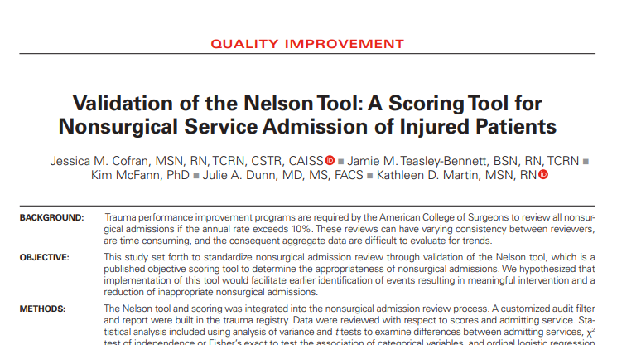
Nelson Tool
Tool for the Evaluation of Nontrauma Service Admissions
Algorithm/Criteria | Points
Age >65 years | 1
3 or more comorbidities | 1
ISS < 10 | 1
MOI GLF | 1
No ICU admission | 1
No need for surgical intervention | 1
No blood products | 1
Journal of Trauma Nursing 29(5):p 266-271, September/October 2022.
Notes:
Point for each criteria
Score 6-7→ Admission to a non-surgical service. Close in primary review
Score 4-5 →Secondary review as there is a high risk for adverse events
Score 0-3 → Potentially inappropriate for NSA. Secondary review with potential for escalation to tertiary review

Slide 175
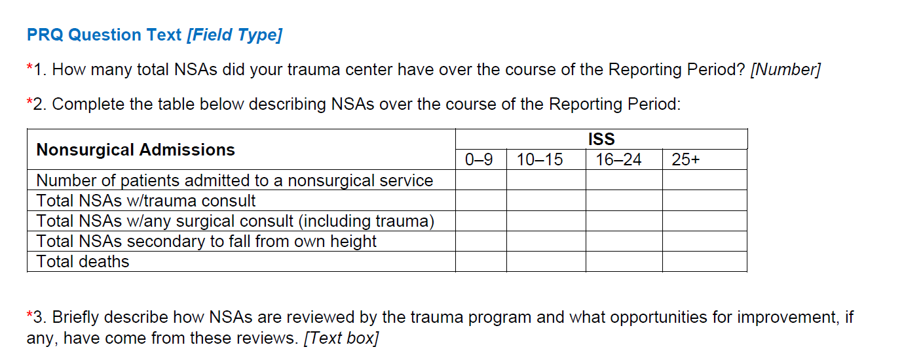
7.8 Nonsurgical Trauma Admissions Review

Slide 176
7.9 Trauma Diversion Review – Type II
LI, LII, LIII, PTCI, PTCII
Trauma diversions are reviewed by the Trauma Operations Committee
Discussions aimed at preventing future diversion
Compliance by documentation of the meeting minutes
Notes:
PRQ-
1. Upload the completed template
2. Upload minutes/documentation from trauma operations committee reviews in which
trauma diversions were discussed.

Slide 177
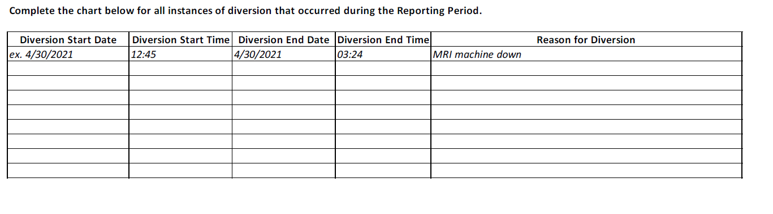
7.9 Trauma Diversion Review
*Upload the completed “Trauma Diversions Review” template
*Upload minutes/documentation from trauma operations committee reviews in which trauma diversions were discussed [Attachment]

Slide 178
7.10 Prehospital Care Feedback-Type II
LI, LII, LIII, PTCI, PTCII
Review and provide PI specific feedback to EMS:
Triage
Clinical care
Patient outcomes
Process can be Email, Letter, PI form, Internal software communication
Share communication as part of the PI process and loop closure
Notes:
Prehospital partners are part of the trauma team. They learn from your feedback about clinical care and patient outcomes. This information is helpful to their internal PI processes to continuously improve prehospital patient care.
PRQ Question Text:
*1. Describe the process for reviewing and providing feedback to EMS agencies, related to accuracy of triage and provision of care. [Text box]
*2. Describe the process for reviewing and providing feedback to referring providers, related to the care and outcomes of their patients and any potential opportunities for improvement in initial care. [Text box]
Goal is on patients with opportunity, not all injured pts.

Slide 179

Case Review = Peel the Onion

Slide 180
Elderly Fall Case
90-year-old female arrives by private car with family
C/o fall down 4 stairs with chest discomfort
Trauma workup reveals multiple rib fractures
Admit to floor by trauma surgeon
24 hours later, decompensates/rapid response activated
Pt → ICU with oxygen and aggressive pulmonary toilet
Pt returns to the floor three days later
Does well and is discharged home

Slide 181
Elderly Fall Case
Primary Review
Unplanned ICU
Nursing assessment
-Incentive spirometry
-PIC Score
pain, inspiration, cough
Guideline compliance
Rib Fracture Guideline
Geriatric Guideline
Secondary Review
Guideline Compliance
Admission to floor with multiple rib fxs
No RT, PT or Pulmonology consult
Multi-modal pain control
Tertiary Review
Guideline Compliance
Admission to floor with multiple rib fxs
No RT , PT or Pulmonology consult
Multi-modal pain control

Slide 182
Action Plan
Provider Education
> 3 rib fxs admit to ICU
Review case in M & M with residents
Case review with nursing:
Incentive spirometry
PIC score implementation
Aggressive pulmonary hygiene
Multimodal pain control
Pulmonology, RT, PT consult
Tracking: (options)
Tracking unplanned ICU geriatric rib fractures
Compliance rib fracture guideline
Multi-modal pain control guideline
Loop Closure
Education completed to all surgeons, residents and APP staff
Case presented at M & M
Case study presented at nursing staff meeting in ED, ICU, trauma floor
Tracked Geriatric rib fracture guideline compliance for 3 months
Tracked unplanned ICU in geriatric patient with rib fractures
Monitored unplanned ICU on the quality dashboard

Slide 183

PIPS Resources
Trauma Outcomes & Performance Improvement Course (TOPIC®)
Society of Trauma Nurses Course www.traumanurses.org

Slide 184
Summary
PI Plan should drive the PI process
Loop closure → measured over time → hardwired
Risk-adjusted benchmarking drives program improvements

Slide 185
Questions?

Slide 186
8. Education & Outreach
Content update: October 29, 2025
Notes:
This chapter reviews processes for identifying adverse events and implementing subsequent corrective action plans, measurable through patient outcomes.
Problem resolution, outcomes improvement, and loop closure are readily identifiable through the PI structure.
These are core functions- the framework of what we do. How we achieve the best patient outcomes and strive to continuously improve care to our patients and families.
Performance Improvement is the number one reason for programs not passing their visit, requiring a focus visit or need to strengthen their processes.

Slide 187
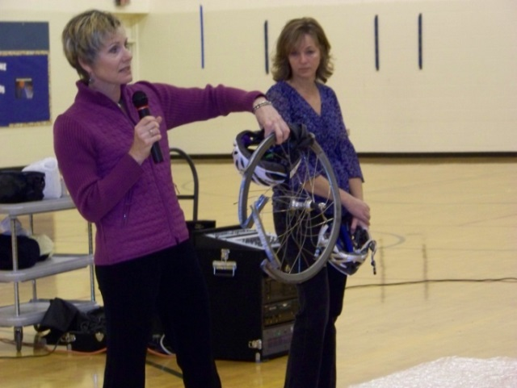
8 Education & Outreach
Integral part of trauma program
Trauma Program Obligation:
Educate providers
Ensure public access to educational resources

Slide 188
8.1 Public & Professional Trauma Education – Type II
LI, LII, LIII, PTCI, PTCII
Examples
Stop the Bleed
Advanced Trauma Life Support (ATLS)
International Trauma Life Support (ITLS)
Prehospital Trauma Life Support (PHTLS)
Trauma Evaluation and Management (TEAM)
Measures of Compliance
Schedule of education sessions/courses
Describe most successful programs and why you believe they were successful.
All centers must provide public and professional trauma education.

Slide 189
8.2 Nursing Trauma Orientation & Education – Type II
LI, LII, LIII, PTCI, PTCII
All trauma centers must provide trauma orientation to new nursing staff caring for trauma:
Center developed educational program integrating PIPS-identified issues
Simulation training
Online learning
Conferences
Annual training events
Nurses must participate in trauma CE corresponding to their scope of practice and population served.
Examples:
Advanced Trauma Care for Nurses (ATCN)
Trauma Nursing Core Course (TNCC)
Pediatric Care After Resuscitation (PCAR)
Pediatric Trauma Across the Care Continuum (PTACC)
Trauma Care After Resuscitation (TCAR)
Transport Nurse Advanced Trauma Course (TNATC)
Methods to demonstrate compliance:
Describe process
Nursing orientation materials
Compliance per unit
CE certifications/transcripts
Nursing Education Activity | % ED Nurses Completed | % ICU Nurses Completed | % PACU Nurses Completed

Slide 190

8.3 Prehospital Provider Training – Type II
LI, LII, LIII, PTCI, PTCII
All trauma centers, the trauma program must participate in the training of prehospital personnel.
Measure of Compliance:
Documentation demonstrating training of prehospital personnel

Slide 191
8.4 Commitment to Postgraduate Education – Type II
LI, PTCI
Residency rotations in trauma:
Defined curriculum
Trauma-specific objectives
Rotations (at minimum) in:
General surgery
Orthopaedic
Neurosurgery
Emergency Medicine
ACGME accredited program
Sufficient trauma volume & exposure
Rotation continuously available
ACGME = Accreditation Council for Graduate Medical Education
Notes:
Additional Information
“Available” to residents implies that the rotation is open
to receive trainees at all times and from, at minimum, the
specialties mentioned above.
An adequate volume and breadth of cases to meet
competency requirements implies that residents have an
opportunity to gain exposure to these cases. A volume and
breadth of cases without an opportunity for exposure would
not meet the standard.

Slide 192
8.4 Methods to Demonstrate Compliance
Describe the resident assignment to the trauma service
Trauma exposure for senior general surgery residents and typical allocation
Rotation schedules for the reporting period
Upload trauma-related learning objectives
Dates and titles of trauma-related teaching sessions
Letter from Program Director noting ACGME program verification and verifying ample exposure to meet requirements
# Major operative trauma cases during the reporting period
Major Operative Trauma Cases | Number
Laparotomies/Laparoscopies
Thoracotomies/Thoracoscopies
Neck Explorations
Sternotomies
Major Vascular Surgeries

Slide 193
9. Research
Content update: October 29, 2025

Slide 194
9.1 Research and Scholarly Activities -Type II
LI, PTCI
Scholarly Activities:
Articles: > 10 trauma-related research articles
Participation: at least 1 faculty member must be:
Visiting professor, Invited lecture, Speaker at a regional, national, or international trauma conference
Residents/Fellows Support
Lab experience
Clinical trials
Resident trauma paper competitions at the state, region, or national levels
Resident trauma research presentations

Slide 195
9.1 Research and Scholarly Activities -Type II
LI, PTCI
*Research Article (Minimum) Criteria: 10 Articles
3 adult/pediatric trauma surgeon
3 disciplines other than adult/pediatric surgery
1 acute care surgery allowed
Additional Criteria
Research must be performed at the trauma center
Case series counts if >5 patients
Basic science research must involve topics directly related to trauma pathophysiology or injury
Published or accepted articles count
Peer-reviewed and Indexed journals only (i.e. PubMed)
International Committee Med Journal Editors (ICMJE)
Authorship Criteria: substantial contribution, writing, approval & accountable for all aspects of the article
Category 1: Institutional & Administrative Commitment

Slide 196
Publication Disciplines
Trauma Surgery
Basic Sciences
Neurosurgery
Orthopaedic Surgery
Emergency Medicine
Critical Care
Radiology
Anesthesiology
Plastics
Vascular Surgery
Cardiothoracic Surgery
Rehabilitation
Acute Care Surgery
Nursing
Craniofacial Surgery
Soft Tissue Coverage
Acute Care Surgery (x1)

Slide 197
Summary
Education includes
Public
Prehospital
Nursing
Physicians
Residents/Fellow
Research includes
Activities
Publications
All of this requires:
Administrative Support
Fiscal contributions
Personnel
Planning

Slide 198
Questions

Slide 199
Navigating a Virtual Visit
Content update: October 29, 2025

Slide 200
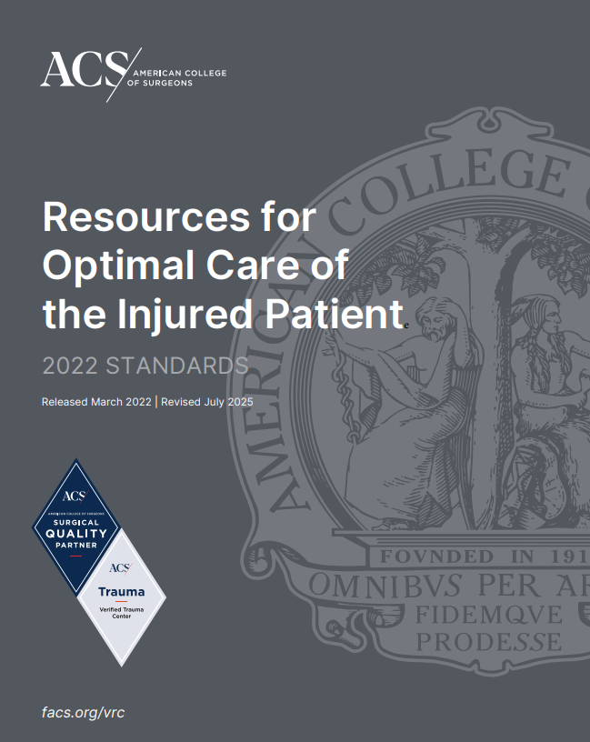
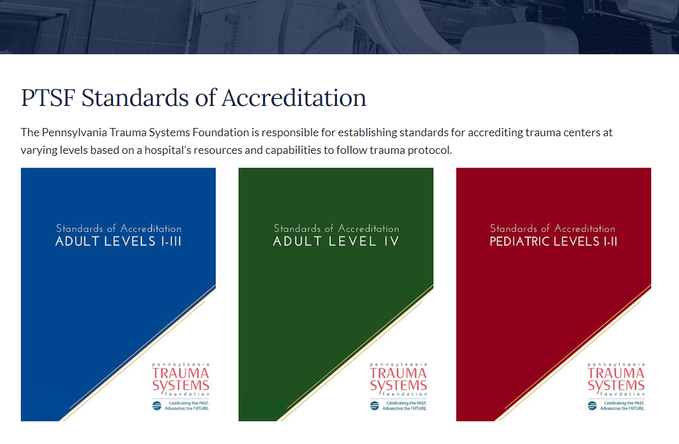
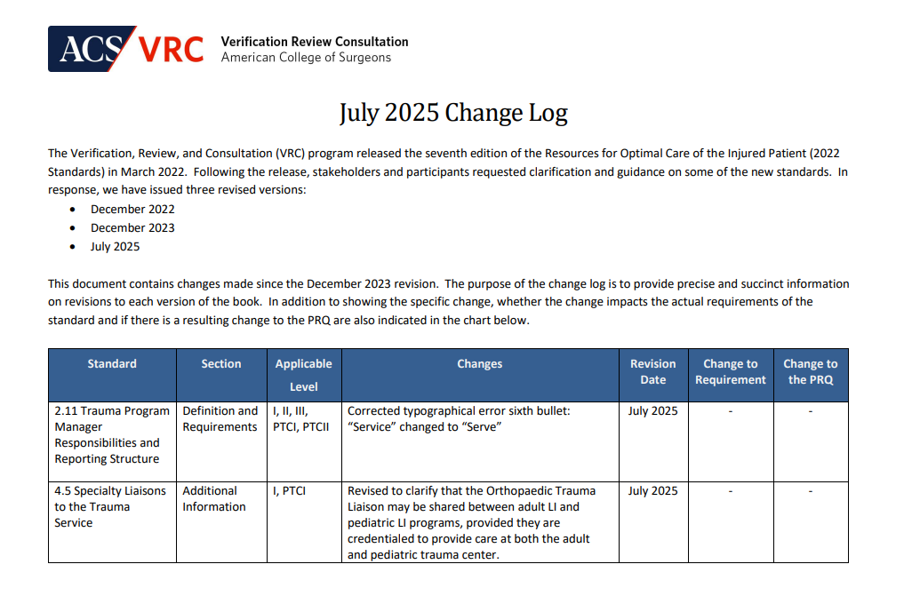
Go to the source….
Review the latest version of standards, FAQ, change log, reference documents for ACS or State based on designation or verification

Slide 201
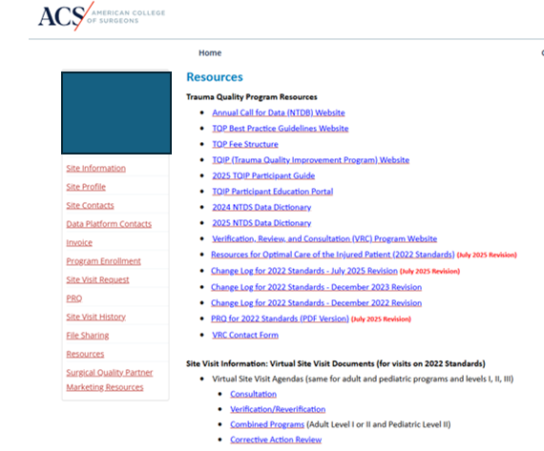
Qport Resources

Slide 202
Pre-Review Activities for a Virtual Visit
Complete ACS/State verification/designation applications timely to avoid delays or potential center expiration (ACS Qport portal)
Confirm with own IS/HR to ensure document access for ACS surveyor will be provided-IS security and legal may need to review BAA/DUA already in place with ACS
Start early to organize support documents: resolutions, guidelines, injury prevention activities, TQIP reports, PI minutes
Consider using a tool to track and identify responsible lead & timeline for activities
Minimum of 12 months before survey/expiration date start filling out the PRQ including description of requirements and documents for measures of compliance
Notes:
Suggest that the center have someone else review the PRQ before submitting for grammar and flow

Slide 203
Important Dates & Timelines for ACS
Check with ACS early to confirm when application is due based on your center’s expiration date.
PRQ due 45 days prior to scheduled survey date
PCR due 30 days prior to scheduled survey date
Prep survey meeting with center leaders/surveyors –minimum of2-3 weeks prior to survey date

Slide 204
Pre-Review Meeting
Schedule mtg with survey team at minimum 2-3 weeks prior to survey date
Survey team should already have access to your PRQ and support documents
Consider loading a test patient chart to verify access and ease of navigation for surveyors-confirm ability to open bookmarks
Charts need to be available for surveyor access 14 days prior to scheduled survey date

Slide 205
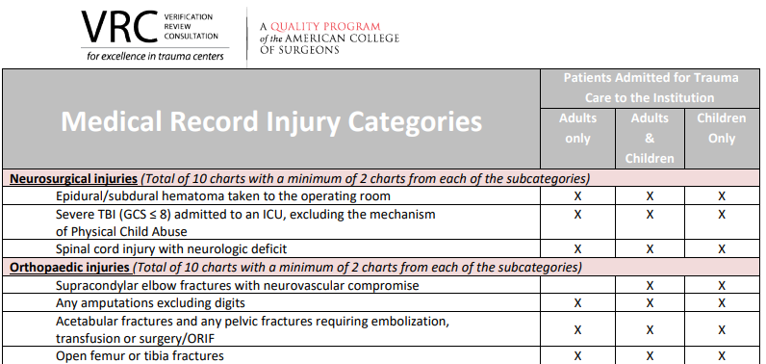
Chart Selection Tips
Review categories and inclusion criteria
Important to include charts that demonstrate PI process-levels of review
Complete PI fields in the PCR form to assist lead reviewer in chart selection process
Limit number of individuals putting charts together and placing bookmarks
Make sure you have a version of adobe that provides ability to build the charts
Highlight flowsheet to identify key care timeline (time of activation page, team arrival)
Create a spreadsheet to confirm build complete for charts

Slide 206
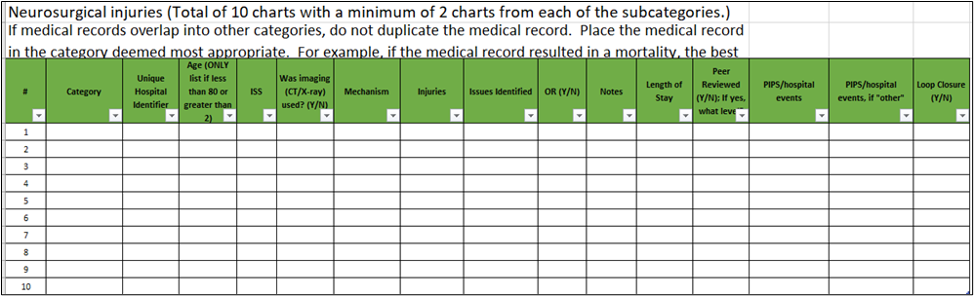
Chart Selection

Slide 207
Tips for Chart Layout
Complete ACS face sheet
Check to confirm face sheet data matches registry & PI data
Place clinical documents in the flow of reviewing a chart
Prehospital/OSH
ED note/flowsheet
H & P, consults
OR/ICU
OR notes/radiology
PI documents can go after face sheet or at end of chart with guidelines or other support documents

Slide 208

ACS Face Sheet
Center’s PI form information (reviews) should match this form
Notes:
Mention should match center’s PI form

Slide 209
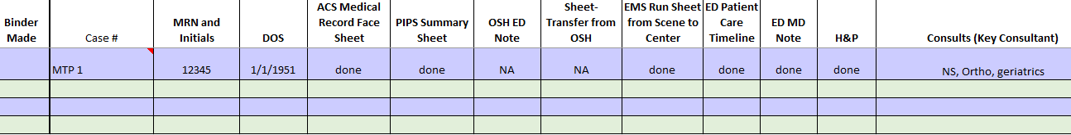
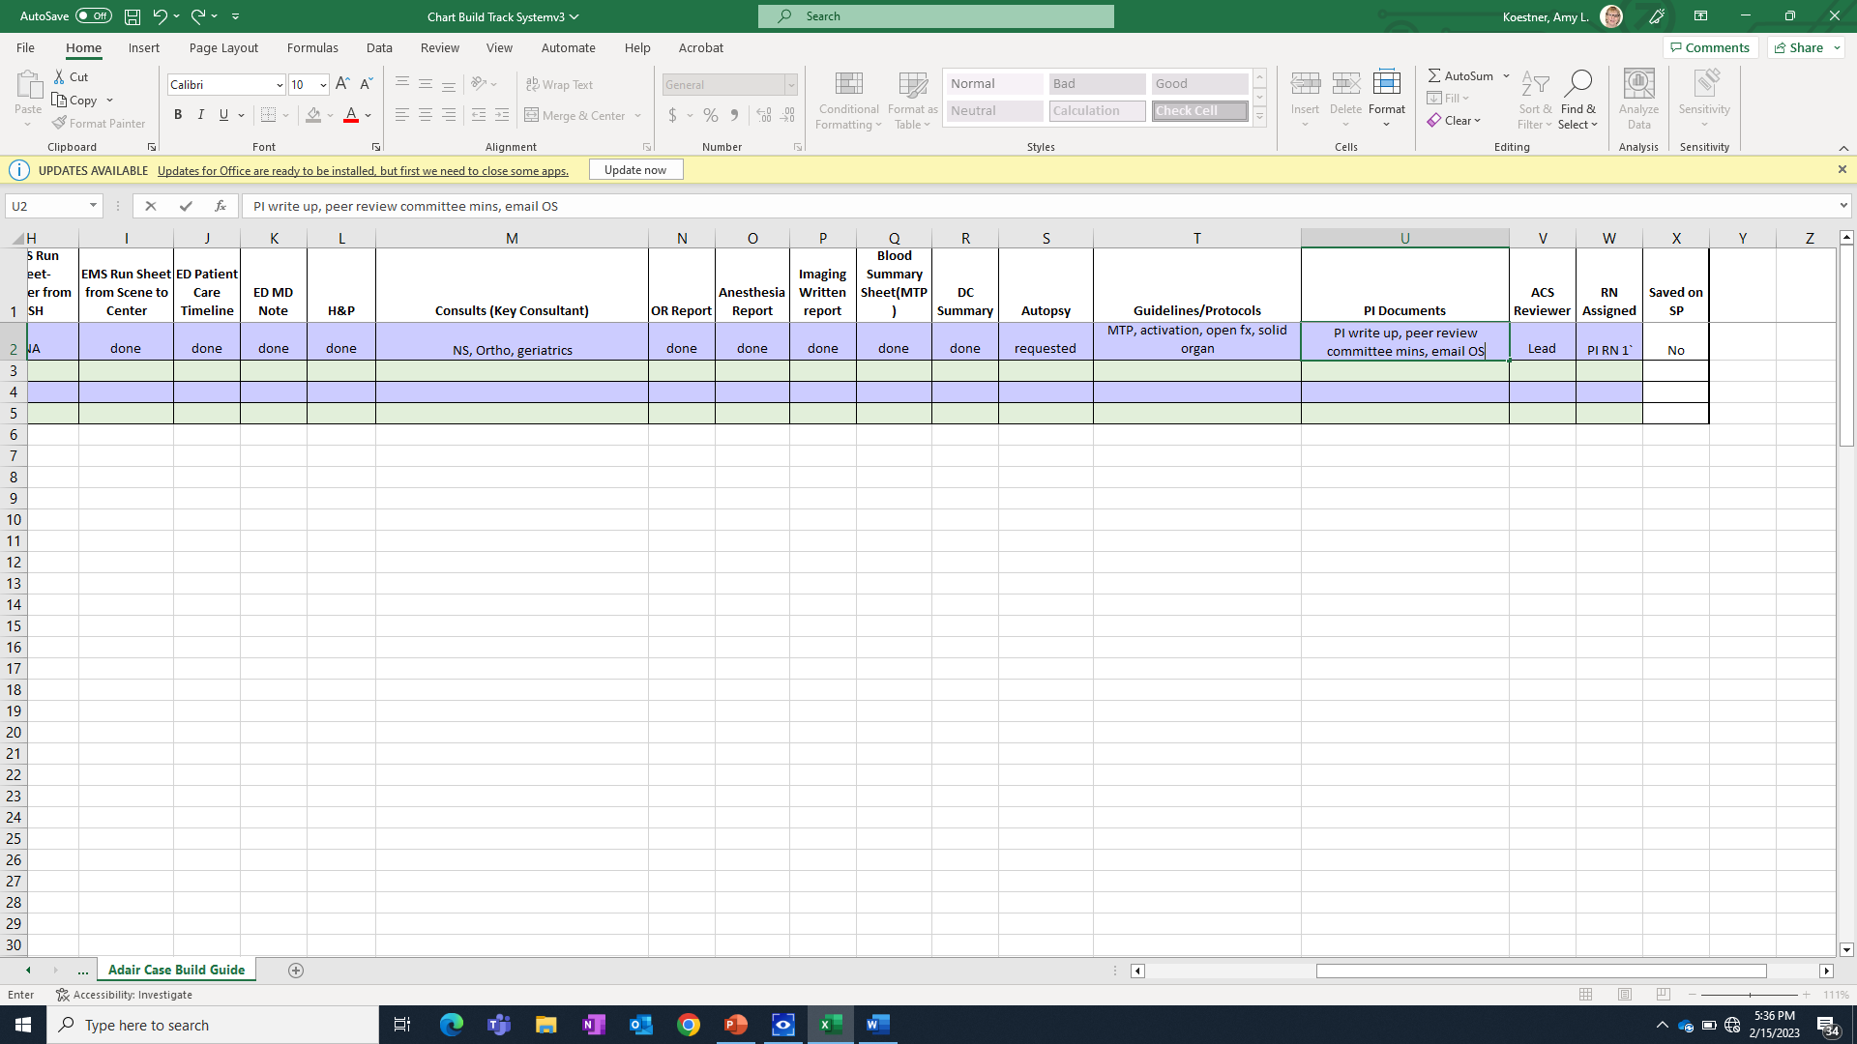
Tool to assist with chart build
Notes:
Figure out a tool that works for you. Allows you to confirm that all the appropriate documents have been loaded to your chart folder

Slide 210
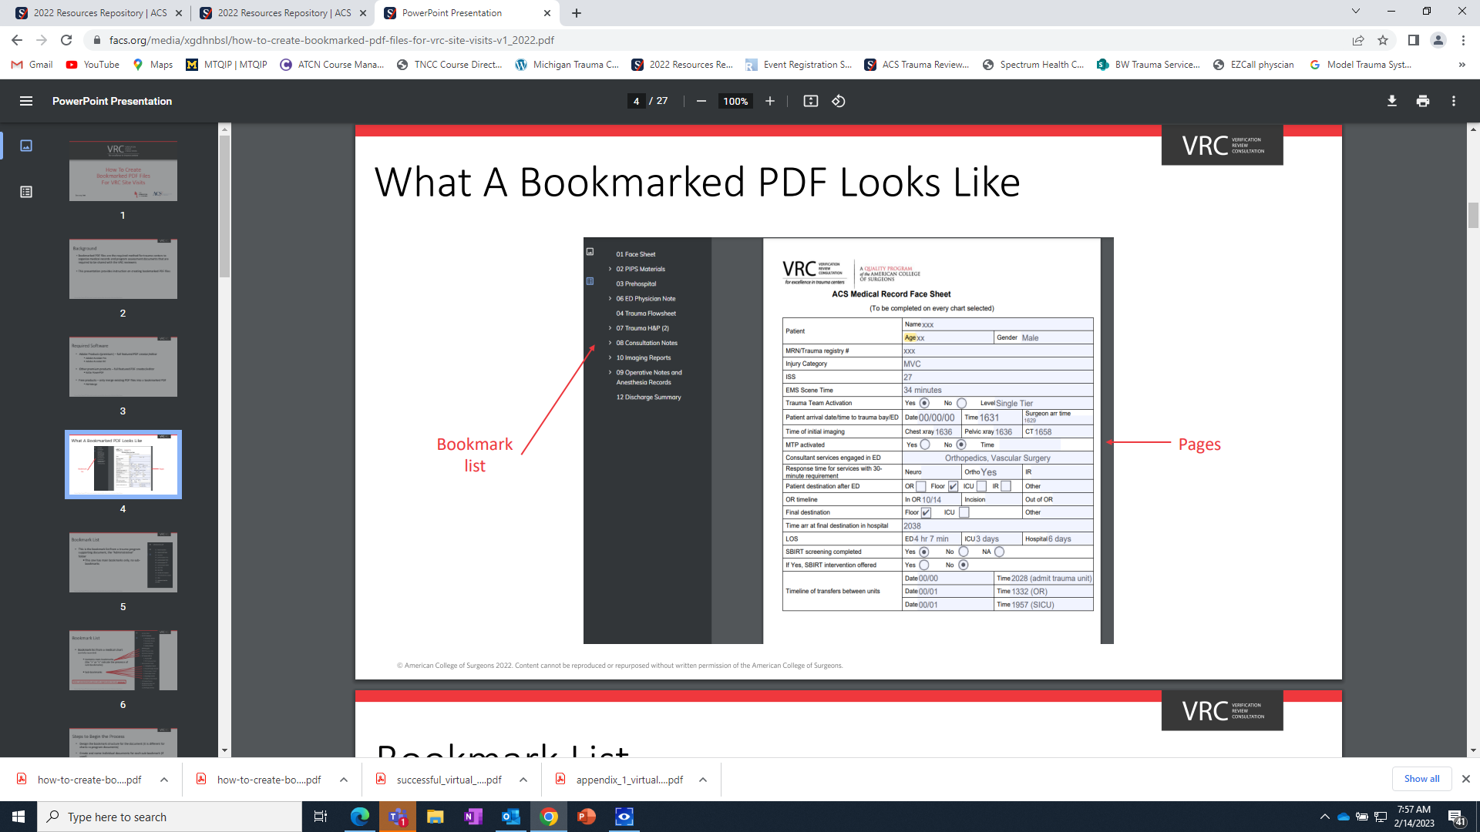
Utilize tools provided on ACS website to ensure ease of access to charts and other documents

Slide 211
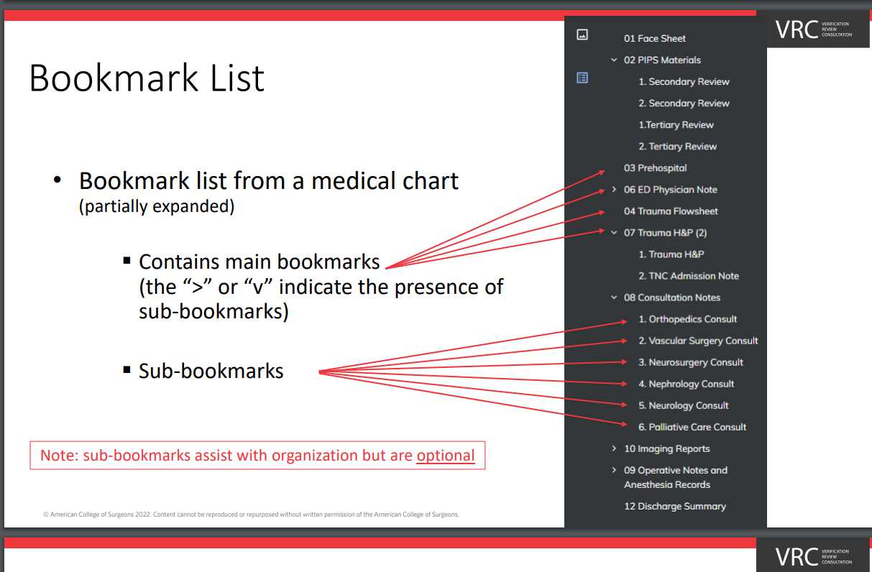
Drill down to sub-categories to further assist with chart review process

Slide 212
PI Documents to Include in Chart Folder
PI form that documents all components of process Level 1-3 PI review
Loop Closure documents
Email
PPT/Education process
PI minutes
Guideline/protocol/policy
PI Initiative documentation connected to case

Slide 213


Example form to demonstrate PI Levels of Review

Slide 214
Welcome Presentation
20-30 minutes opening intro to the program
Attendees: key administrator(s), trauma leadership, logistics coordinator, chart navigators
Introduction of your team and surveyors
Briefly describe your program team (photos) surgeons, APPs, TPM, PI team, Registrars, IP coord
Avoid listing hospital awards
Review opportunities for improvement from previous ACS report-action items and loop closure
Possibly include Team/resource enhancements or Key PI initiatives
Brief explanation of PI Process (levels of review)
Walk through logistics of day-including how to move to breakout rooms

Slide 215
Chart Review Session
Set up breakout room for each ACS surveyor
Include an individual that knows trauma PI process
Include an individual that can navigate EMR to walk through clinical care questions (imaging and clinical decision-making)
Consider TPM or TMD as a rover to move between breakout rooms based on your resources
Prep for this session by reviewing all the cases and your PI documents
Notes:
This process is a great opportunity to identify any issues the PI process missed during the initial PI process. Be prepared to discuss issues you missed or possibly incomplete loop closure
Surveyors are looking for honest conversation

Slide 216
TQIP
What TQIP data do you want to highlight?
Focus on TQIP identified PI initiative (PPT to timeline actions/results)
Walk through report
Speak to where/how your center uses the TQIP report
Committee meeting report out
Meetings with specialty services
Administrative report out
Goal is to communicate TQIP report impact with PI process and best practice

Slide 217
PRQ Session
Send “save the date” to block calendars
Avoid having a group participating from a conference room
Share list of participants, title, role with surveyors prior to session
Avoid or limit individuals calling in with cell phones
Attendees put their name and role on platform to assist surveyors during category discussion
Prior to meeting send team members/liaisons their section of the PRQ-refresh memory and keep conversation on track
All attendees should have their camera on at least when they are speaking

Slide 218
Tour Prep
Practice the tour process-check for internet connection issues
Consider leapfrog approach with using multiple devices connected through platform (Teams, Zoom, Webex)
Each device needs 2-3 people:
1) responsible for moving/turning camera,
2) spokesperson, introducing team members & surveyors,
3) monitoring hallways for patients & notify others of the live video
If possible, practice with the individuals that will be participating in the tour
Create practice questions to build confidence with team

Slide 219
Post Tour
Series of short meetings with TMD, TPM, and surveyors
May have questions to clarify or confirm information
Discuss center’s future needs or wish list
Discuss finding prior to exit interview

Slide 220
Exit Interview
Read statement from COT that reviews final verification process details
Discuss finding and preliminarily report to be submitted to COT
Notes:
As of 10/2025 the turnaround for report is 10-12 weeks.

Slide 221
Summary
Preparation can not be overstated
Start early with updating documents and guidelines
Implement a communication tool that works for your team
PRQ – needs multiple sets of eyes
Practice the tour

Slide 222
Questions ?

