Slide 1
Antibiotic Stewardship in Post-Acute and Long-Term Care
Why is it important and how do to it
Leslie Eber MD CMD
September 24,2025

Slide 2

Objectives
Review the goals of an antibiotic stewardship program
Review how inappropriate antibiotics can harm and using the “just in case” strategy is not recommended
Discuss how individual providers can engage in an antibiotic stewardship program and increase patient safety
Identify best practices for using antibiotics in the most common infections in PALTC
Review the use of vaccinations to prevent lower respiratory tract infections

Slide 3

Why should we be good Stewards of our Antibiotic Use?
As many as 70% of nursing home residents receive antibiotics each year and up to 75% of these antibiotics are prescribed incorrectly.
Antibiotic usage is not harmless: Resistance, side effects, C. Diff infections
Recent evidence implicates a viral pathogen in at least 25% of older adults presenting with community-acquired pneumonia
Widespread antibiotic use increases likelihood of infection by multidrug-resistant organisms (MDROs)
Jump RLP, et al. Infectious Diseases in Older Adults of Long-Term Care Facilities: Update on
Approach to Diagnosis and Management. J Am Geriatr Soc 2018; 66(4):789-803

Slide 4
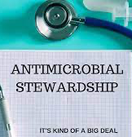
What is an Antibiotic Stewardship Program and Why do we need one?
An antibiotic Stewardship program
  Monitors appropriate use of antibiotics
  Ensures providers are using the right antibiotic, at the right dose for the right duration
  Monitors ADRs (Adverse Drug Reactions)
How does this program help us?
  Provides us with education: when to test for an infection
  Provides tools to guide treatment and duration
  Can share antibiotic resistance data and local antibiograms
  Antibiotic audits and feedback on testing and utilization

Slide 5

Antibiotic Stewardship Pearls
Infections
Have symptoms that are new or acutely worse.
Have Alternative noninfectious causes of signs and symptoms (eg, dehydration, medications) considered and evaluated before an event is deemed an infection.
Should not be based on a single piece of evidence but should always consider the clinical presentation and any microbiologic or radiologic information that is available.
Always use antibiotics that are adjusted for renal function and check for interactions with other medications

Slide 6

Why are our Patients so vulnerable to infections?
  Immune response declines with age, a phenomenon known as immunosenescence
  Changes include:
    Thymic involution -> depressed T-cell function
    B cells may produce antibodies with lower affinity -> weakened immunogenicity of vaccines
    Decreased macrophage activity -> infections may have a longer course
GRS Teaching slides, American Geriatric Society 2021

Slide 7
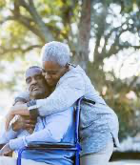
Why are our Patients so vulnerable to infections?
Aging impacts host Resistance factors and Leads to increased risk of infection
  Poor skin integrity →predisposition to skin and soft tissue infection
  Impaired cough or gag reflex → increased risk of pneumonia
  Increased gastric pH and decreased GI motility → predisposition to diarrheal illnesses
GRS Teaching slides, American Geriatric Society 2021

Slide 8

However……
  The impact of comorbidities on immune function and host resistance is greater than the impact of age itself
    Diabetes, chronic kidney disease, heart failure, chronic edema due to venous insufficiency, COPD and stroke are all examples of illnesses that increase infection risk
GRS Teaching slides, American Geriatric Society 2021

Slide 9

Let’s Review the Top 10
Types of Infections in PALTC
Non-purulent cellulitis
Abscess or purulent cellulitis
Mild diabetic foot wound
Uncomplicated UTI
Complicated UTI
Community acquired bacterial pneumonia
7. Acute exacerbation of COPD
8. COVID-19 infection
9. Influenza infection
10. Clostridioides difficile (C. diff)
Bonus:
Pressure injuries

Slide 10

What about Fevers?
  Older adults often present without typical signs and symptoms
  Fever may be absent in 30%–50% of older adults with serious infections
  Fever in older long-term care residents can be defined as:
    Single oral temperature >100°F (37.8°C), or
    Temperature >2°F (1.1°C) over baseline, or
    Oral temperature >99°F (37.2°C) on repeated measures
GRS Teaching slides, American Geriatric Society 2021

Slide 11

The KASIC LTC Treatment Guidance
The Kentucky Antimicrobial Stewardship Innovation Consortium developed a new tool with empiric treatment recommendations for common infections for adult LTC patients
  Published July 2024
Always adjust your antibiotic choice when culture and sensitivities are available
Find the tool:
  https://kymdro.org/kasic/wp-content/uploads/2024/06/KASIC-LTC-Treatment-Guide.pdf

Slide 12
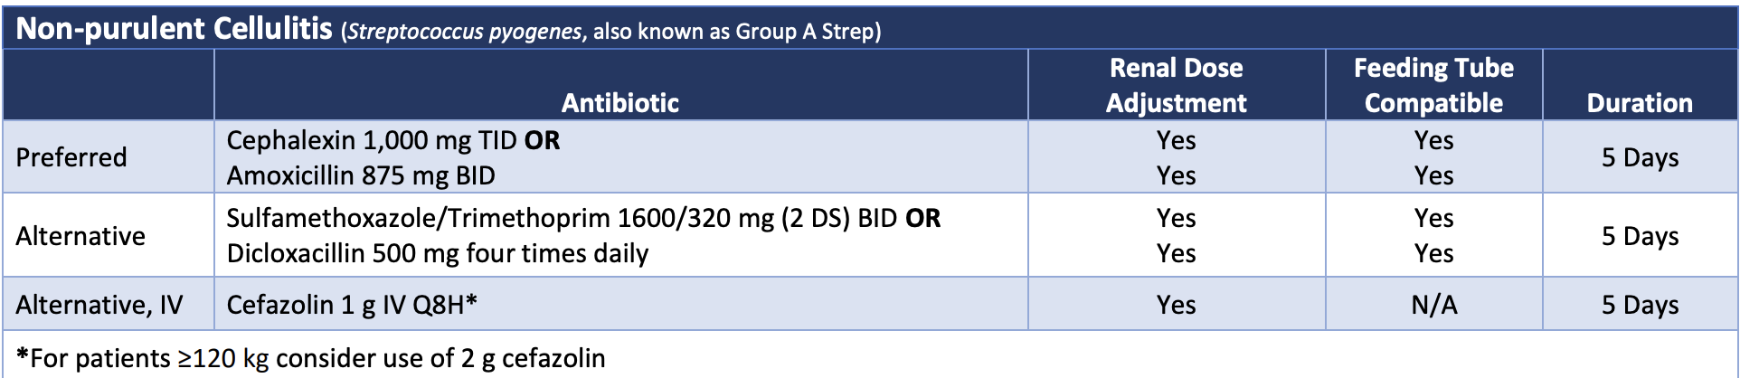
Non-purulent Cellulitis
Pro Tip:
  Note the length of treatment: 5 Days

Slide 13
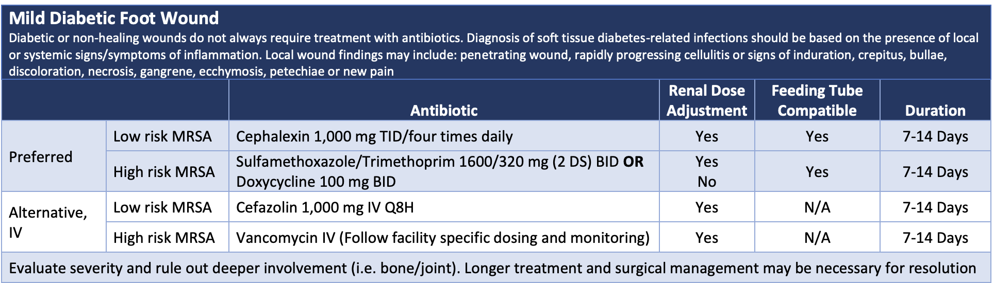
Mild Diabetic Foot Wound
Pro Tips :
  Diabetic/Non-healing wounds DO NOT always require antibiotics
  Signs of infection: induration, crepitus, bullae, discoloration, necrosis, gangrene, ecchymosis, or new pain
  If at high risk for MRSA could also use a combo of Bactrim or doxy + Keflex

Slide 14
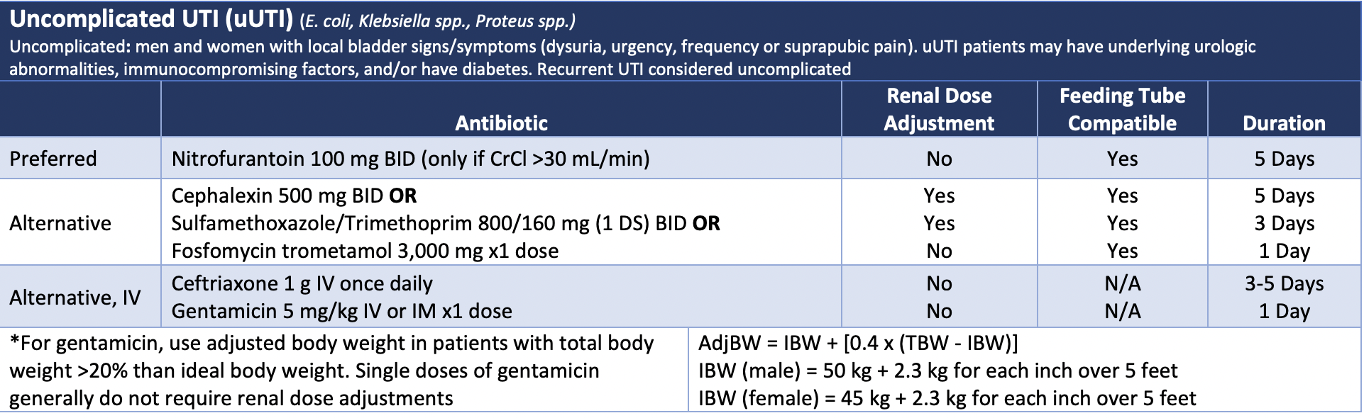
Uncomplicated UTI
Pro-Tips:
  To Dx a UTI in a patient without a catheter, there should be New Urinary Symptoms!
  For Men: UTIs are unusual and often associated with kidney stones, strictures or BPH
  Can treat for 3-5 days, especially if symptoms resolve
  Do not recommend Gentamicin

Slide 15
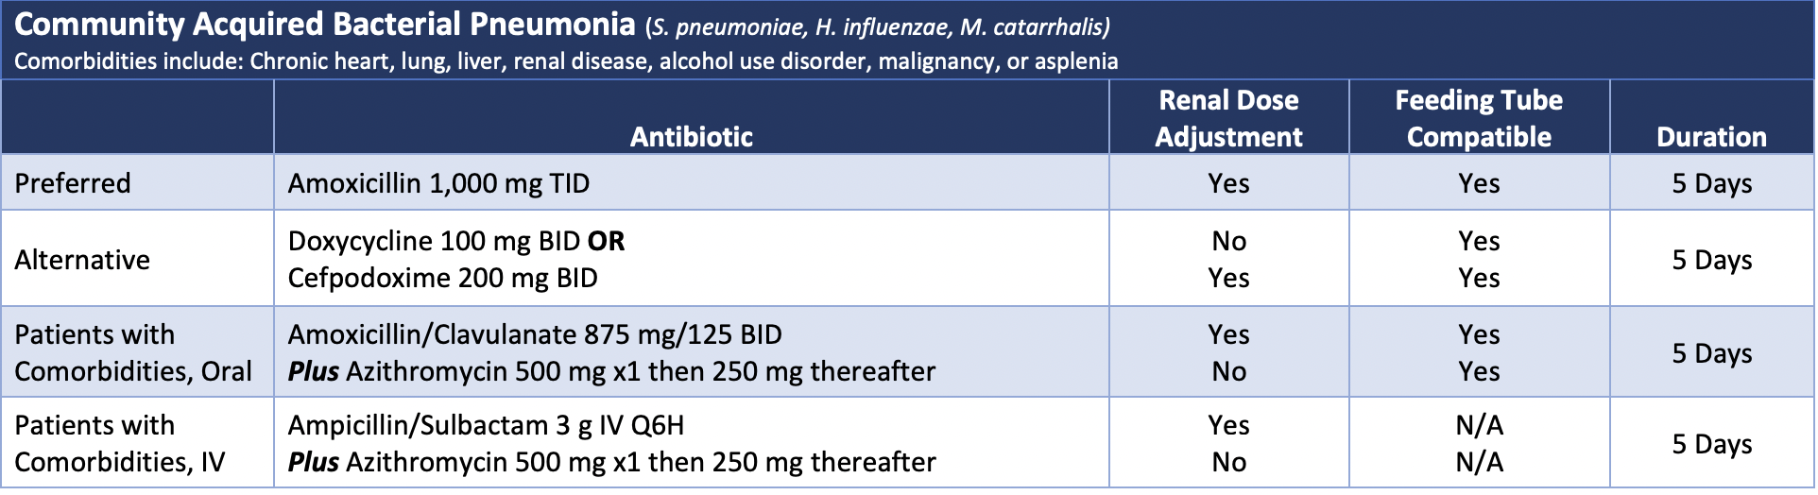
Community Acquired Bacterial Pneumonia
Pro Tips:
  Note: Patients with co-morbidities
    Amox/Clavulanate AND Azithromycin
    If PCN allergy: Ceftriaxone + Azithromycin

Slide 16
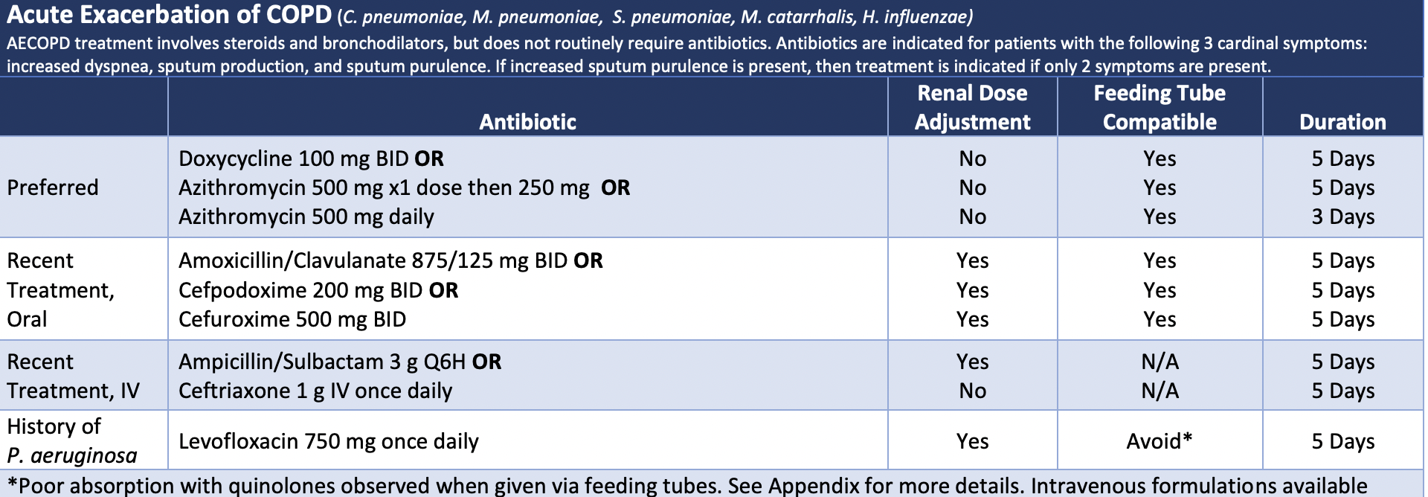
Acute Exacerbation of COPD
Pro Tips:
COPD exacerbations do not always need abx
With moderate to severe exacerbations and increased dyspnea, sputum production + Sputum purulence => Abx
If fever, toxic appearance, elevated WBC, tachycardia, hypotension: consider PNA/sepsis
Consider COVID-19 infection/influenza

Slide 17
De-escalation

Slide 18
Probiotics: Do They work?

Slide 19
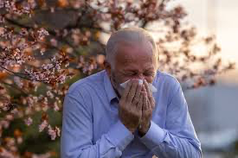
Vaccines can Prevent Respiratory Infections!

Slide 20

There is a Lot of Confusion right now about Vaccination
Changes in the ACIP
Lack of transparency
Increased circulation of misinformation and
disinformation
Information overload!

Slide 21
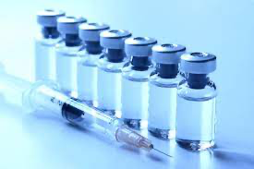
Vaccination: How to approach the Topic
Assume the patient’s acceptance, it is apart of normal preventative health care
  It will even benefit people on hospice
Answer any questions and explain the benefits of the PNA, Influenza, COVID-19 and RSV vaccines to prevent illness, hospitalization and death,
  Provide reassurance for co- administer of these vaccines, example MMR
Address the “Passive Positives” (35-40% of the eligible population)
  They Approve of vaccination but lack motivation
  They may feel good about the protection it confers but not so good about the prospect of side effects (yet again).
  Many of them are actively trying not to think about viruses this fall.
  Use the IIFF Model: Information, Immediate registration, Focused engagement and Favorable activation
J. SIEGEL, B. ROSENBERG, K. JETELINA A New Way to Inspire People to Get a COVID Vaccine. Scientific American.
https://www.scientificamerican.com/article/a-new-way-to-inspire-people-to-get-a-covid-vaccine/?utm_source=substack&utm_medium=email
Notes:
1st: Remind people that it feels good to know your are protected, Second, people need information about eligibility. Having three respiratory vaccines available at the same time can create confusion about optimal timing of the shots and how many you can get at once, Third, health care workers need to remind patients about vaccines even during visits for other reasons. People are exhausted from more than three years of a pandemic; they likely now turn away rather than toward information about COVID and other viruses. So it helps, for instance, when doctors and pharmacists tell people that they can receive the fall shot right then.
Finally, and closely related to the previous point, if a person gets motivated, seize the chance. Their motivation is likely to be short-lived. It is critical to have a shot available the instant a person becomes interested in one.
magine a conversation with grandma that puts all these factors together. Next time you see her, remind her about all the positives of being up-to-date on COVID vaccinations, such as more confidence that seeing her grandkids won’t send her to the hospital. At the same time you can tell grandma that she is eligible to get the updated shot right now. Finally—and this is key—if she says OK, take her to get her shot right then.

Slide 22
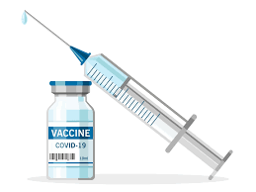
Other Vaccinations Needed to Prevent Respiratory infections
Influenza Vaccination
  High-dose or adjuvanted vaccines recommended for individuals over 65
  Vaccine is safe for those with egg allergies
COVID-19 Updated Vaccine 2025-2026
  Aims to prevent severe illness, hospitalization, death, and reduce the risk of Long COVID
  Public perception has shifted, and many no longer view COVID as a significant threat
RSV Vaccine: NOT an annual vaccine
  One dose of any FDA-approved RSV vaccine recommended for all adults aged 75 and older
  One dose advised for adults aged 50–74 who are at higher risk of severe RSV
Pneumococcal Vaccines
  A single dose of PCV 21 recommended for all adults aged 50 and above who have not previously received the PCV vaccine

Slide 23
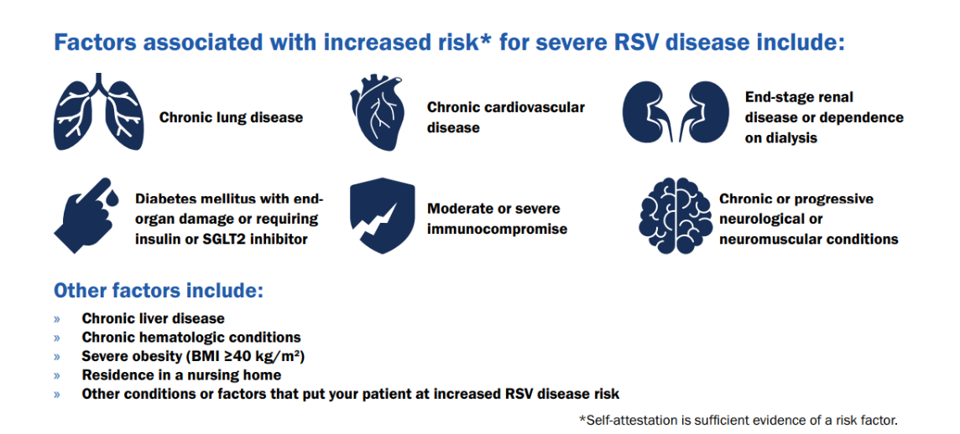
https://www.cdc.gov/rsv/media/pdfs/2025/01/355818-A_RSV_VaccineForOlderAdultsFlyer-01072025-V9-WEB.pdf

Slide 24
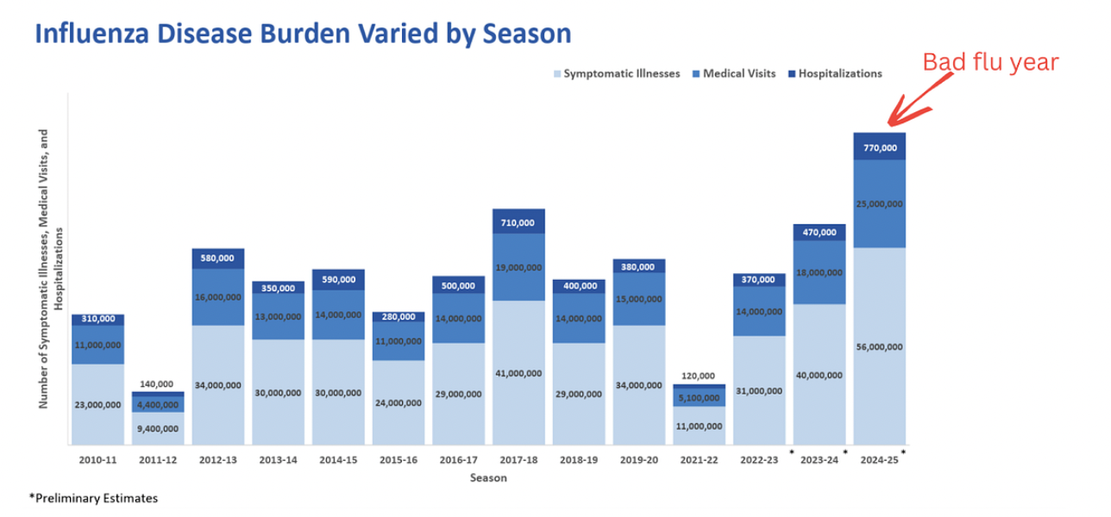
Influenza Disease Burden 2010-2025
Katelyn Jetelina, Your Local Epidemiologist, Vaccine policy meeting: the essentials, June 26, 2025.

Slide 25
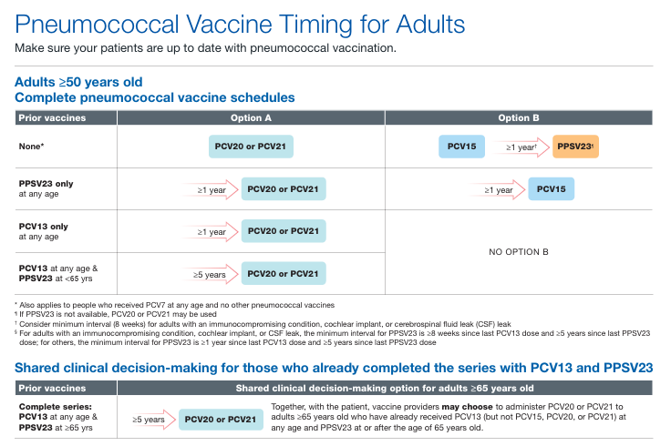
NEW

Slide 26

The Top Takeaways!
Every time we write an order for an antibiotic, we should ask 3 questions:
  Right drug?
  Right dose? (renal dosing needed?)
  Right duration?
Antibiotics are not benign; do not use “just in case”!
Infection are never bilateral on lower extremities
With COPD exacerbations, always consider an infection trigger
Vaccinations will help prevent poor outcomes from flu, COVID-19 and community acquired pneumonia
  It is the single most powerful thing we can do to keep residents healthy and living their highest quality of life

Slide 27

Thank you!

